Slide 1
DASHBOARDS WITH STORYBUILDER

Slide 2
Executive Dashboard
Primary Competitor Insights
Category Action Plans
Editing, Time Frames, Events, and Distribution
Featuring

Slide 3
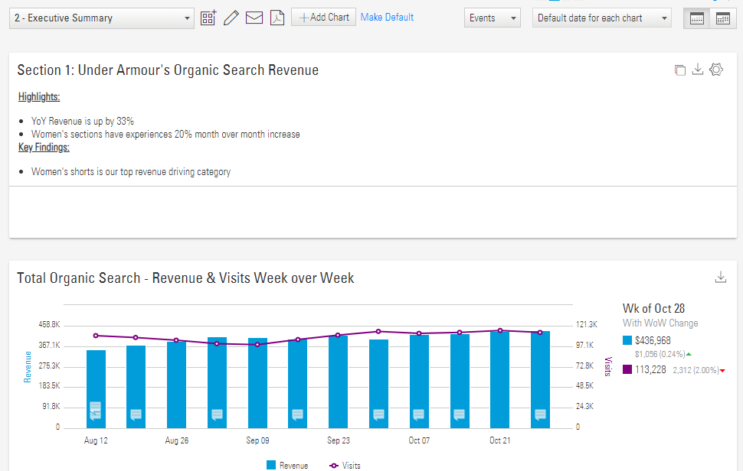

Slide 4
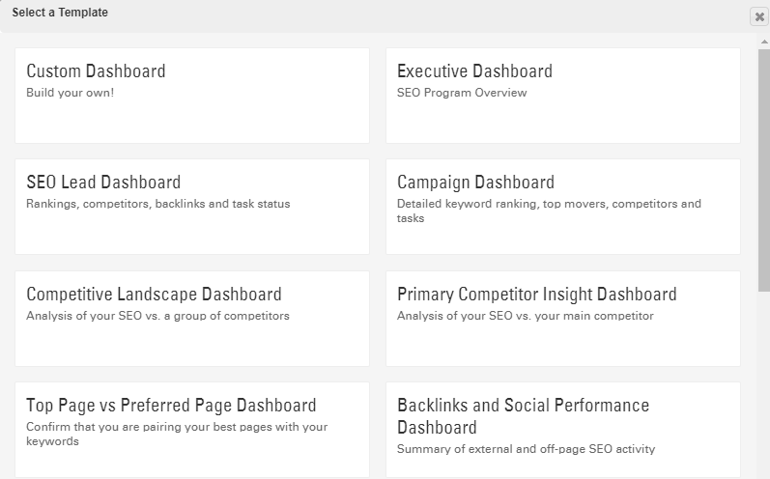

Slide 5
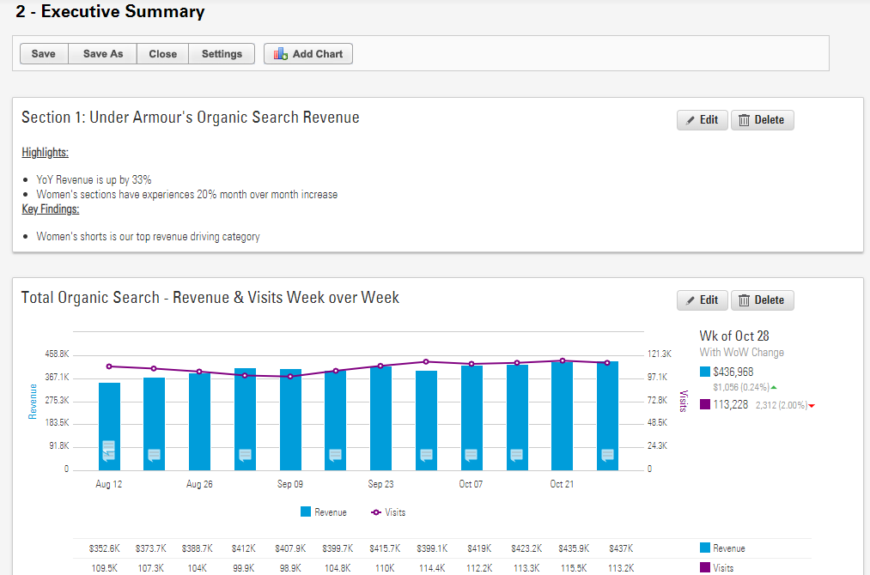

Slide 6
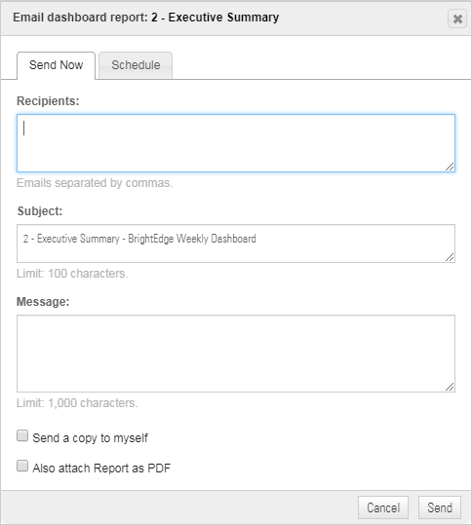

Slide 7
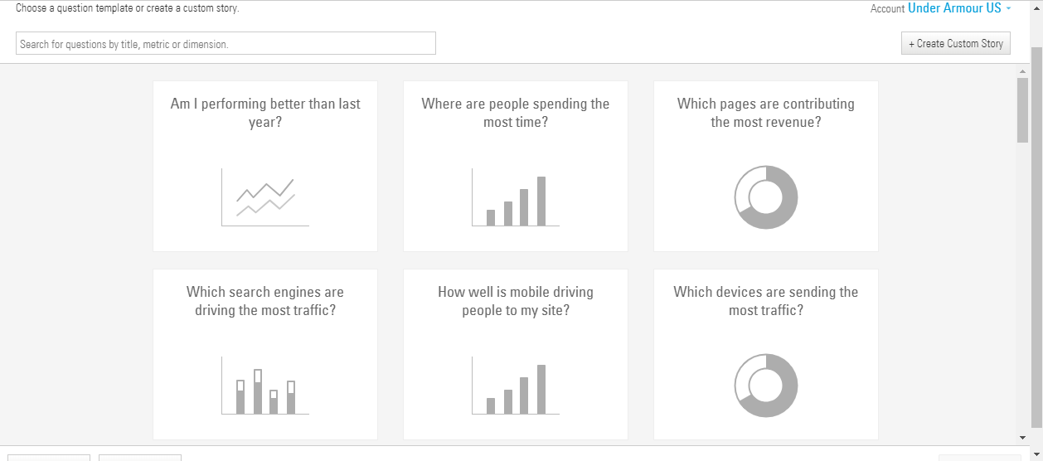

Slide 8
Platform demo and training

