Slide 1
BrightEdge Summer Series SEO 103:
DEVELOPING PRE-OPTIMIZED CONTENT
July 14th, 2017
  Submit your questions using the Q&A box
  Recording of this webinar will be shared by email and on the login page

Slide 2

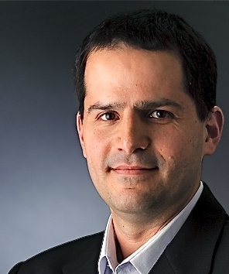
BOAZ RONKIN
HYMAN CHUNG
VP Product Marketing
BRIGHTEDGE
Director, Product Management
BRIGHTEDGE

Slide 3

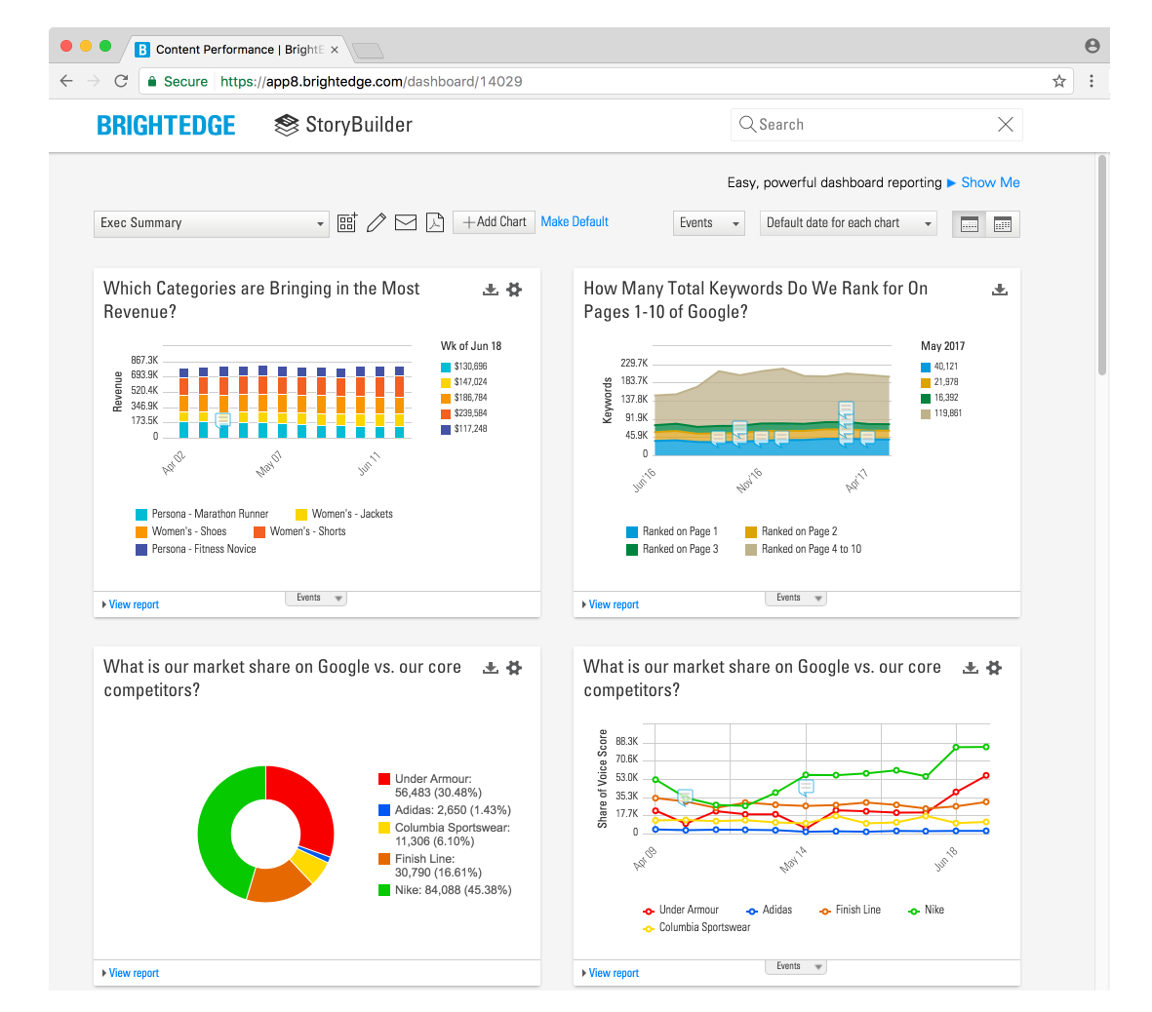








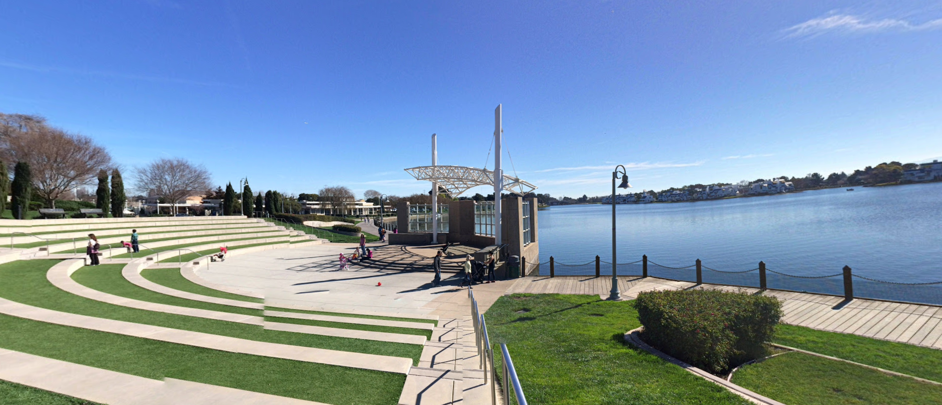
BRIGHTEDGE
Partnering with global brands for SEO and Content Performance Marketing
Notes:
Headquartered in Foster City, CA, with offices in London, New York, Chicago, Cleveland, Seattle, Japan, and Australia.

Slide 4

WHY PRE-OPTIMIZE CONTENT
8 TIPS FOR CONTENT SUCCESS
SUCCESS STORIES
Q&A

Slide 5
POLL #1
How effective is your current content marketing program?
Very effective
Somewhat effective
Neutral
Somewhat ineffective
Very ineffective
Not applicable

Slide 6
Developing Pre-optimized Content
WHY PRE-OPTIMIZE?

Slide 7

2016
2017
BRAND LOYALTY
CONTENT READERSHIP(?)
BRAND IDENTITY
DONE FOR ME LATELY?
NEWSPAPERS AND TV
2.7M DAILY BLOG POSTS
MARKETING FUNNEL
MICRO-MOMENTS
CUSTOMERS LOOK FOR GREAT CONTENT BEFORE THEY LOOK FOR BRANDS

Slide 8

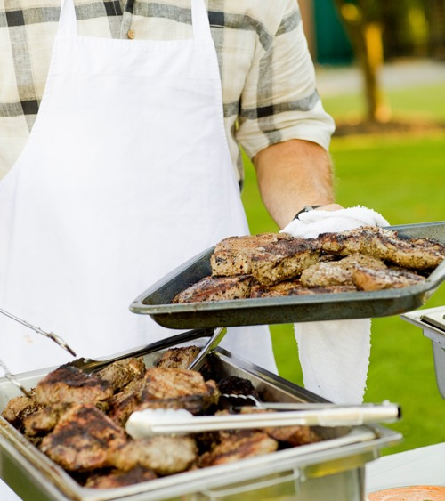





MICRO-MOMENTS: PAY ATTENTION TO THE TOPICS AND FORMATS CUSTOMERS ARE SEARCHING FOR
I-Want-To-Know Moments
I-Want-To-Go
Moments
I-Want-To-Do
Moments
I-Want-To-Buy
Moments
65%
of online consumers look up more information online now versus a few years ago.
2X
increase in “near me” search interest in the past year.
91%
of smartphone users turn to their phones for ideas while doing a task.
82%
of smartphone users consult their phones while in a store deciding what to buy.
Notes:
Google has been promoting the idea of micro-moment for a while.
Hyman, do you want to describe what those are, and how they related to organic keywords and content formats?

Slide 9
BRIGHTEDGE RESEARCH
CONTENT IS CRITICAL
YET MISSES THE MARK
42%
50%
20%
of marketers viewed Content Marketing as their top initiative for 2017
of B2B brands produce content that engages their target audiences
of B2C brands produce content that engages their target audiences
Notes:
https://www.surveymonkey.com/results/SM-JB3JZXCB/
42.46% of BrightEdge customers surveyed said Content Marketing is their #1 initiative for 2017.

Slide 10

TIME TO TUNE
THE WATERFALL
STRATEGY
IDEATION
DEVELOPMENT
PUBLICATION
OPTIMIZATION
Notes:
Traditionally, content marketing follows a waterfall model where one phase starts only after a previous phase ends.
Hyman, what challenges do customers experience as they go through each waterfall phase?

Slide 11

GOALS
OF PRE-OPTIMIZED CONTENT
HIGH-VALUE TOPIC OPPORTUNITIES
SEARCH- AND MOBILE-FRIENDLY CONTENT
FASTER PRODUCTION

Slide 12
POLL #2
Where could your content marketing program use the most tuning?
Strategy
Ideation
Development
Publication
Optimization
All of the above
Not applicable

Slide 13
02
Developing Pre-optimized Content
8 TIPS FOR SUCCESS

Slide 14
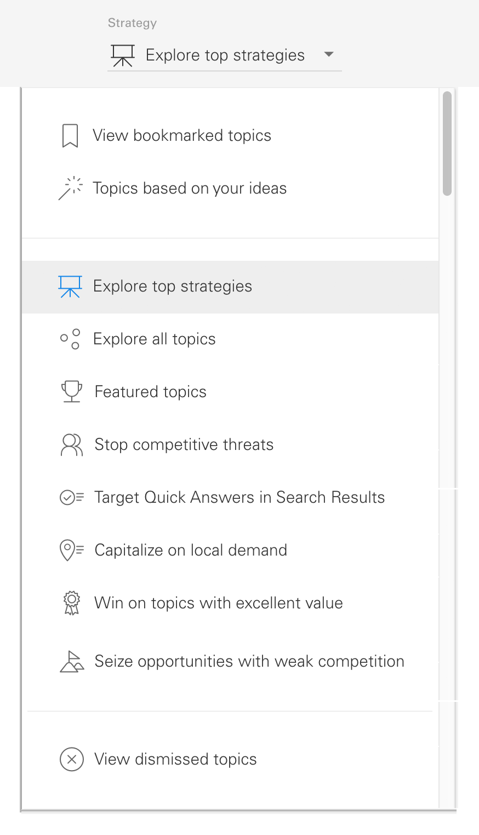
1. SHARPEN
YOUR CONTENT STRATEGY
Notes:
When it comes to generating TOFU content, it’s a good idea to have an organic strategy in mind
since organic search is such an important acquisition channel of new visitors.
Hyman, what some of the strategies you’re seeing customers adopt to ensure content investments drive key business objectives?

Slide 15
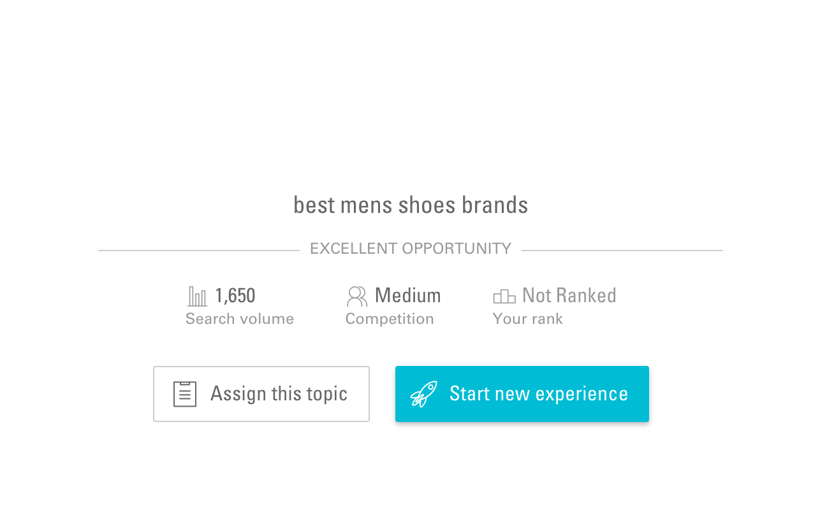
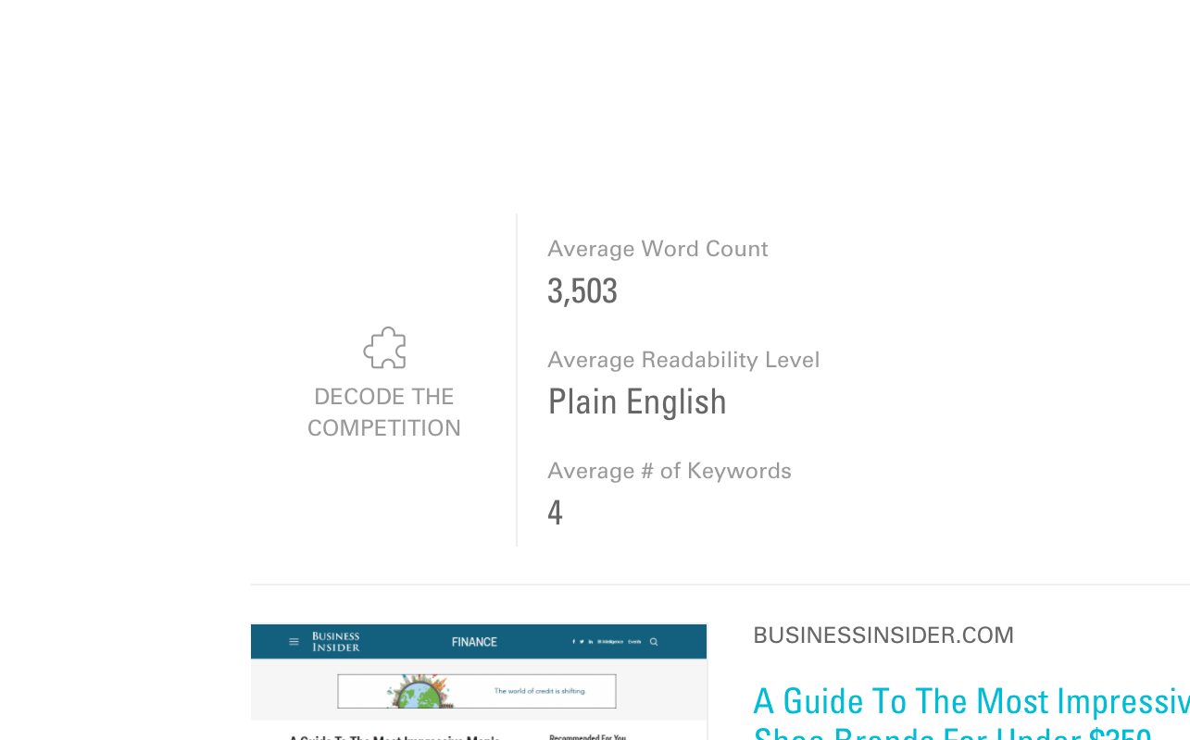
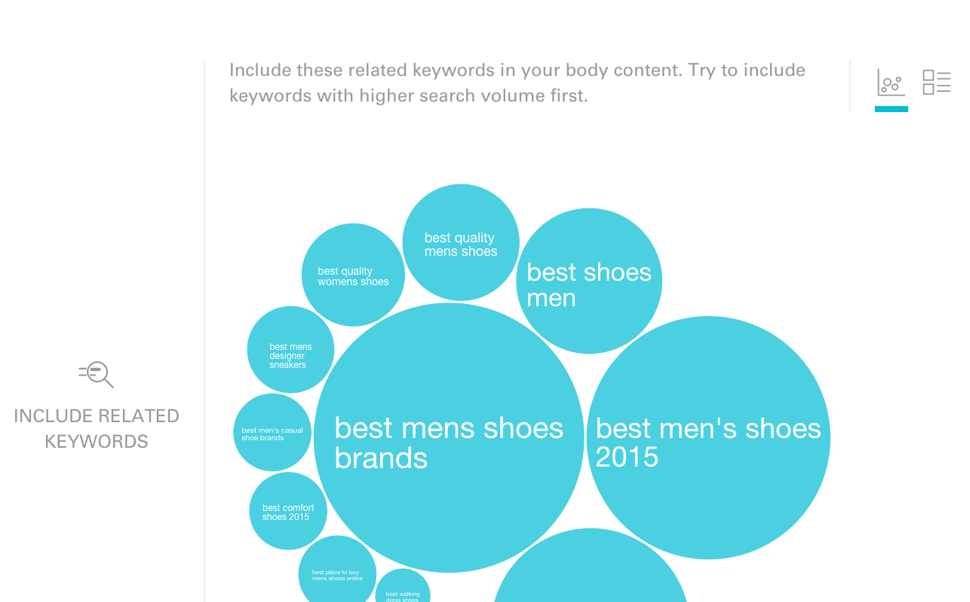
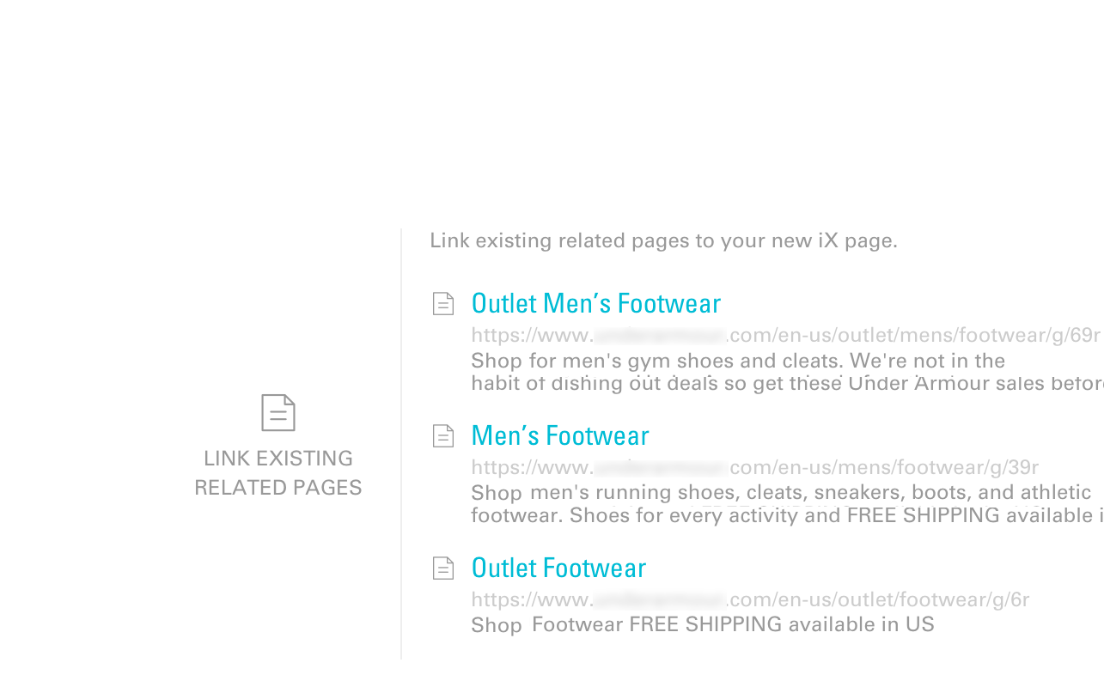
2. PRIORITIZE PROFITABLE
TOPICS
Notes:
Often, writers make sure published content is well aligned with a topic they want to promote.
But they don’t necessarily take actions to ensure the content is aligned with the needs and wants of their readers
So they end up with content that’s shopping for readers.
Hyman, what signals should writers pay attention to when trying to decide on the topics they want to cover?

Slide 16
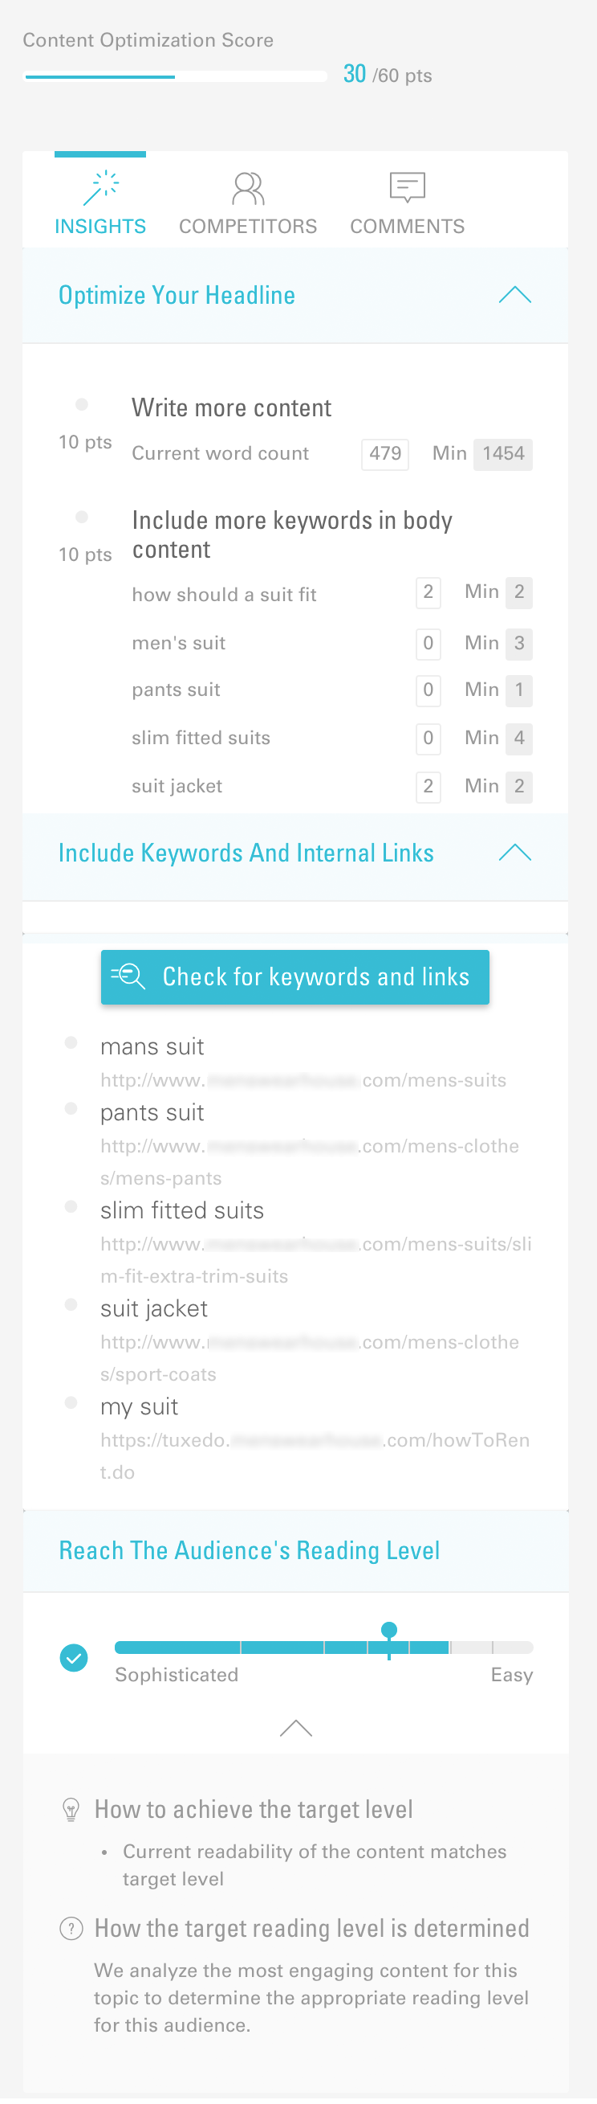
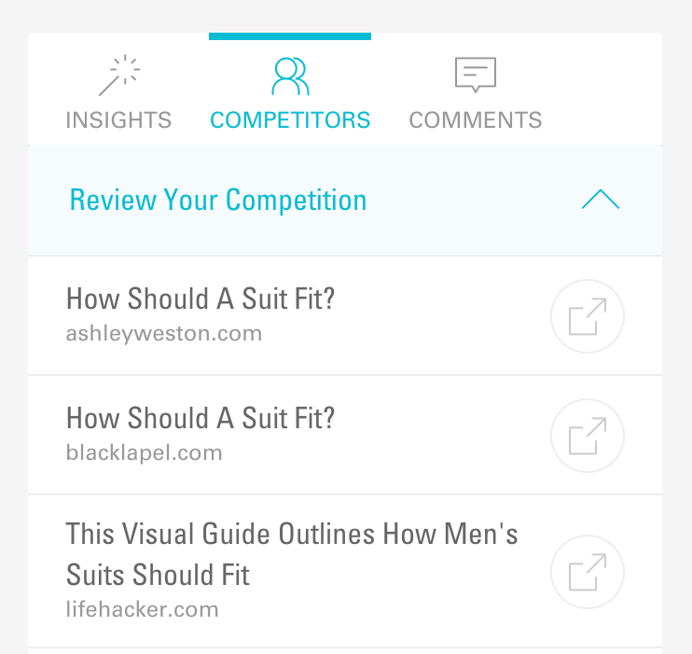
3. TUNE CONTENT TO YOUR AUDIENCE
Notes:
Hyman, let’s say I have my next topic in mind. I’m starting to draft the content.
What should I pay attention to, to make sure the content will be optimized from the get-go?

Slide 17
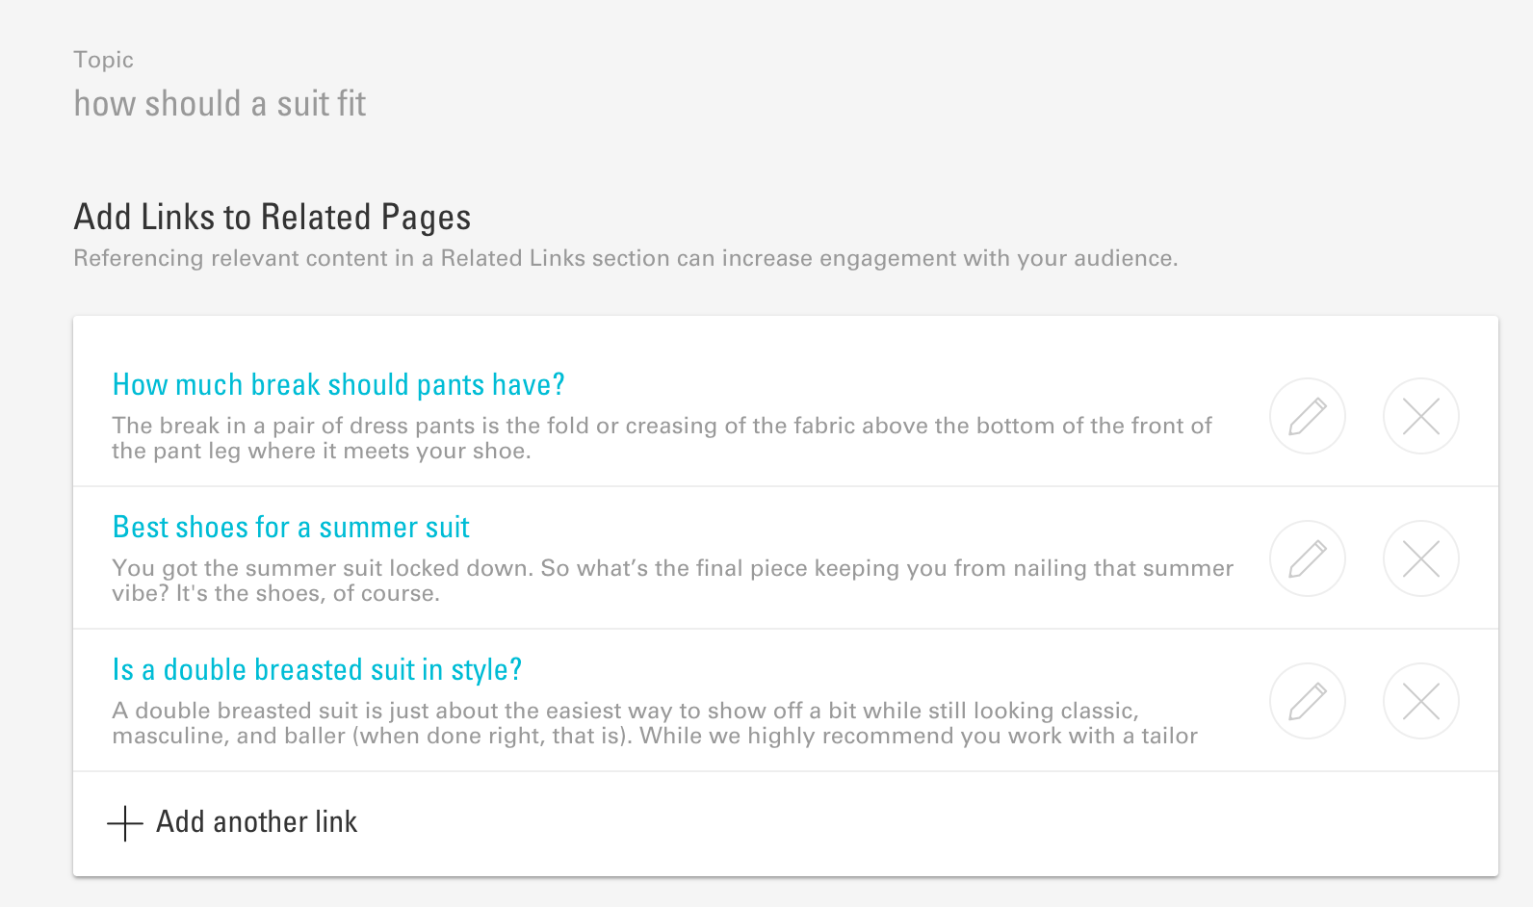
4. KEEP READERS CLICKING
Notes:
Of course we want our readers to ultimately convert.
But many will not convert immediately after reading our new article.
So we have to keep them engaged.
Hyman, what should writers be mindful of to keep their readers from bouncing after reading a page?

Slide 18
BUYER’S JOURNEY INCLUDES MULTIPLE BRAND INTERACTIONS
Awareness
Consideration
Decision
What is a DSLR camera?
Which is the best DSLR camera?
Best price for Nikon 3200

Slide 19
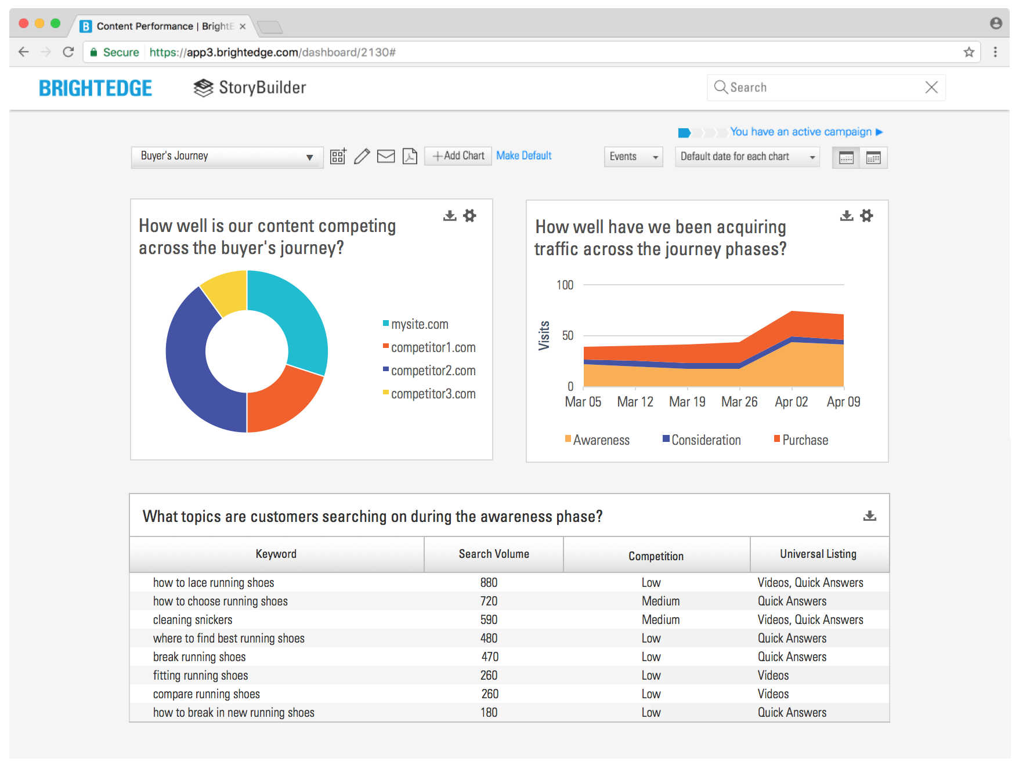
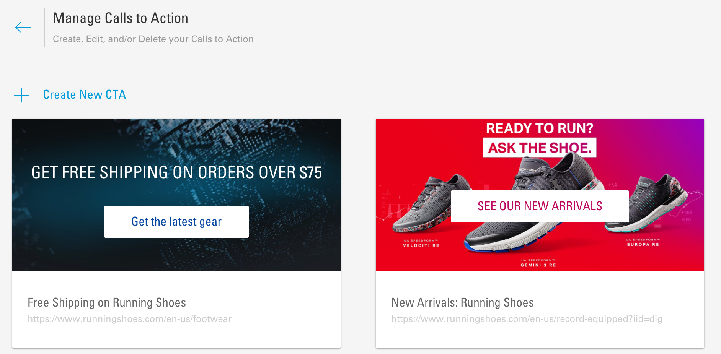
5. GUIDE VISITORS TO CONVERSION POINTS
Notes:
So there are hard conversions – buying my product
And then there are soft conversions – to progressively move the visitor to becoming a customer.
Hyman, what should writers keep in mind when it comes to deploying CTAs?

Slide 20
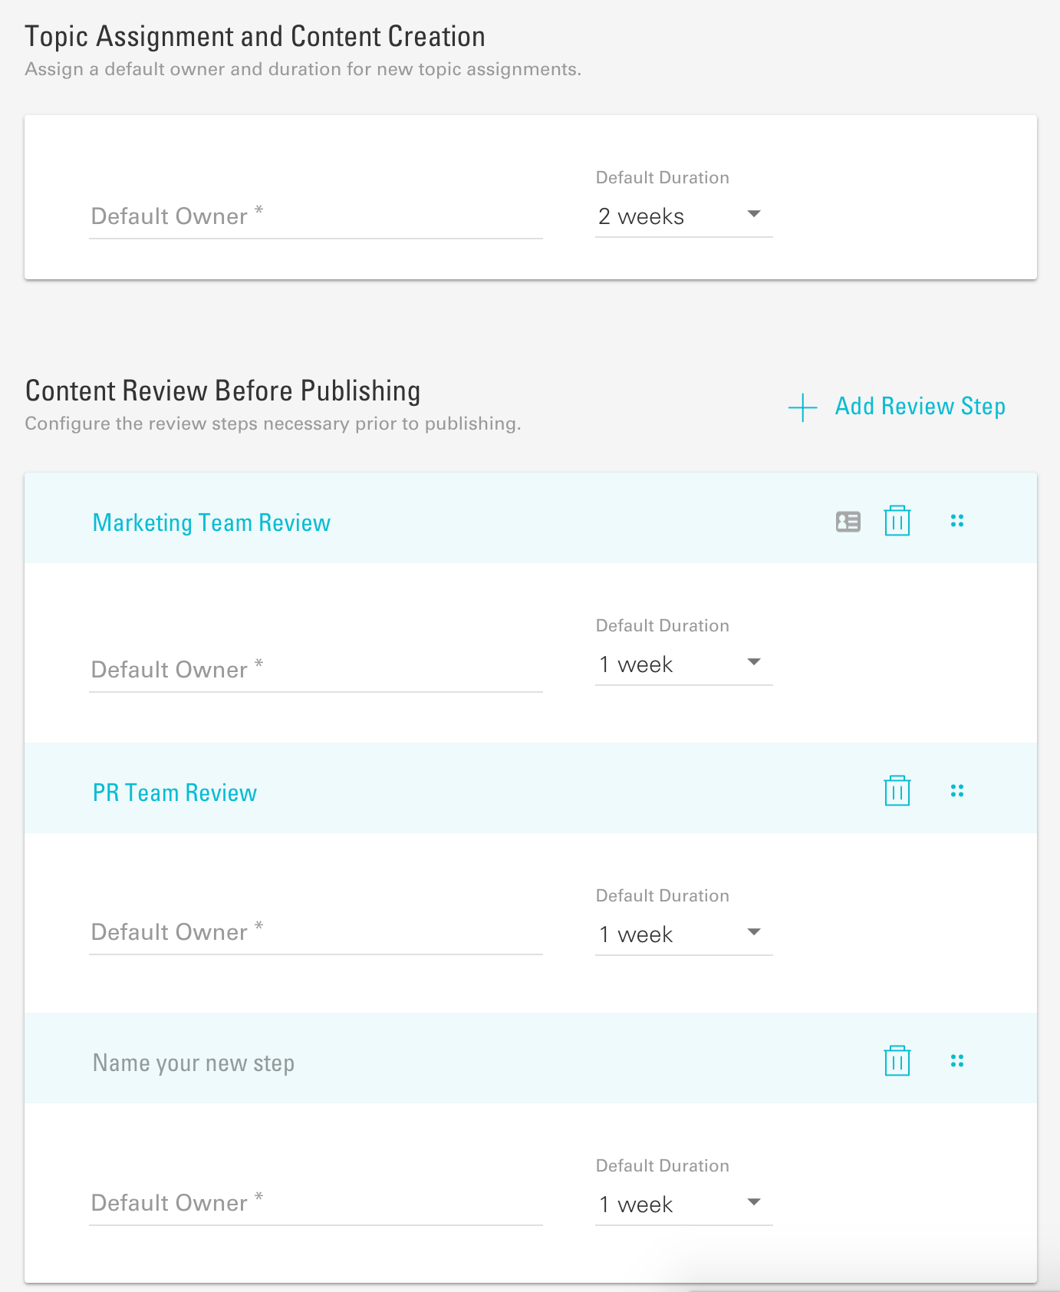
6. SIMPLIFY REVIEW AND APPROVAL
Notes:
Hyman, how can teams use automation to speed up and simplify content development, review, and approval?

Slide 21
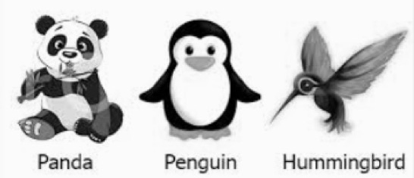






7. KEEP PUBLISHED CONTENT OPTIMIZED
Notes:
Hyman, what do writers need to be aware of when it comes to keeping content search- and mobile-friendly?

Slide 22
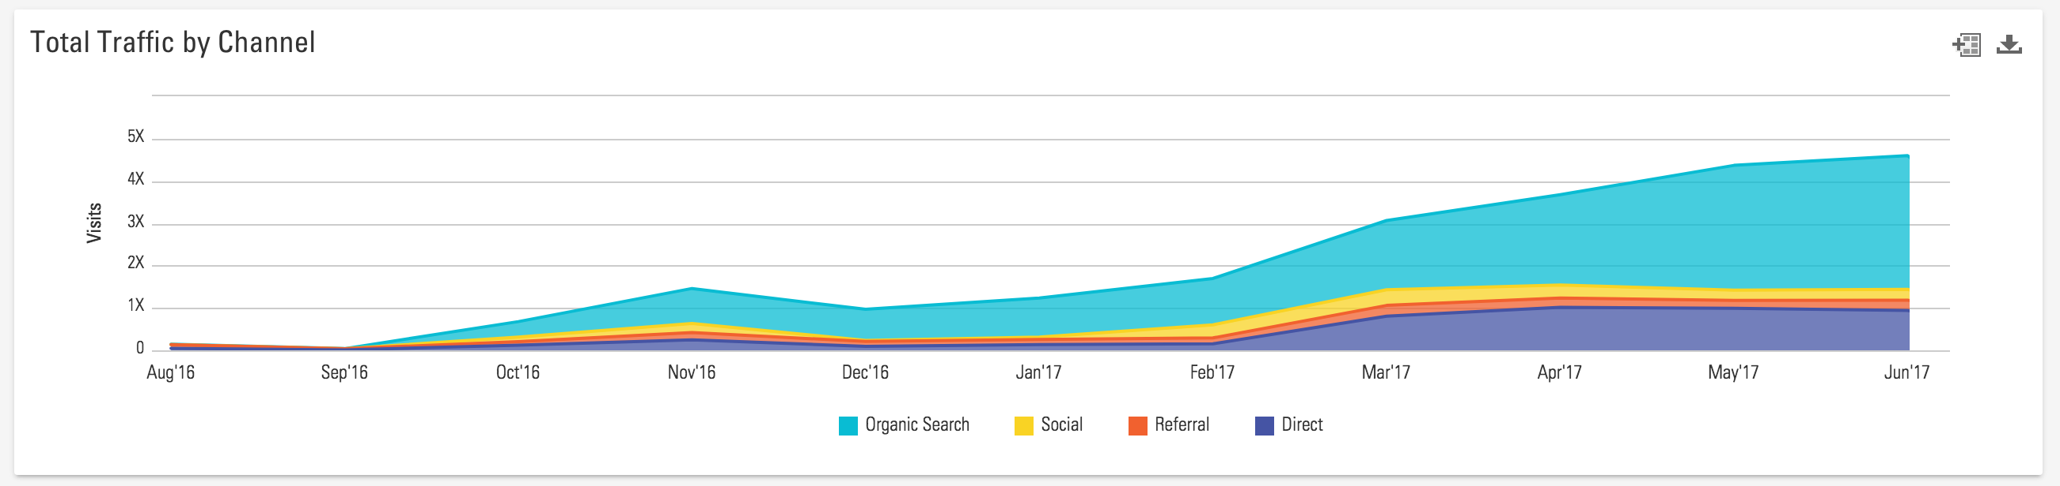
8. IDENTIFY WINNING TACTICS
Notes:
Pre-optimized content has huge organic play, but it can also be used by other channels and programs, so it’s a win for all teams.

Slide 23
DEVELOPING PRE-OPTIMIZED CONTENT
1. SHARPEN YOUR CONTENT STRATEGY
2. PRIORITIZE PROFITABLE TOPICS
3. TUNE CONTENT TO YOUR AUDIENCE
4. KEEP READERS CLICKING
5. GUIDE VISITORS TO CONVERSION POINTS
6. SIMPLIFY REVIEW AND APPROVAL
7. KEEP PUBLISHED CONTENT OPTIMIZED
8. IDENTIFY WINNING TACTICS

Slide 24
03
Developing Pre-optimized Content
SUCCESS EXAMPLES

Slide 25


Organic traffic grew from 25% to 40%
Outperformed some blog content by up to 6X

Slide 26

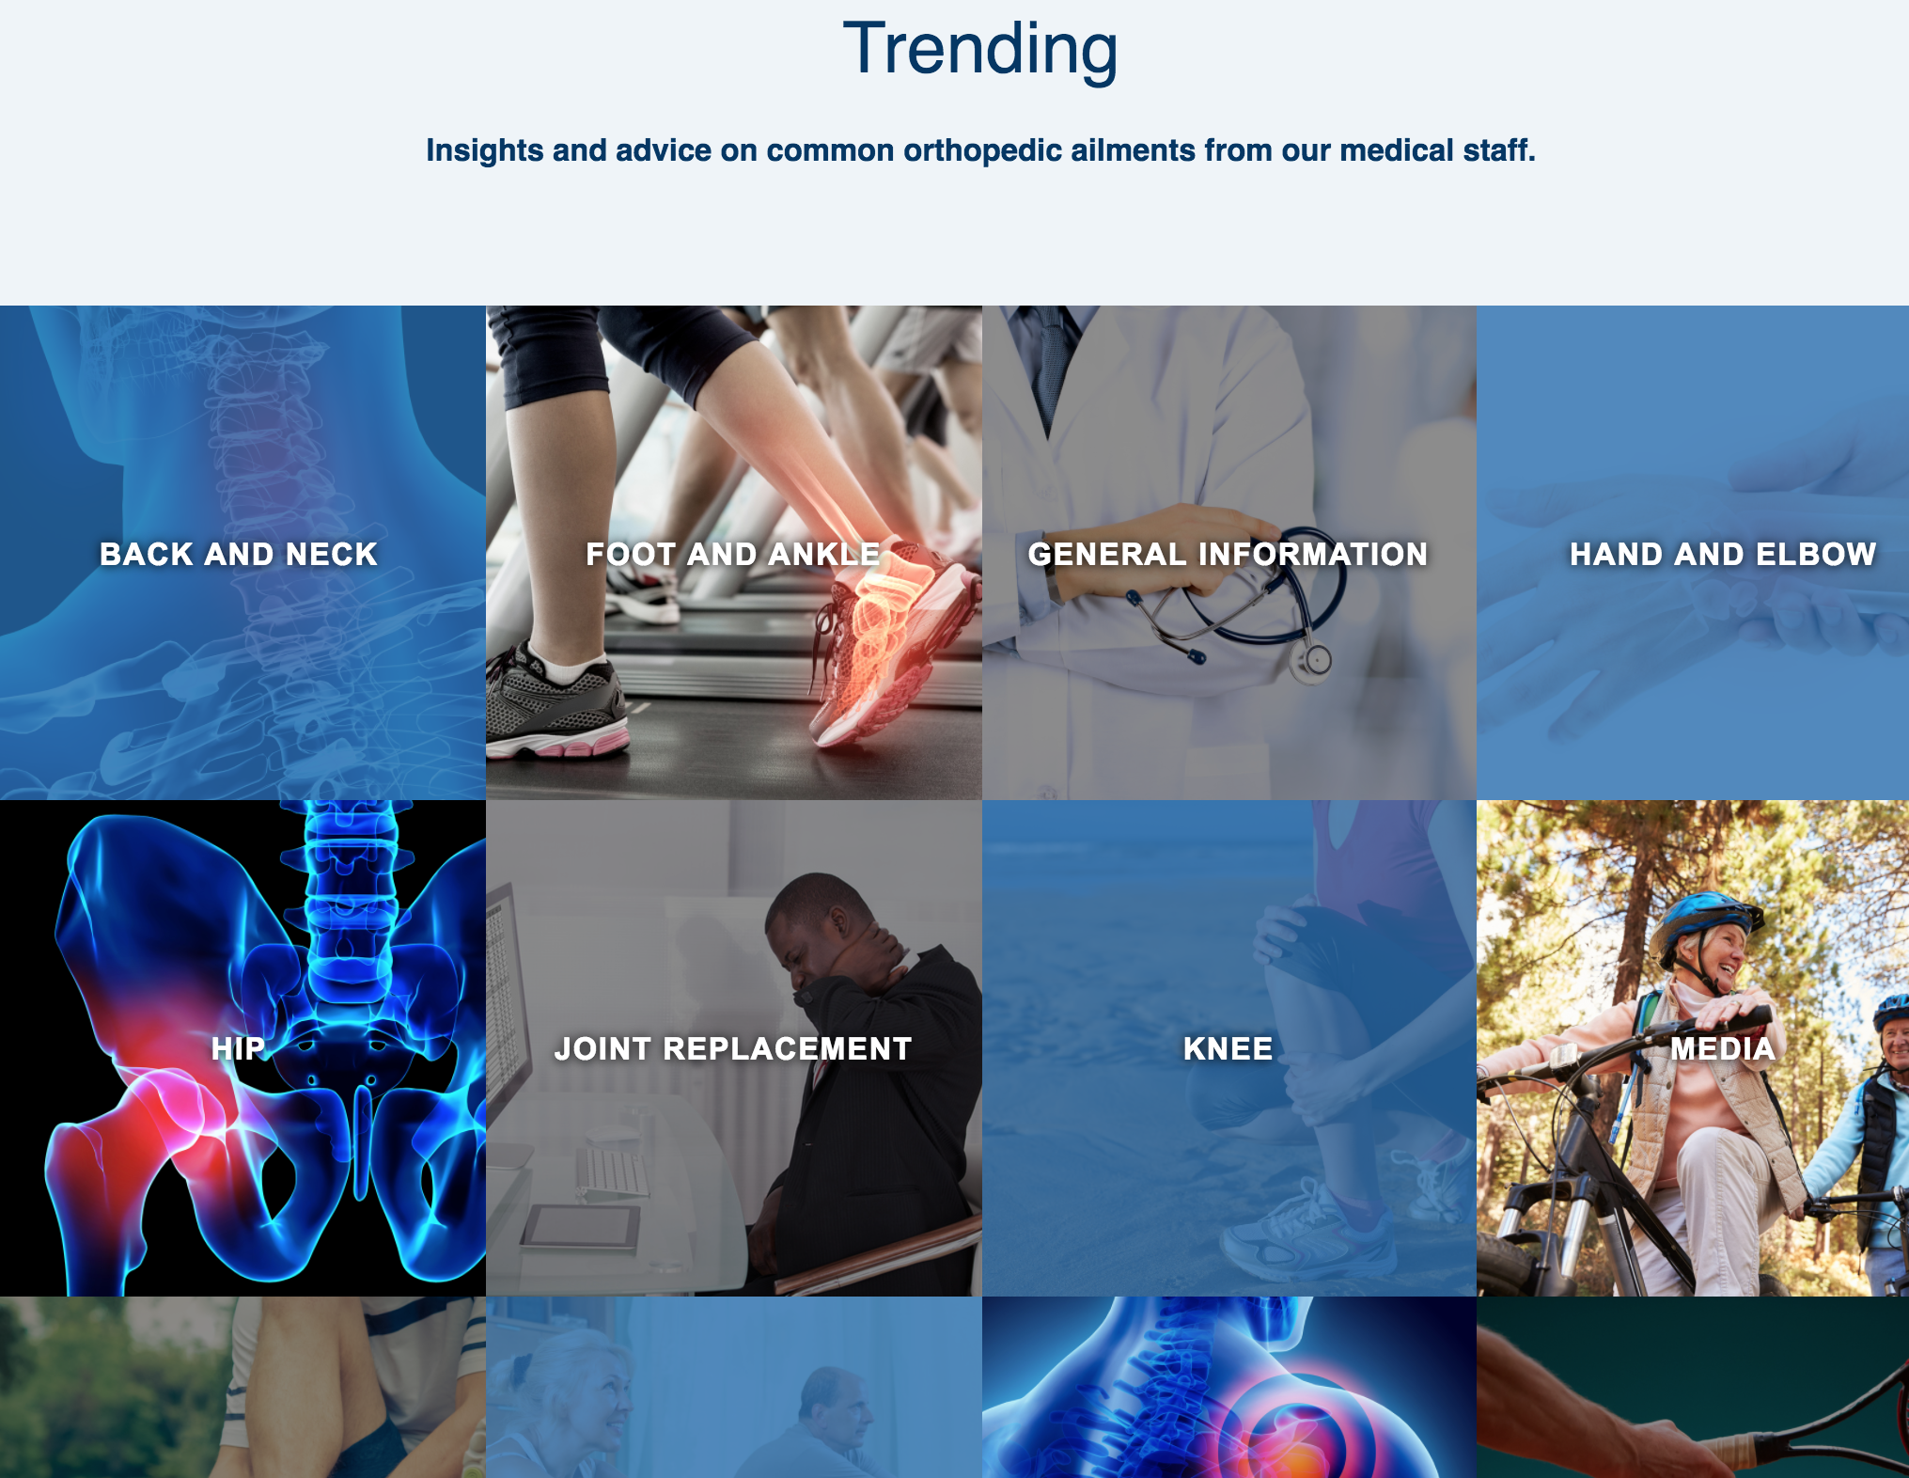
+100 pre-optimized pages generating 65% of all site appointment requests
Notes:
Great content, written by doctors
Isn’t driving much traffic
Not optimized for seo/mobile
Buried deep in the site, no page authority
Created a category-based repository that addresses very popular
Second phase: Quick Answer strategy
“What is” content
Third phase: Local content – sports medicine for local football team
Account has been able to rapidly publish more than 100 pages of value medical advice to its website, which now generate 65% of all appointment requests across the company’s entire online presence

Slide 27

JOIN US FOR OUR NEXT WEBINAR
SEO 104 - Making the Case
for SEO
Learn how to capture and report data that communicates the value of SEO.
July 28, 2017 10:00 AM PST
brightedge.com/events
Notes:
SEED QUESTIONS
What are some of the differences in developing pre-optimzed content between B2B and B2C?
How do I identify topics that will help me become more visible in Quick Answers?
What do I need to do to ensure my content performs well for mobile?
What can I do to make my new content more easily found on my site?

Slide 28
04
Developing Pre-optimized Content
Q&A
Notes:
SEED QUESTIONS
What are some of the differences in developing pre-optimzed content between B2B and B2C?
How do I identify topics that will help me become more visible in Quick Answers?
What do I need to do to ensure my content performs well for mobile?
What can I do to make my new content more easily found on my site?

Slide 29
THANK YOU!

