Slide 1

#BrightEdgeWebinar

Slide 2

Summer Series 102
Quick Wins with SEO
June 30, 2017
#BrightEdgeWebinar
Notes:
We will be Sharing this presentation after the webinar – and it will be available on demand
Please ask questions throughout the presentation
And make sure to share out any cool sights on Twitter using #BrightEdgeWebinar

Slide 3
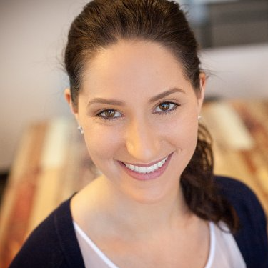
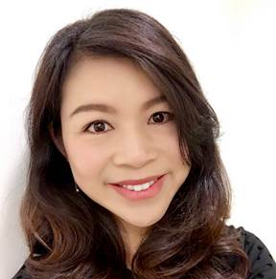
PRESENTERS
KATIE O’LEARY
CAROLYN BAO
Sr. Manager, Product Marketing
BRIGHTEDGE
Sr. Director, Product Marketing
BRIGHTEDGE
#BrightEdgeWebinar
Notes:
Under a minute of self introduction
-- Hi everyone, My name is Katie O’Leary, I am the sr PMM her at BrightEdge. Throughout my career I have focused on different areas of digital marketing, from social to web. I joined BrightEdge recently, with the goal to evangelize and help this community understand and use SEO to their benefit. So I am excited to speak everyone today.
-- Good morning everyone, thank you for attending today’s webinar. My name is Carolyn Bao. I’m the Sr. Product Marketing Director at BrightEdge. As a digital marketer who’s been in the industry for almost over a decade, I’ve learned to appreciate the importance of SEO, and as an ex-customer of BrightEdge, I’m convinced that every digital marketer can benefit from utilizing a comprehensive SEO platform like BrightEdge, to stretch the shelf-life of their digital content, and maximize their business impact.

Slide 4
01
02
03
04
Recap of SEO 101
Optimize content using Intent Signal
Secure top spot in Local 3-Pack
Increase SEO equity from orphan pages
Agenda
#BrightEdgeWebinar

Slide 5
What is your level of SEO knowledge
Beginner (just getting started)
Novice (keyword, search ranking…)
Intermediate (H1, duplicated content…)
Advanced (page loading speed, pogo-sticking…)
#BrightEdgeWebinar

Slide 6
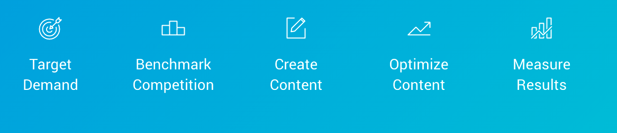
Recap of SEO 101
#BrightEdgeWebinar
Notes:
In our last webinar Erik Newton discussed some basic SEO methodologies specially on-page and off-page factors. The holistic SEO management will include both on-page and off-page enhancements. In today’s session we will teach you quick wins you can gain from on-page and off-page factors
Keyword – is the collection of words users enter when performing a search query on a search engine: example,
Tracked keywords vs. untracked keywords
Keyword groups – important segmentation tool for your digital strategy
On-page – components on your webpage that are directly tied to page content and metadata
Page titles, H1 tags, Images, etc...
Off-page – components that reside outside of direct page content
Backlinks, social, internal links, and your site taxonomy
We highly recommend that you set up a baseline reports to understand revenue goal, marketing activities that impact those goals, page level optimization metrics keep you track --- we will also touch on metrics as we go through this deck on how to show success with each win

Slide 7
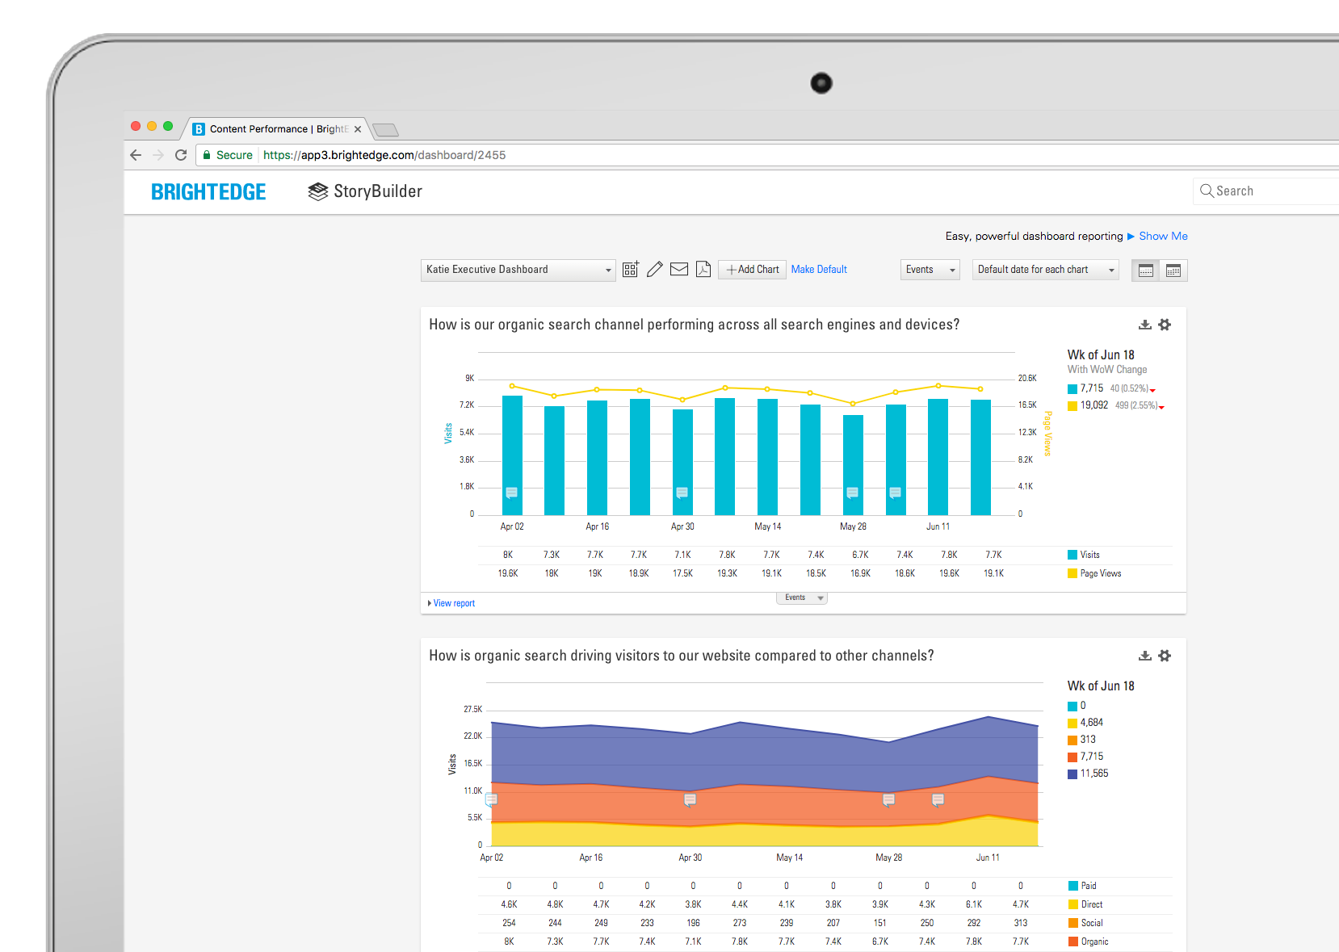
Create SEO success roadmap
KPIs:
Conversion metrics
User experience metrics
Traffic acquisition metrics
Keyword metrics
Identify
What you want to do
What you can do
What you will do
#BrightEdgeWebinar
#BrightEdgeWebinar
Notes:
Elevate your roll within our organization to Stop just tracking keyword ranking
Quick win – have an SEO success roadmap – ready your organization
We highly recommend that you set up a baseline reports to understand revenue goal, marketing activities that impact those goals, page level optimization metrics keep you on track --- touch on metrics as we go through this deck
Charts to include:
Clicks and impressions
Keyword performance – search volume and rank
Site performance – visits, conversion, revenue
Based on insights prioritize to capture
Weak competition
Striking distance keywords
Local -- Universal results
Identify what is in your control
What do you want to do
What can you do
Where am I today

Slide 8
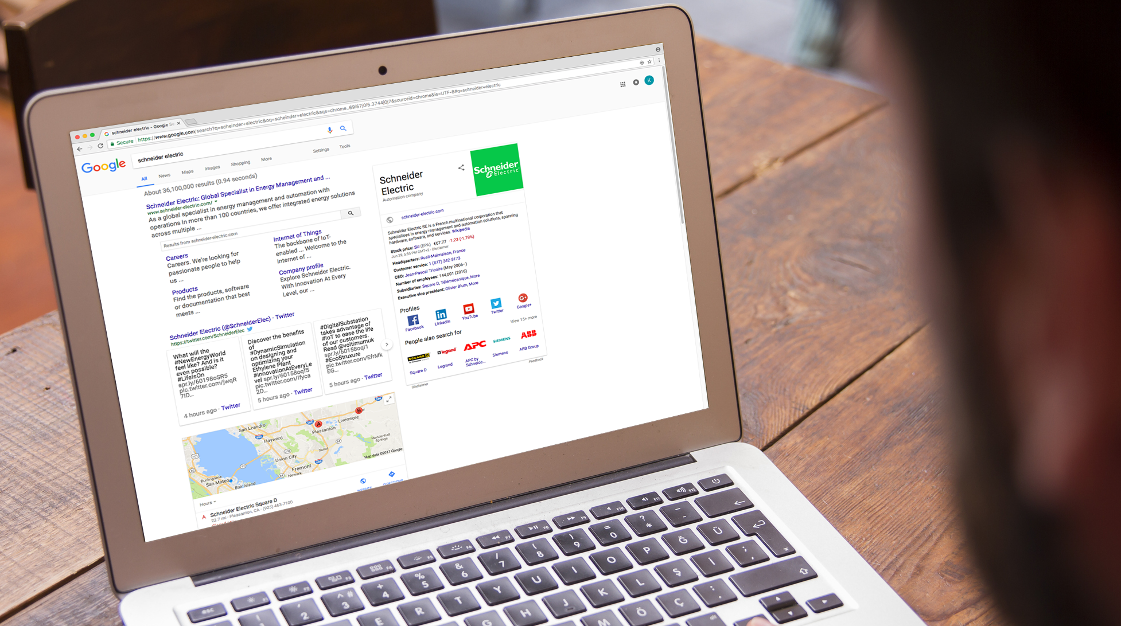

CHALLENGE
Schneider’s goal is to permeate SEO and content performance into every aspect of website ownership, development, and content creation, and to make SEO experts out of everyone who touches the site
SOLUTION
Worked closely with the analytics team to integrate everything into BrightEdge
Used dashboard features to automatically deliver data in a consumable format at regular intervals, which takes the pressure off a person to make reports and gives the task to BrightEdge to do it best
results
In the first six months with the BrightEdge platform Schneider had 500 users logging in regularly to check their statistics
#BrightEdgeWebinar
Notes:
THE PROBLEM
Schneider Electric is the global leader in energy management and automation, operating in over 100 countries with over 170,000 employees and selling BtoB and BtoC. They already have over 500 registered users of the BrightEdge platform. Fisher’s goal is to permeate SEO and content performance into every aspect of website ownership, development, and content creation, and to make SEO experts out of everyone who touches the site.
THE SOLUTION
“The transformation that I’m really trying to bring about is that today marketers are data scientists. If you’re not running your process by the numbers, it may not be an issue now, but you run the risk of being eclipsed by your competitors who are. One of the ways that we’re trying to run the business by the numbers is by making the numbers more easily available. We’ve worked closely with the analytics team to integrate everything into BrightEdge. We use dashboard features to automatically deliver this data in a really consumable format at regular intervals, which takes the pressure off a person to make reports and gives the task to BrightEdge to do it best.” See David's video.
THE RESULTS
“BrightEdge helps us in globalizing and standardizing our approach to SEO so we have standard topics and standard keywords groups that each country and language can leverage, which makes sure that there are no content gaps or misses as we globalize and localize our SEO approach. In our first six months with the BrightEdge platform we had 500 users logging in regularly to check their statistics. We also underwent a massive web migration to an entirely new platform, entirely new design, and entirely new brand. We used BrightEdge professional services to help us with that migration and as a result we’ve seen an increase in organic traffic each month since then.”
BrightEdge has really helped me elevate the SEO program at Schneider Electric to generate not just adoption but excitement.

Slide 9
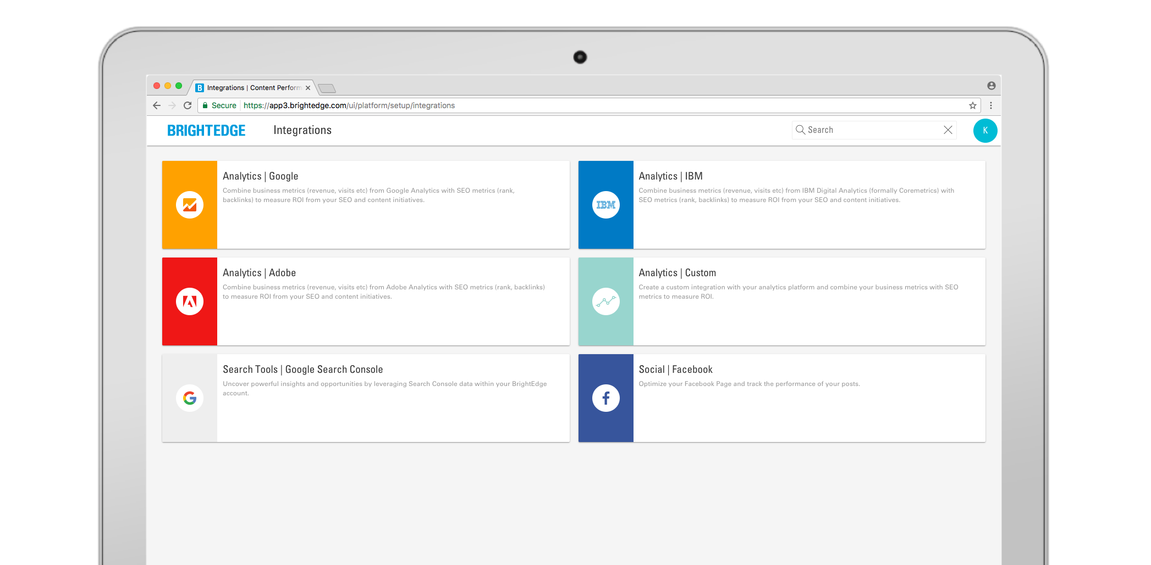
Pull data sources into one platform for holistic analysis
#BrightEdgeWebinar
Notes:
Connect all the dots by having your website analytics platform, connected to your SEO analysis tool

Slide 10
Did you know that some keywords do not have any chance to be above the fold on SERP?
Yes
No
#BrightEdgeWebinar

Slide 11
02
Optimize content using Intent Signal
#BrightEdgeWebinar

Slide 12
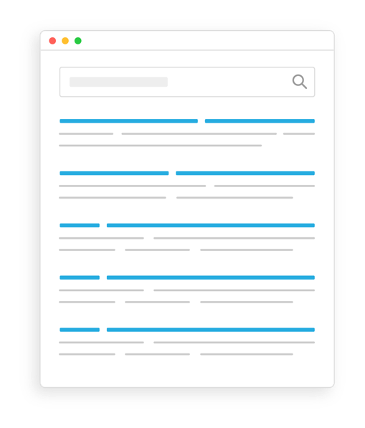
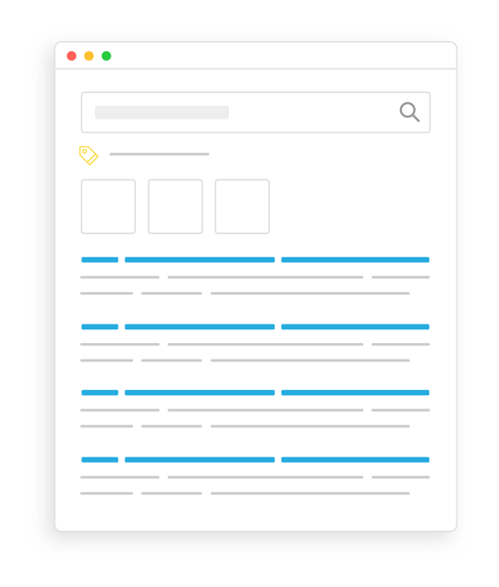
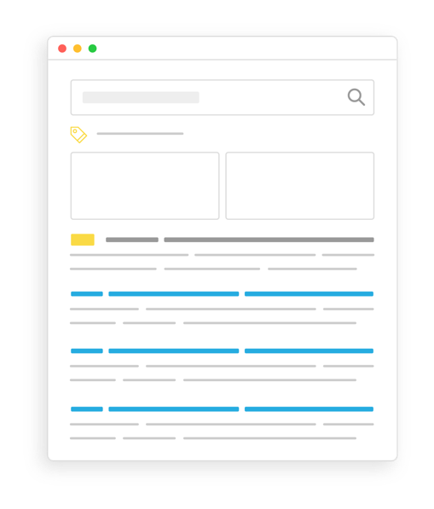
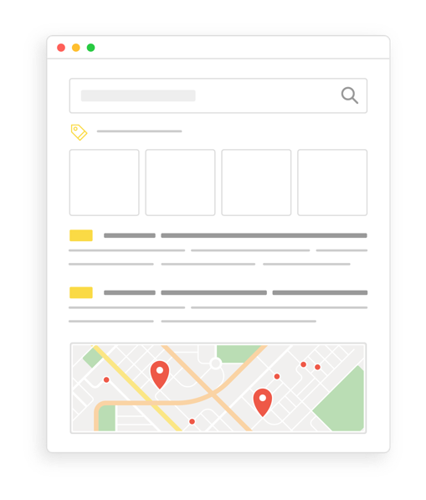
Serp layout is evolving
10 Blue Links
Highly Contextual
#BrightEdgeWebinar
Notes:
With the changing SERP landscape, marketers need to know what drives organic success and how to prioritize where they spend their time.
Not all SERPs are created equal
Very similar keywords can have very different SERPs (see example)
What you think might be different with how Google sees it. (Heuristic approach)
Purchase vs informational intent
70% higher CTR above the fold (below means lower traffic and $$)
Google continues to get smarter and optimize – to show users info the think is most valuable, in presentation that will be most accessible.
Marketers need to do the same to be successful.
A simple way to think about this is fishing. When you’re fishing, you first want to go to the place that has the most fish. This gives you the best opportunity.
That’s what above-the-fold is to organic. It’s the best place to focus your organic efforts first so that you’re going after the greatest opportunity.
So to get the best use of your time and to deliver the greatest business impact, you need a systematic and scalable way to know which keywords are above-the-fold.
Know what the customer wants, what keywords or content will help you get there, and whether there is organic opportunity
We want to help surface the data in as easy a way as possible so you can act on it.

Slide 13
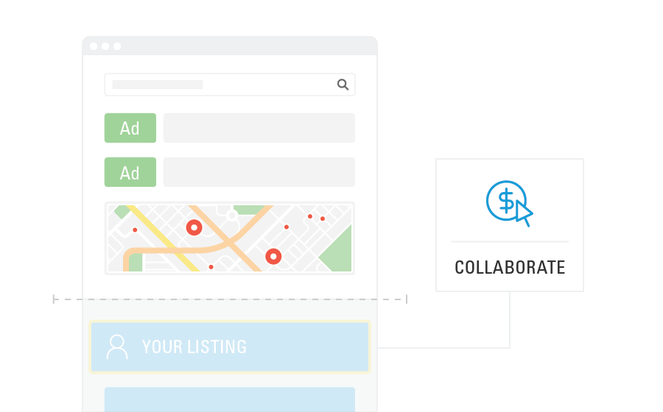
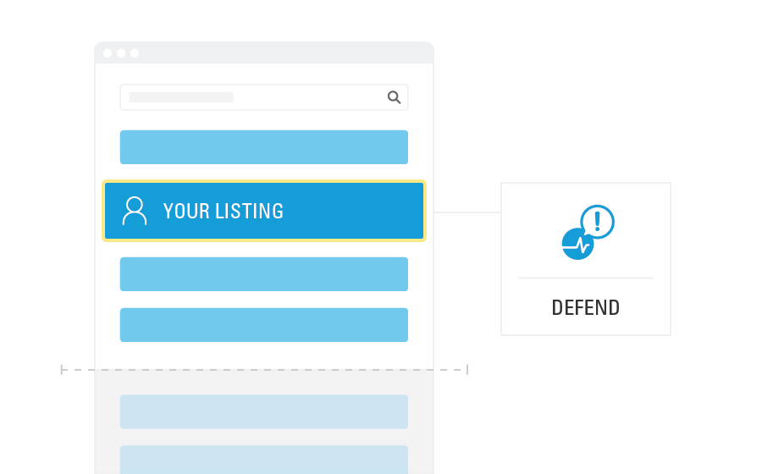
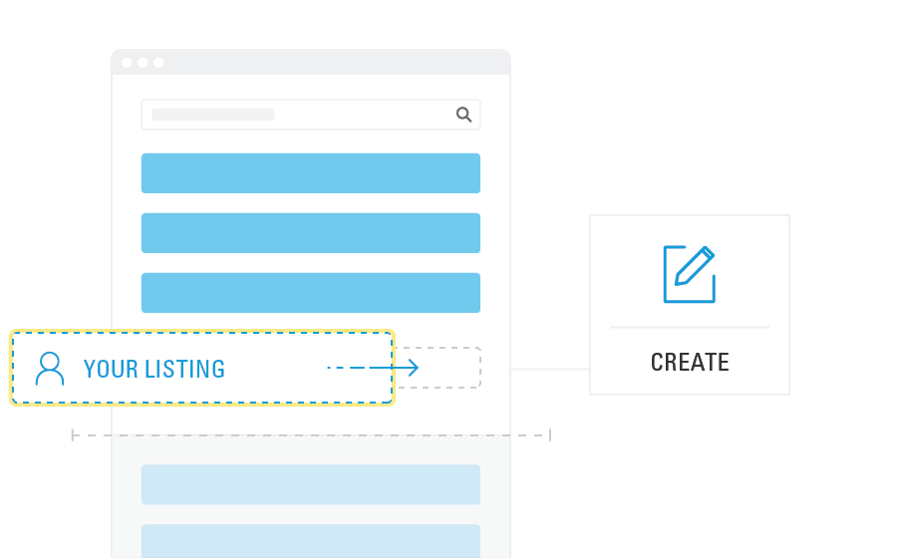
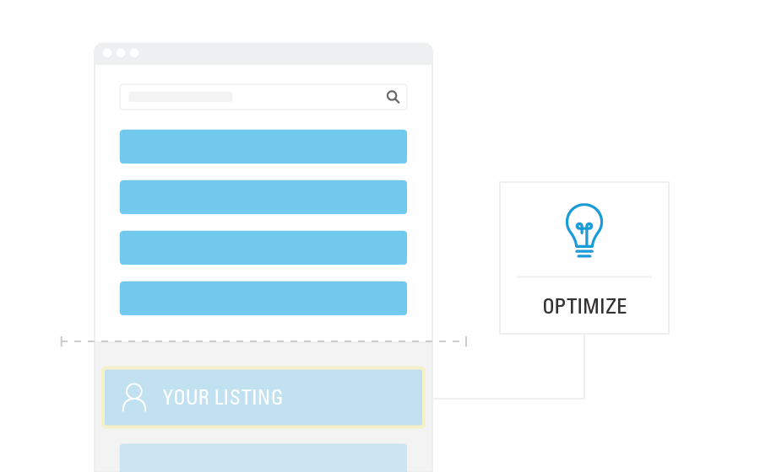
SERP opportunities uncovered by intent signal
COLLABORATE
Keyword does not rank above the fold, nor do you have content above the fold
DEFEND
Keyword and your content are above fold
CREATE
Keyword ranks above the fold, but you do not have existing content
Optimize
Keyword ranks above the fold, but your content is just below the fold
#BrightEdgeWebinar
Notes:
Within the BE platform there is a feature called Intent Signal, that helps you identify 4 distinct groups of opportunities.
Intent Signal takes these different search uses cases and categorizes your keywords in four different buckets as opportunities to either optimize for SEO or collaborate with Paid teams. Understanding whether a keyword is ranking organic listings above the fold or not is critical, and understanding whether or not your listing is currently above the fold. 2 metrics to allow you to segment and prioritize your tracked keywords by organic-friendliness, saving you hours of manual work
The way this works is
Our unique insights tell you which micro-moments display organic results above the fold—and where your listings aren’t yet above the fold but close.
We’ll also tell you where the next best opportunities are – these are ones where organic results appear above the fold, but you don’t yet have content for these topics or your content is currently ranking on page 3 or later. These are ones where you will want to create new content
Intent Signal also shows you where you’re performing well on above-the-fold opportunities, and need to monitor and defend your position
And then we’ll tell you where it’s harder to fish and you should collaborate with the paid team to drive success

Slide 14
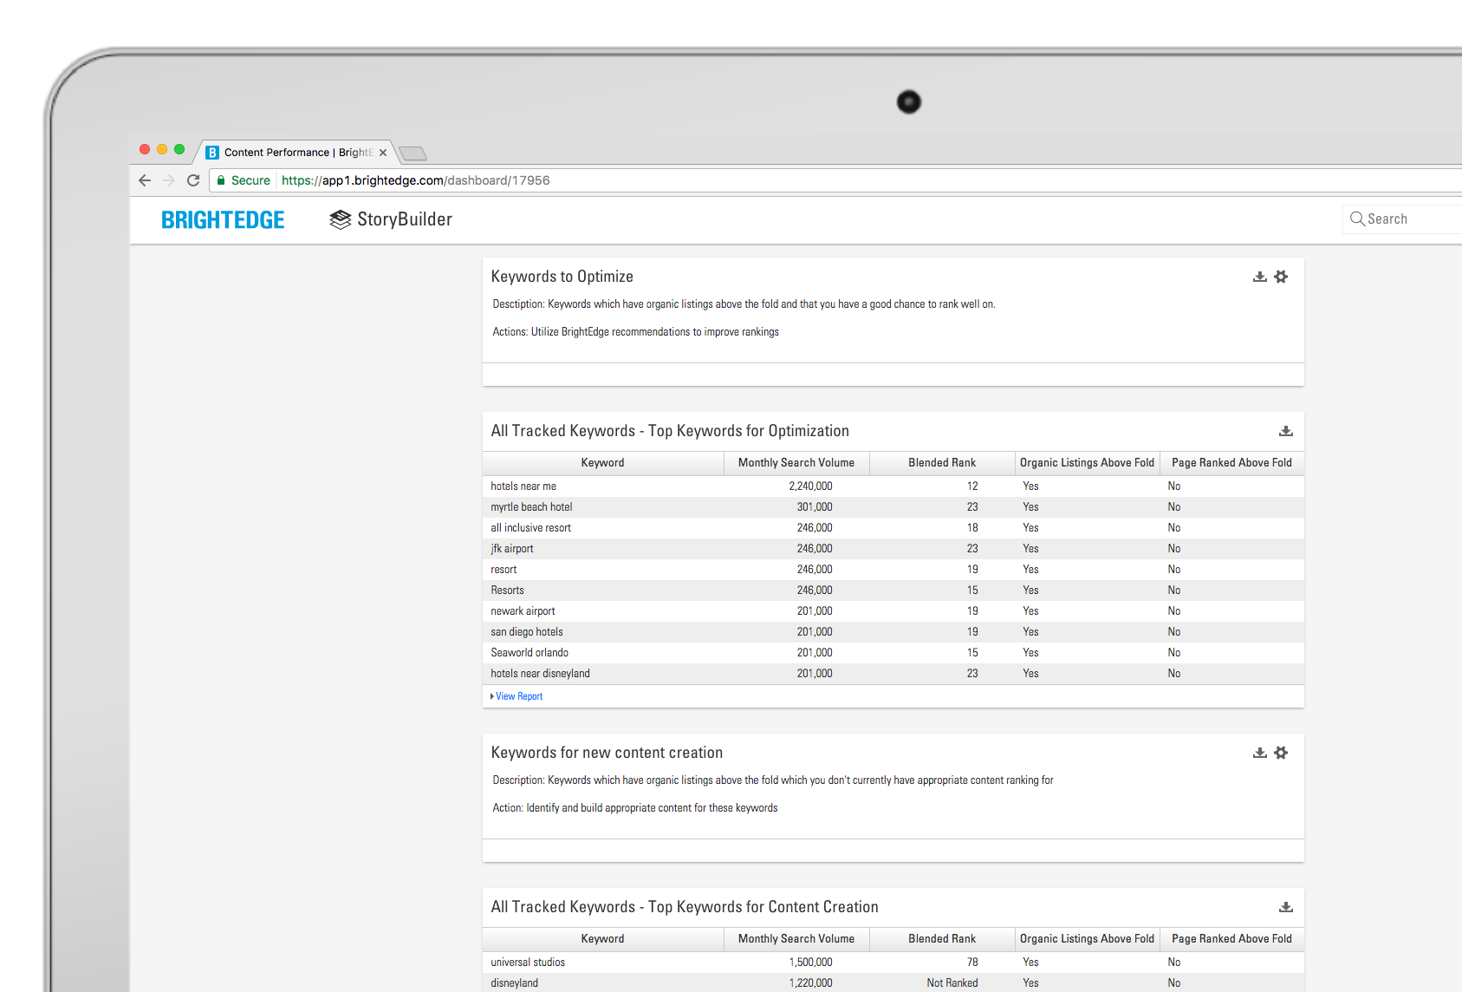
Intent signal dashboard
Build a dashboard that helps you identify and prioritize Intent Signal categories
Discover keywords that rank above the fold, but your page is not above the fold
#BrightEdgeWebinar
Notes:
Optimize those pages
on-page content optimization
off-page improvements
Acquire new users with more visible content
Go to keyword reporting
Set keyword group to “All Keywords”
Click “Columns”
Add “Organic Listings Above Fold” and “Page Ranked Above Fold” – click ’Apply”
Check the keywords

Slide 15
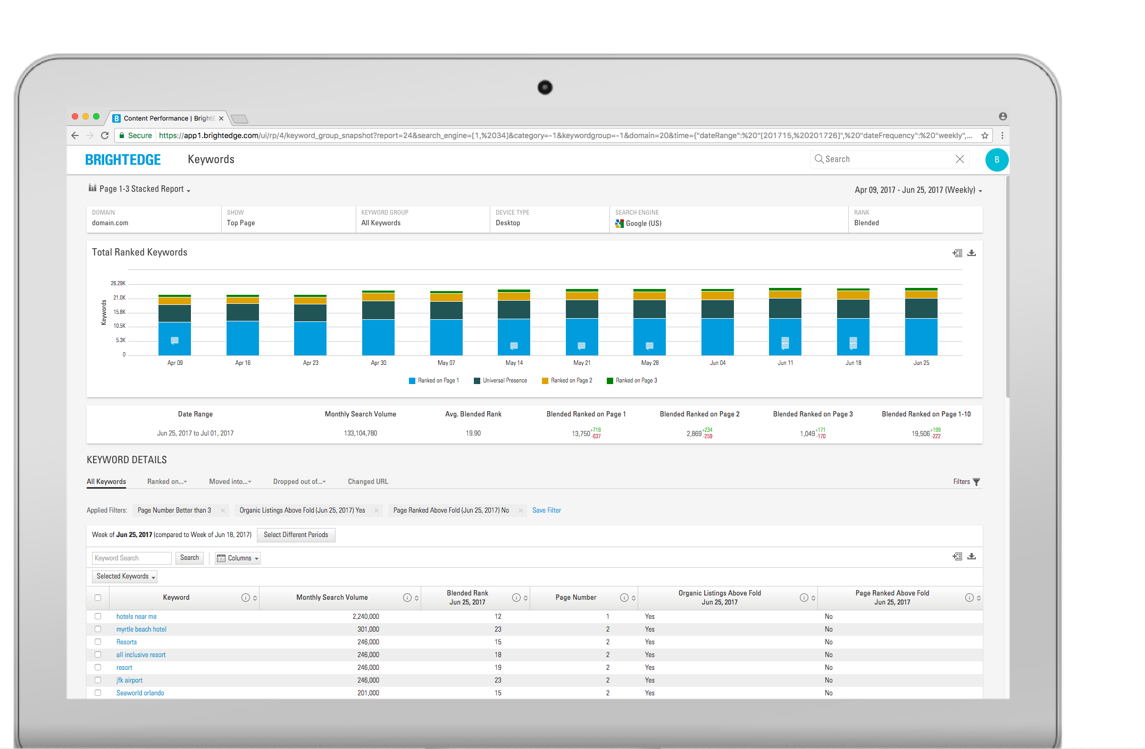
Optimize
Narrow down your keyword list to low hanging fruit opportunities
Focus your efforts on keywords with the best chance to rank above-the-fold
Apply filters
Bonus Tip: Have SEM bid while SEO optimizes
#BrightEdgeWebinar
Notes:
Use reporting filters to gain insights into metrics like universal results, competitor performance, and rank by device
Customize columns to add in CTR, classic rank, or Intent Signal metrics
Apply filters to view more targeted and actionable data sets
Bonus tip: Optimize organically for keywords with the highest CTR. SEM can focus on keywords with lower CTRs.
Keyword Reporting lets you be informed and make actionable decisions based on the data
Dive deeper into reporting for each keyword to better understand the page that is currently associated with that keyword

Slide 16
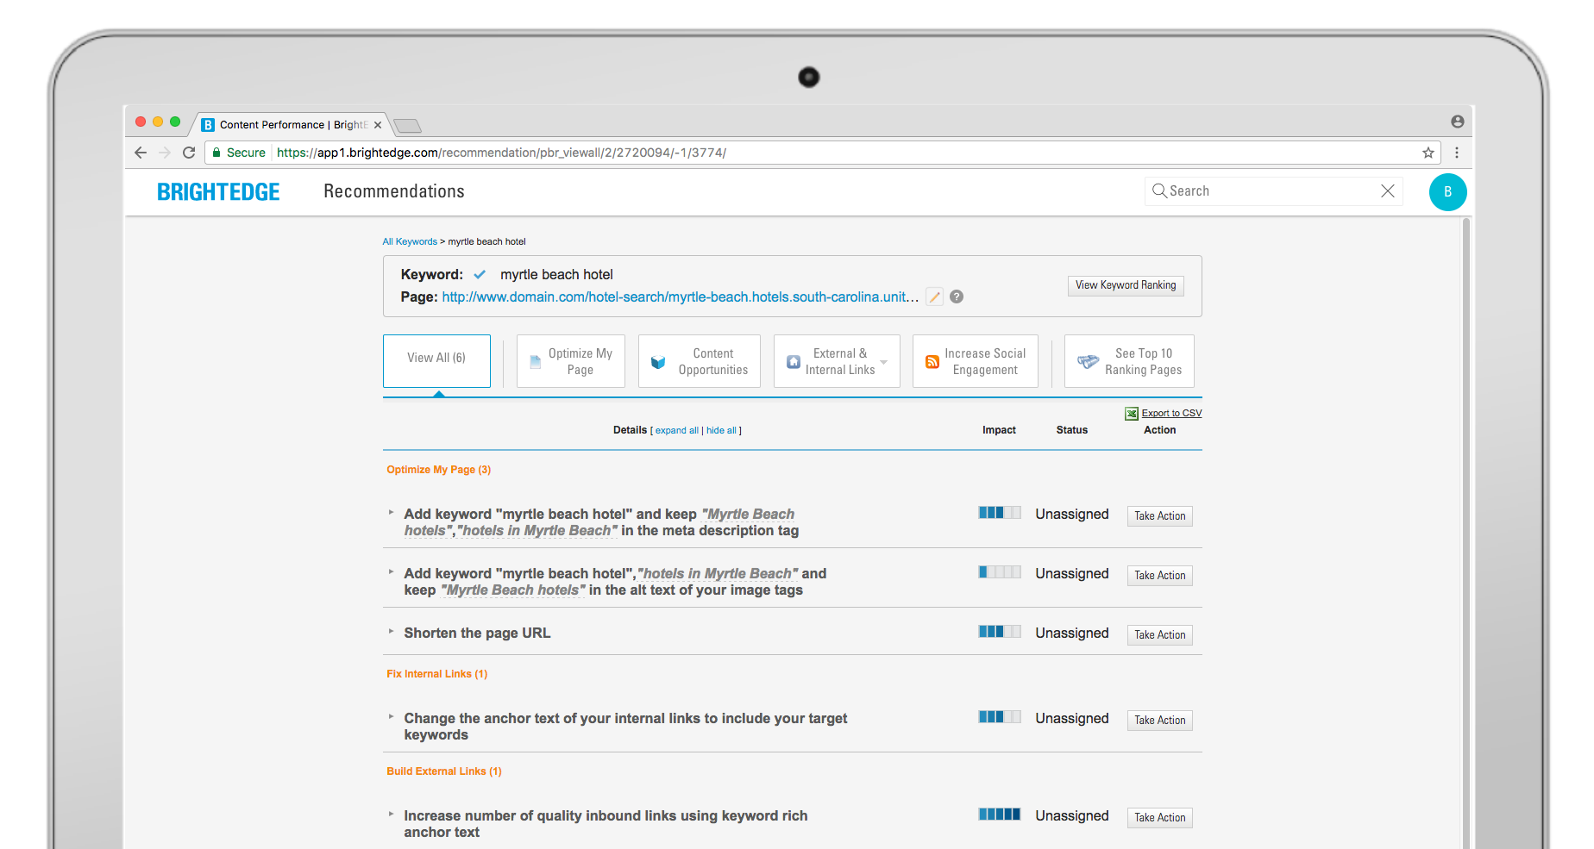
Recommendations
Based on the page associated with those keywords – BrightEdge will give you quick wins on how to improve
#BrightEdgeWebinar

Slide 17
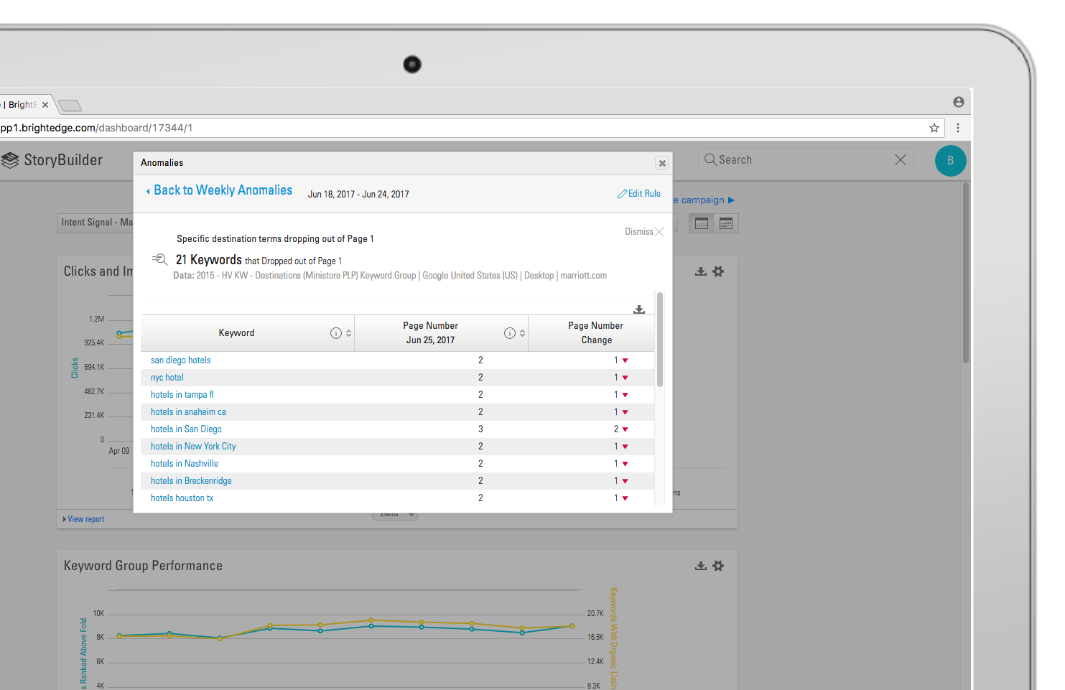
Anomaly Detection alerts you of changes
Set specific triggers that are relevant to your business metrics and conditions
Add filters to narrow down the data set or set rules
Set the threshold that will trigger an email alert
#BrightEdgeWebinar
Notes:
As soon as the KPIs you are tracking cross your threshold you will be alerted
Go to Anomaly Detection and name your alert
Select an existing Keyword Group you want to track
Add filters to narrow down the data set or set rules (use default if unsure)
Set the threshold that will trigger an email alert

Slide 18


CHALLENGE
10% drop in organic traffic for vintage style swimsuits
Compete with large retailers for SERP visibility
SOLUTION
Used BrightEdge to identify which keywords were above and below the fold
BrightEdge revealed that the bounce rates of pages for keyword group 1 are about 10% less than other pages; while PPC reports showed that group 2 had higher click-through-rate from paid search ads
results
Saw a 10% higher click-through rate when increased PPC budget to keywords that had an organic presence below the fold
Team wants to prioritize stronger engagement of new visitors, they will double down with PPC ads for keywords that UV already has organic listings above the fold
#BrightEdgeWebinar
Notes:
The Problem
Swimwear sales peak in springtime for unique-vintage.com (UV). The company and its digital
agency, EXCLUSIVE, optimized organic content pages months in advance of the 2017 season. Yet,
despite holding steady in organic rank for critical topics, swimwear pages saw organic traffic
decreased by 10% compared to the same period in 2016. The team discovered that Vintage-inspired
swim styles have emerged as a hot trend, so UV has been vying for prominent presence on Search
Engine Results Page (SERP) against large retailers. The Google Ad 4-pack also pushed organic
listings below the fold for many keywords. Quick action was a must.
The Solution
EXCLUSIVE loaded UV’s top 250 SEM keywords into BrightEdge Intent Signal for analysis. Within
minutes, new insights emerged, outlining two distinct keyword groups: Keywords for which UV
content showed up above the fold on SERP, and keywords for which UV content showed up below
the fold. BrightEdge also revealed that the bounce rates of pages for keyword group 1 are about
10% less than other pages; while PPC reports showed that group 2 had higher click-through-rate
from paid search ads. Finally, the team found that after adjusting spend for new visitor acquisition,
cost-per-new-visitor remained the same for both keyword groups.
The Results
UV and EXCLUSIVE now have the insights to adjust their SEM investments to better serve UV’s business needs. “These are insights that we
would have never gained, had it not been for the knowledge received from BrightEdge”, Mike Frekey at EXCLUSIVE said. To accelerate new visitor
acquisition, the team will increase PPC budget of keywords that UV doesn’t have organic presence above the fold as this cohort saw a 10% higher
click-through rate compared to other cohorts in this test. On the other hand, if the team wants to prioritize stronger engagement of new visitors,
they will double down with PPC ads for keywords that UV already has organic listings above the fold.

Slide 19
Poll about Local 3-Pack
Do you have local stores that you need to attract traffic for?
Yes
No

Slide 20
03
Secure top spot in Local 3-Pack
#BrightEdgeWebinar

Slide 21

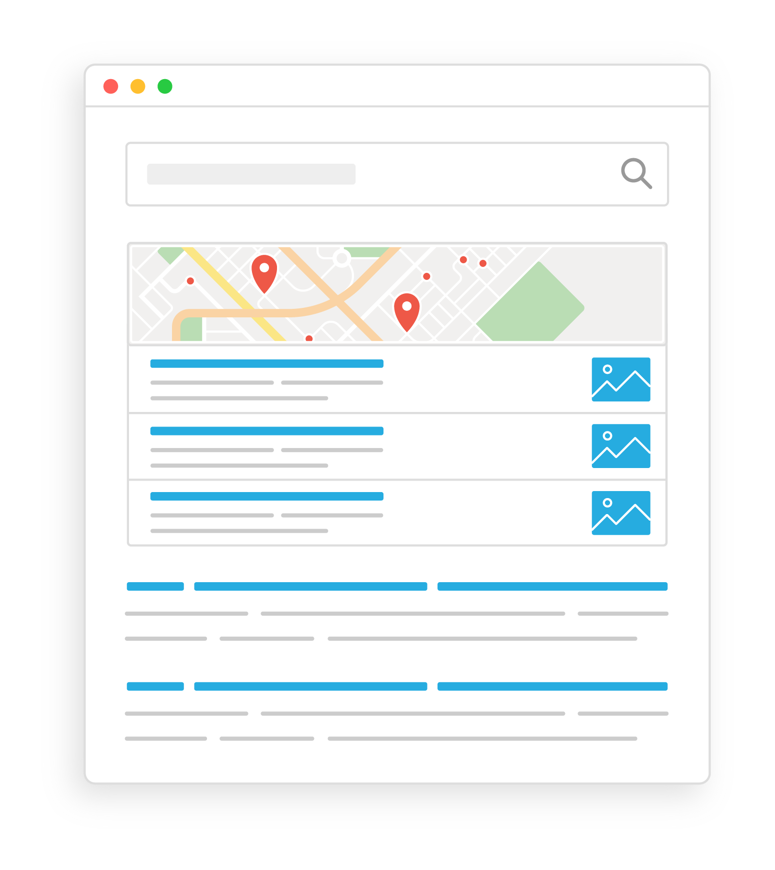

Local 3-pack appears in both desktop and mobile search. Go moments are gaining volume and are an opportunity to drive organic traffic and foot traffic to stores.
I-WANT-TO-GO MOMENT
Local 3-Pack and “Near me”
Of customers are more likely to visit stores if online information is valuable
Notes:
Goal – Acquire more “Iwant to go moments”

Slide 22
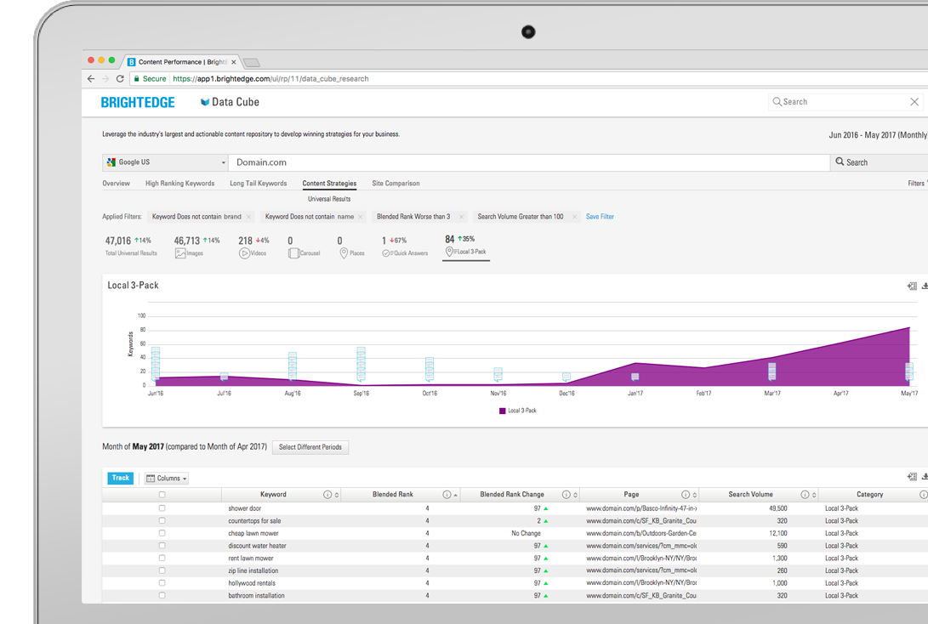
discover high value local keywords
Use Data Cube
Identify non-branded keywords in Local 3-Pack
Use a local search engine
#BrightEdgeWebinar
Notes:
Keywords that are in your striking distance (ranked in 4 or 5) are the most high value keywords to target – close to the top 3 – you can apply filters to narrow your search to make sure only the relevant keywords are shown.
Go to Data Cube
Enter domain
Click on Content Strategies
Click on Local 3-Pack
Use filters
remove brand name (keyword does not contain “name”)
Blended rank worse than 3
Search volume above 100
Understand which keywords are currently triggering local 3-pack searches – and what page they are linking to
Click to track high value keywords

Slide 23
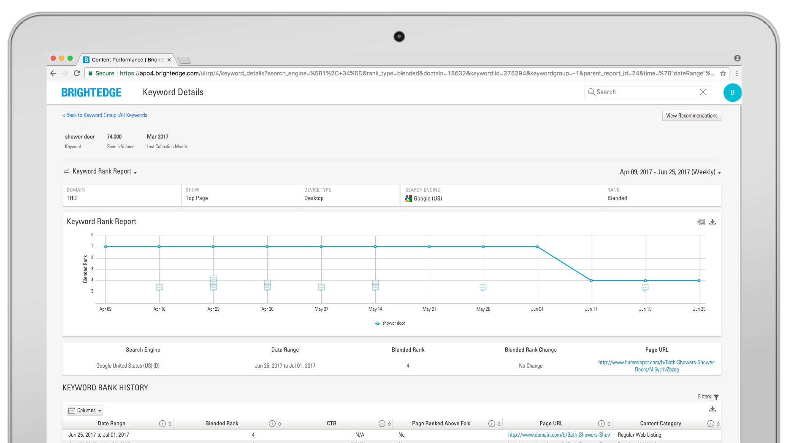
keyword reporting
Notes:
In this webinar we are going on the assumption that you have already optimized and created regional webpages -- in the next webinar you will learn how to create new content

Slide 24
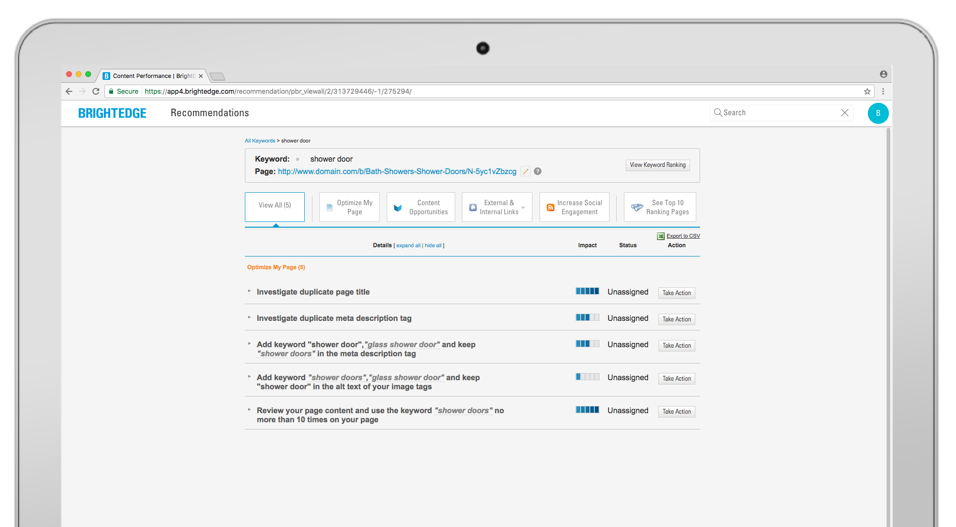
Recommendations
#BrightEdgeWebinar

Slide 25
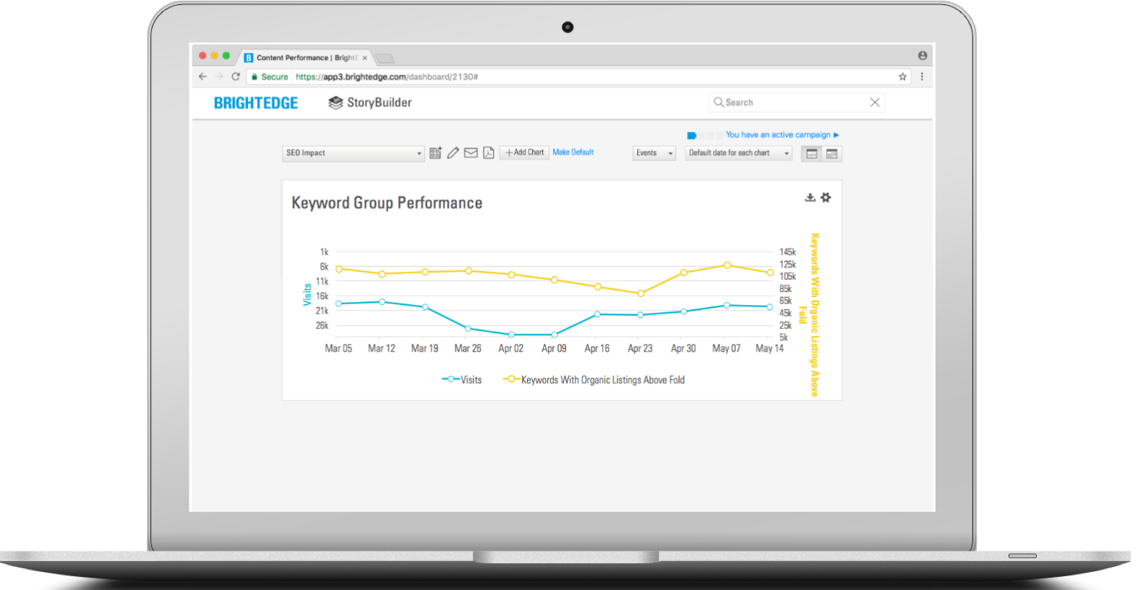
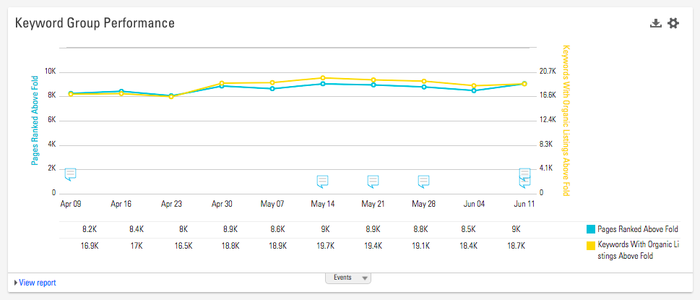
Track your progress on a local level
#BrightEdgeWebinar
Notes:
This means monitoring the local search engines serving your particular area. It will do you little good to monitor clicks and ranks for the keyword, “Italian restaurants near me” on a national scale, for example, when you really just want to rank for the keyword in the Springfield, Illinois area. Instead, track your keywords on local search engines. The closer you can get to your exact location, the more accurate your information will be. Use this data to gain insight into the online local search experience of your exact target audience. You can then use this insight to guide your strategy as you move forward.

Slide 26


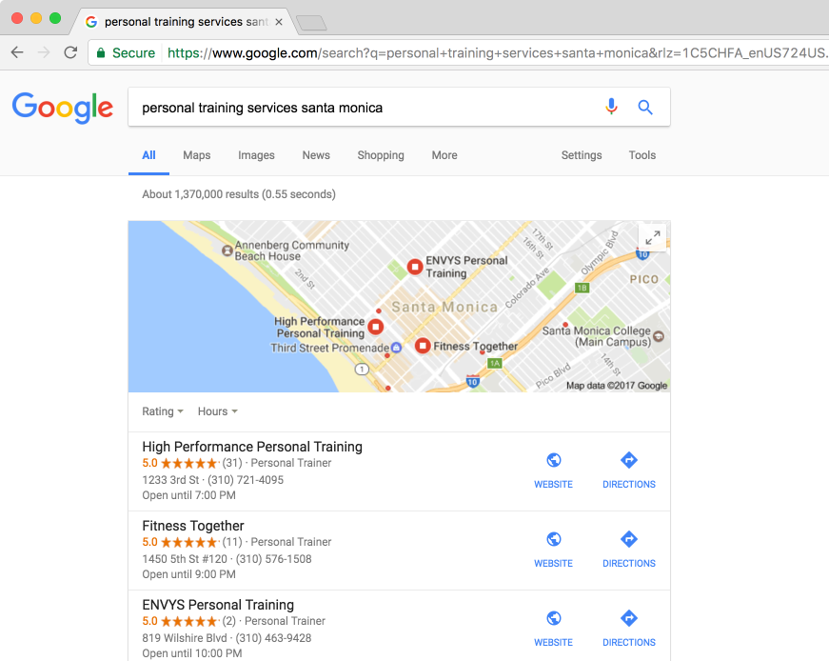
CHALLENGE
Support growth of Fitness Together and two other franchise brands across 400 locations
SOLUTION
Customized reporting dashboards by location
Filtered trended Data Cube reports by location
Enabled franchisees to view reports
BENEFITS GAINED
Franchises now visible on 1st SERP
Local 3-Pack visibility for many key topics
Increased site traffic, store traffic, and revenue
#BrightEdgeWebinar
Notes:
Key points – the process is similar to getting in any universal results such as quick answer

Slide 27
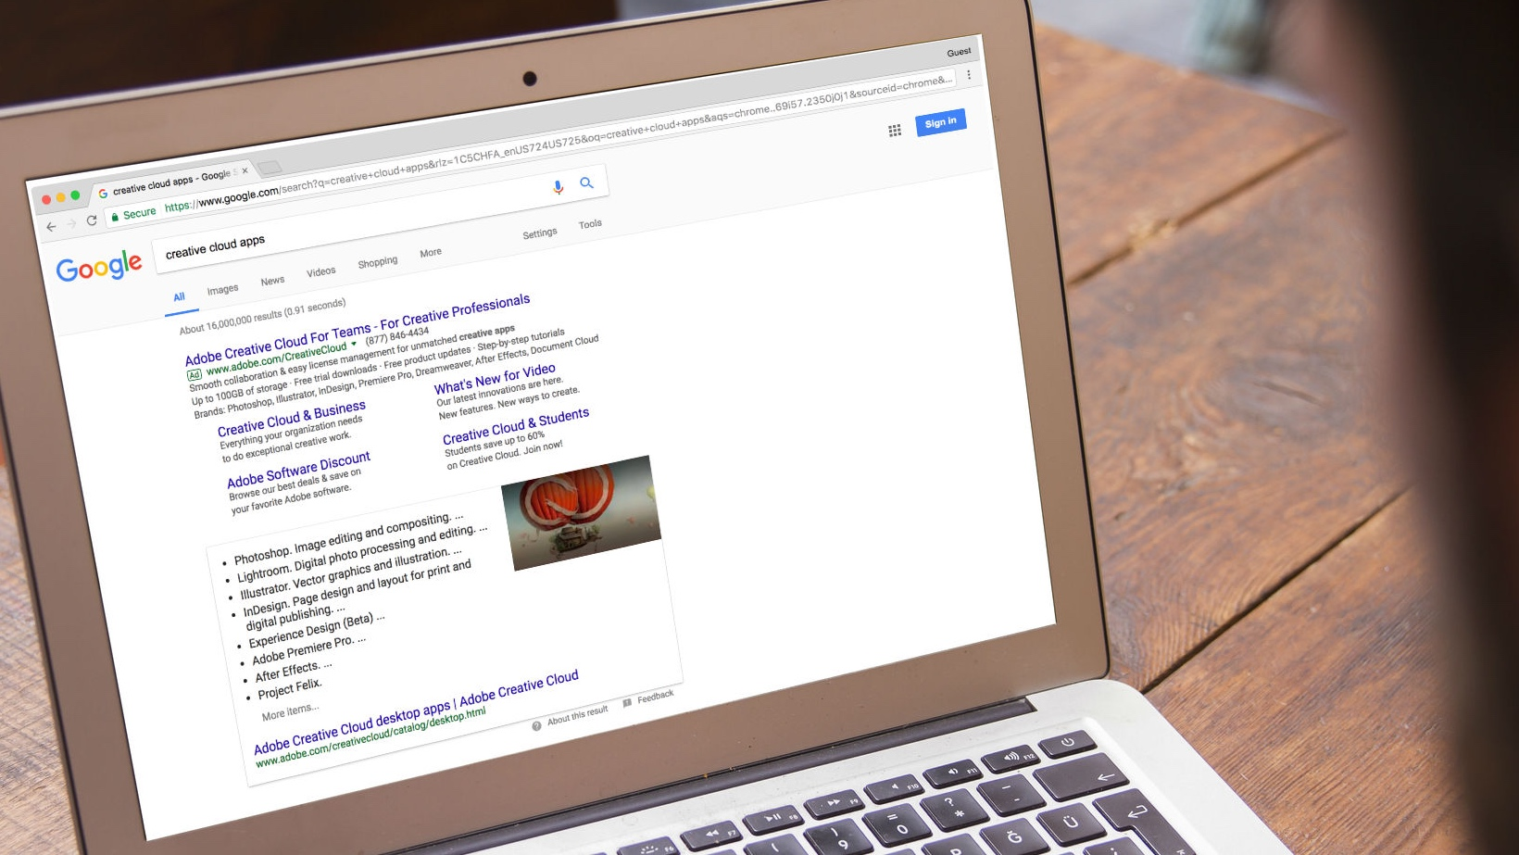
CHALLENGE
Create content for non-branded queries that could answer specific questions
SOLUTION
Using BrightEdge Data Cube, Adobe prioritized in-demand topics
Created feature-related how-to-use content focused on user experience
Monitored topic performance using Universal Results tracking
BENEFITS GAINED
Secured 5,900+ Quick Answers boxes
Increased the number of topics featured in Quick Answers by 17%
For a subset of 2,000 “How to” topics, 60% were featured in Quick Answers
#BrightEdgeWebinar
Notes:
Advanced user – creating not only relevant content, but creating it for a specific content format
We are going to share to webinar after this

Slide 28
Have you tracked, retired and/or optimized orphan pages?
Yes
No
What is an orphan page?

Slide 29
04
Increase SEO equity from orphan pages
#BrightEdgeWebinar

Slide 30



IDENTIFY ORPHAN SITE PAGES
Pages with no incoming internal links
Unreachable via browsing
May no longer necessary
Or representing missed organic opportunities
#BrightEdgeWebinar
Notes:
Orphan pages are website pages that are not linked to from another section of your site. They cannot be found by search engine crawlers, and

Slide 31
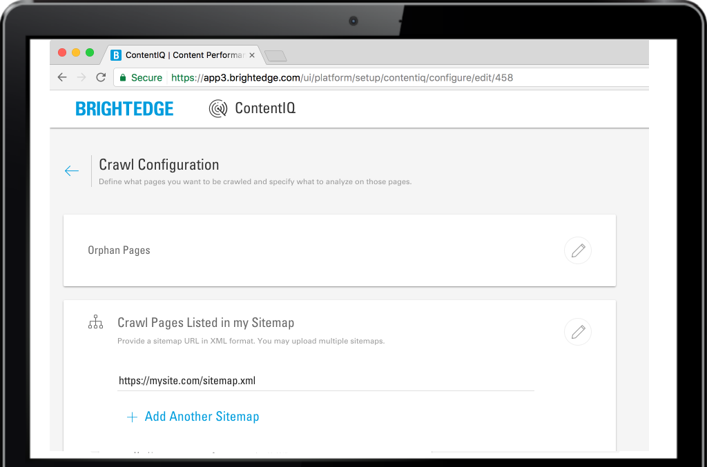
Get a full list of your current website pages
Notes:
Pointing your favorite website audit solution to your home page and expecting it to identify orphan site pages won’t work, because, by definition, orphan pages are not linked to from any domain page. The crawler will never find them. Instead, you need to specify the full list of site URLs that the crawler should examine. There are a few ways to get the URL list:
1. Use your sitemap file
The sitemap is a file that’s typically placed at the root of your domain to help search engine bots understand the content of your site, how often you update it, and how to best surface your content on search engine results pages. When you add a new page or post in your Content Management System (CMS), your sitemap is dynamically updated, but make sure your sitemap contains the full list of your pages before using this technique.
2.

Slide 32
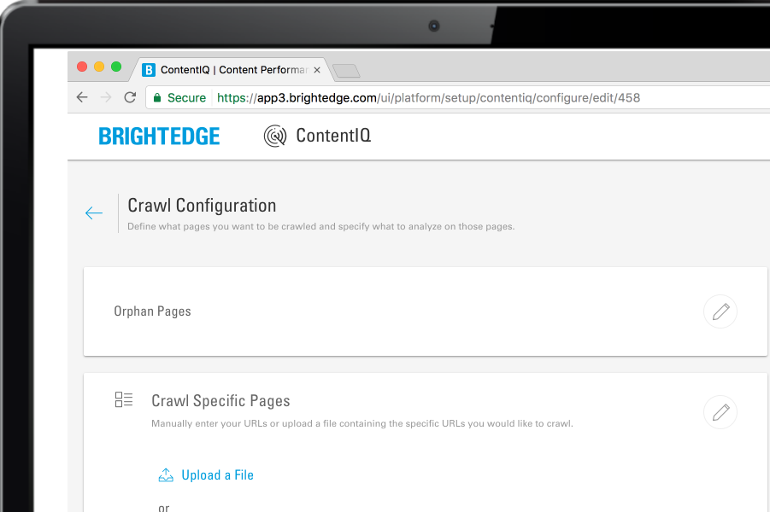
Download a site URL list
Once you have the full list, paste it into your crawl configuration
Notes:
If a sitemap is not an option — for example, if the sitemap does not contain the full page list — then you can generate the list from your CMS. On WordPress, for example, you can have install a lightweight plugin, such as List URLs to export a list of site URLs as a CSV file.
You can also ask your IT to give you a copy of the CMS log that lists all the pages that were served to your visitors. Load the list into Excel and filter on unique URLs.
Once you have the full list, paste it into your crawl configuration: For this example I will be walking through using BrightEdge’s ContentIQ, which is a comprehensive site auditing solution that is integrating into BrightEdge SEO.

Slide 33
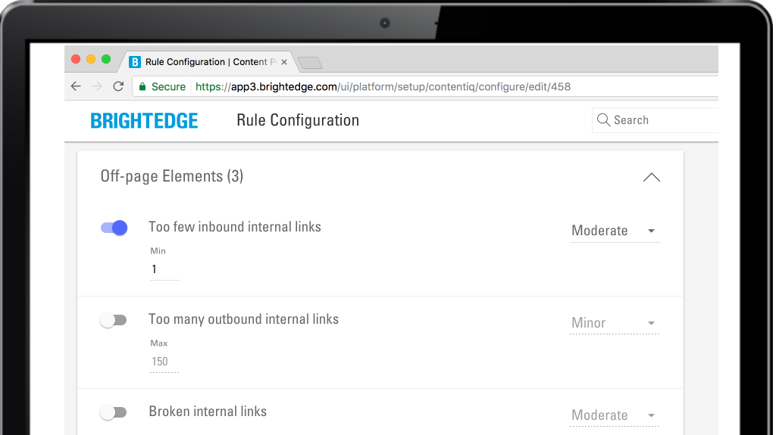
Run a website crawl for pages with zero inbound internal links
Notes:
2) Run a website crawl for pages with zero inbound internal links
To identify orphan pages, set up the audit rule to catch pages that don’t have at least one inbound internal link.
While configuring the audit, set up a recurring crawl to catch any new orphan pages in the future. By the way, if you are relying on URL list then you’ll want to get an update list from your CMS.

Slide 34
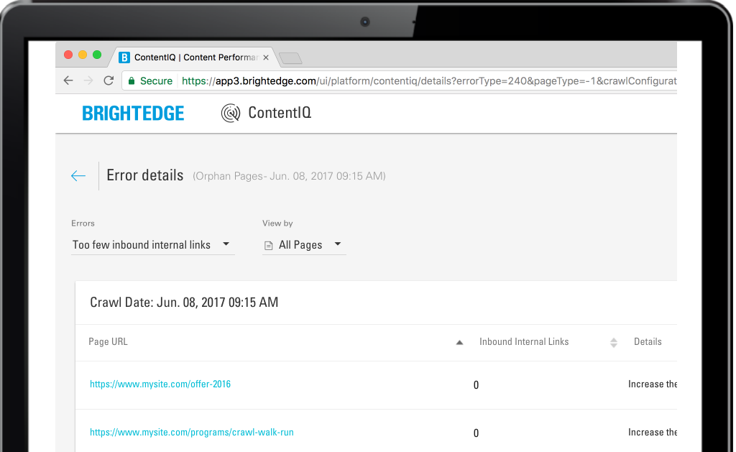
Analyze the audit results
Notes:
Once the audit is complete, log back into ContentIQ and view the results of your audit. Identify the orphan pages and determine their objectives: Are they actively driving referral, paid or social campaign traffic? Do they have quality backlinks? Do site visitors access them extensively via onsite search?

Slide 35
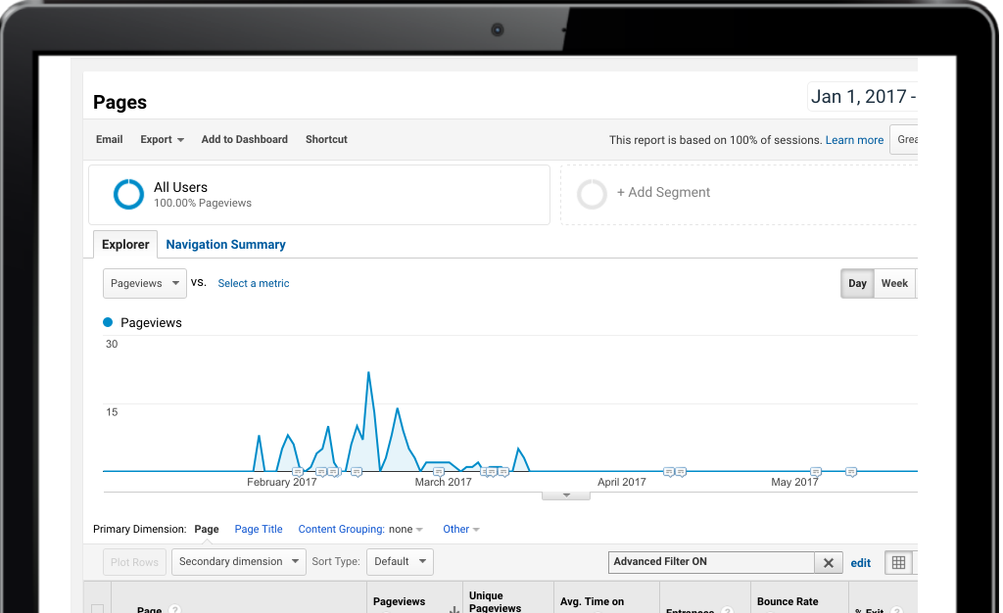
Use your web analytics solution to assess traffic sources
Notes:
Use your web analytics solution to assess traffic sources, visits and page views, entry, and exit behaviors. In this example, we see a campaign page that was helping acquire traffic for a given time. Once the campaign ended, the page no longer attracts traffic, and can be removed from the site:

Slide 36

Resolve any orphan page found
Link to it from other internal pages if it’s imperative for site visitors to find it via browsing
Archive it if it’s no longer needed
Leave it as-is if it’s serving a business need that doesn’t require internal linking to the page
#BrightEdgeWebinar
Notes:
Once you understand what purpose the orphan page serves and how it aids in driving your website and marketing goals, you can determine what step if any to take with the page:
Link to it from other internal pages if it’s imperative for site visitors to find it via browsing
Archive it if it’s no longer needed
Leave it as-is if it’s serving a business need that doesn’t require internal linking to the page

Slide 37
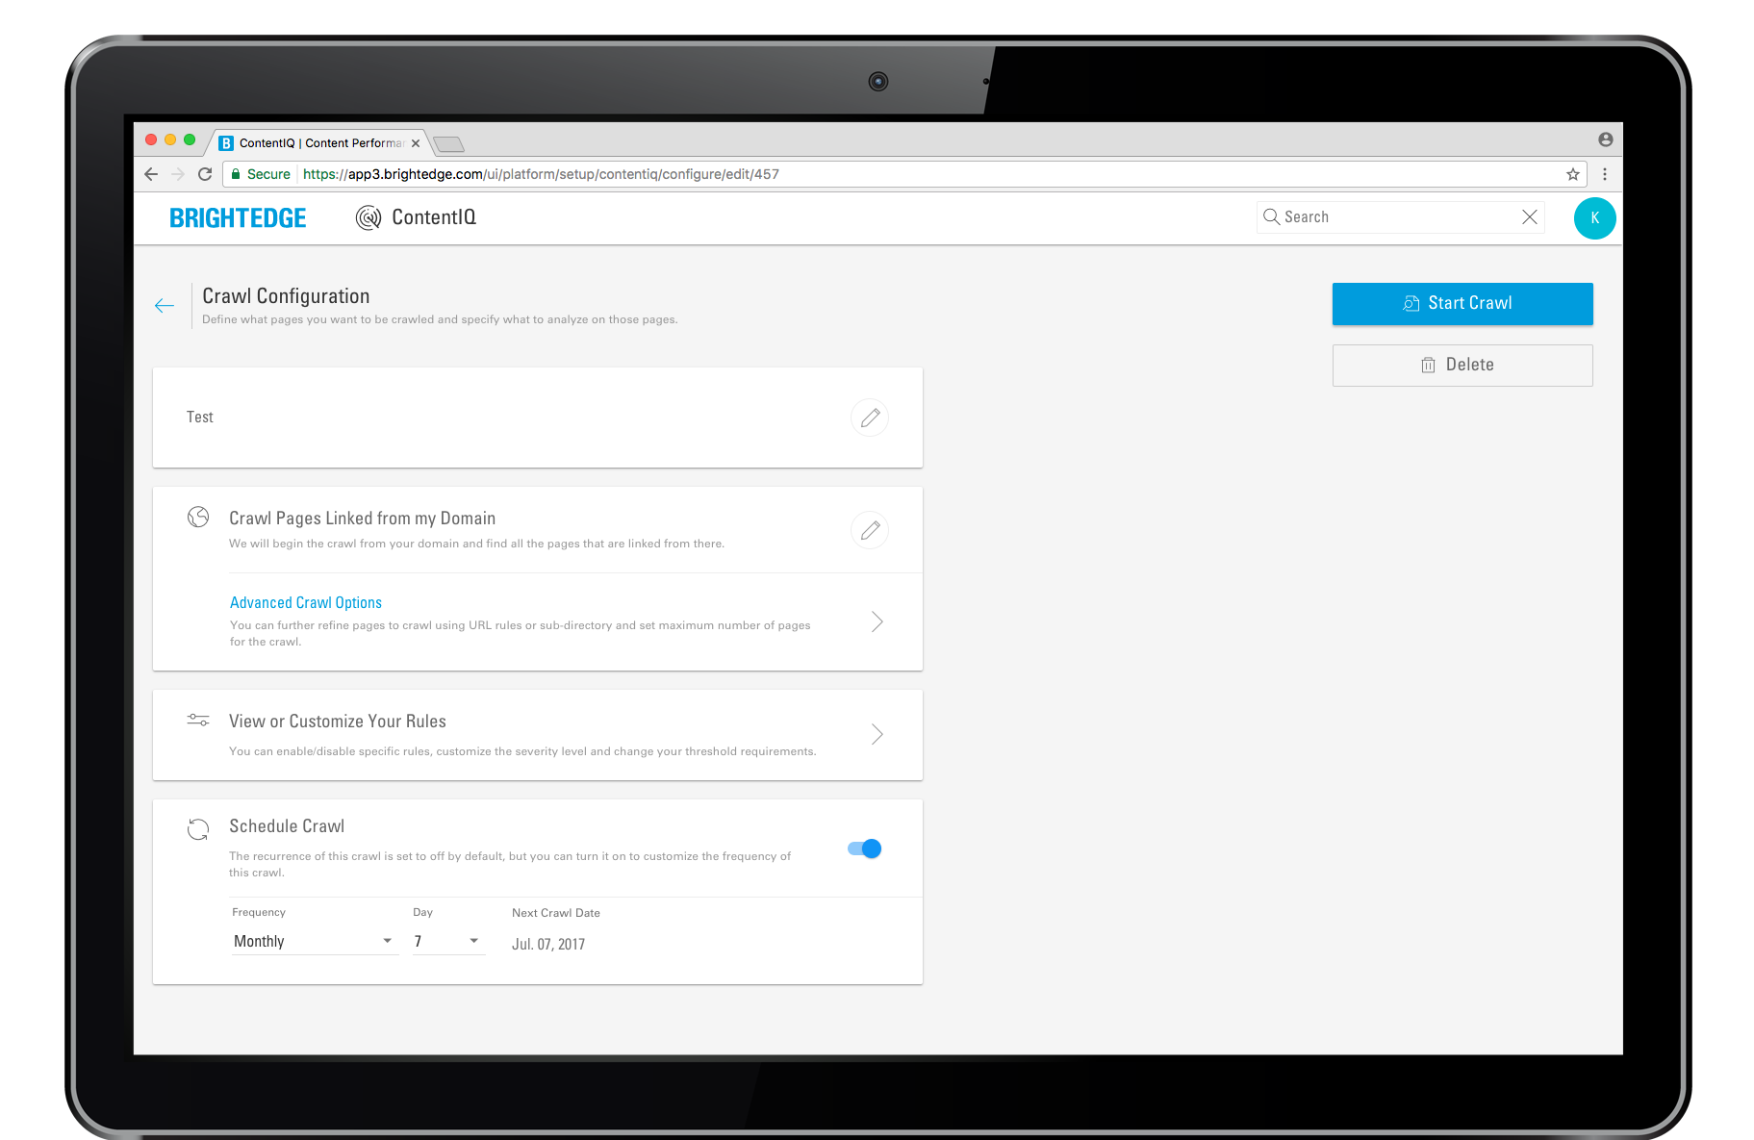
Rerun the audit periodically to catch new orphan pages
#BrightEdgeWebinar
Notes:
Since pages can become orphaned over time — by adding new content and forgetting to link to it, or by accidentally removing links to pages nested deep in the site structure — it is important to check the site regularly for new issues.
As I said earlier, you can configure ContentIQ to rerun your audit by scheduling a crawl:

Slide 38
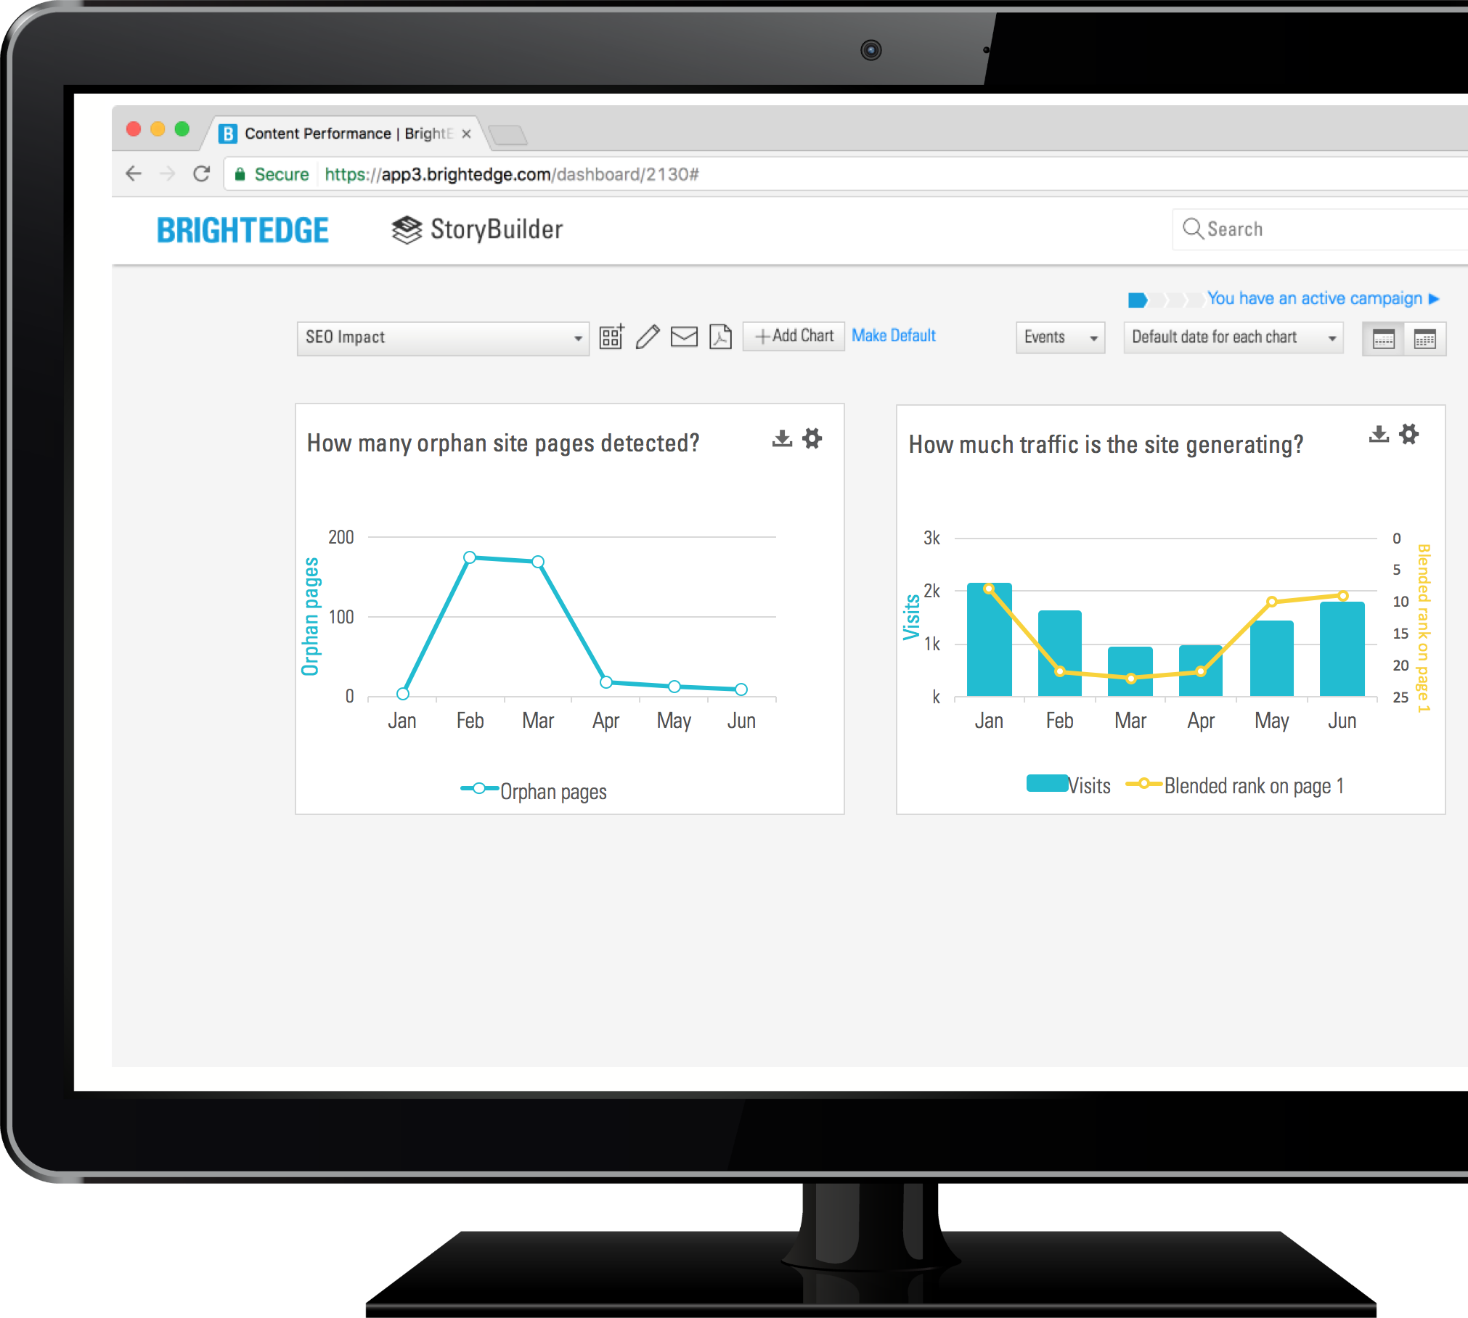
TREND ORPHAN PAGES
Valuable pages that become orphan can degrade average rank and site traffic
#BrightEdgeWebinar

Slide 39
Key Takeaways
Baseline Reporting
Intent Signal
Local 3-Pack
Orphan Pages
Create an initial baseline report to help you quickly understand the business impact of your content
Optimize existing content based on keywords that have the possibility to rank above the fold
Narrow in on keywords in striking distance in order to rank high in universal results
Capitalize on great content to help increase rank and traffic to your site
#BrightEdgeWebinar

Slide 40

BrightEdge Summer Webinar Series
Upgrade your SEO and content skills this summer with the latest insights and best practices
SEO: The Heart of Marketing (on-demand)
Quick Wins with SEO (on-demand)
Developing Pre-Optimized Content (July 14)
Making the Case for SEO (July 28)
Beyond SEO: Connecting Content to Conversions (Aug 11)
Register now

Slide 41
What have you found most useful today?
SEO program includes keywords, on-page, off-page factors
Creating a baseline report is critical to an SEO success roadmap
Optimize content using Intent Signal
Secure top spot in Local 3-pack
Manage orphan pages

Slide 42
What else do you want to learn about SEO?
How to create the initial set of SEO target keywords
How to create SEO optimized content
How to minimize negative SEO impact from site migration
How to create a successful SEO program in my organization
How to measure the performance of my content marketing efforts
How to improve the overall performance of my website

Slide 43
Q&A
#BrightEdgeWebinar

Slide 44
THANK YOU!
info@brightedge.com
#BrightEdgeWebinar

