Slide 1


UNDERSTANDING GOOGLE’S MOBILE FIRST INDEX
Presented by:
Jonny Waite
jonny@directagents.com
Direct Agents
Director of Search
Rachelle Medina
rmedina@brightedge.com
BrightEdge
Senior Manager, Customer Success
Agency Partnerships
Notes:
Jonny Intro and agency intro - Followed by Rachelle and BrightEdge intro

Slide 2
1
WHAT IS GOOGLE’S MOBILE FIRST INDEX?
2
THE IMPORTANCE OF SITE SPEED
AGENDA
3
MOBILE OPTIMIZATIONS FOR USER EXPERIENCE
4
IMPLEMENTING ACCELERATED MOBILE PAGES
5
HOW TO MEASURE MOBILE PERFORMANCE
Notes:
Jonny

Slide 3
Who is confident that their mobile site is properly optimized for the mobile first index?
Place Holder - POLL
Options:
Completely confident
Fairly confident
Not confident at all
What’s the mobile first index?
Notes:
Jonny

Slide 4
WHAT WE KNOW ABOUT GOOGLE’S MOBILE UPDATE
Notes:
Jonny to transition to Rachelle

Slide 5
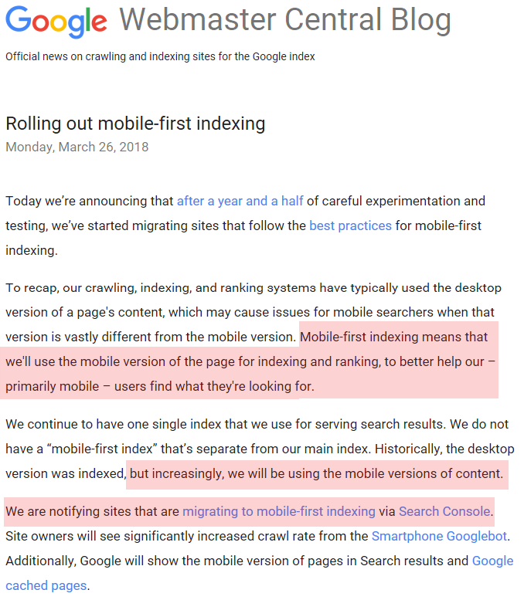
What is Google Saying?
Notes:
Rachelle

Slide 6
What are others saying?
SEARCH ENGINE WATCH
“Don’t be caught waiting till the algorithm updates to start making big moves. If your website isn’t optimized for mobile, take that step today.”
TECH CRUNCH
“Pages that already take advantage of responsive web design and implement dynamic serving don’t usually have to do anything to be ready”
SEARCH ENGINE JOURNAL
“Make sure your site displays the same key content on mobile as it does on desktop. Text, images, and videos should be easy to crawl on mobile.”
“Structured data should be on the mobile and desktop versions of a site. If there are separate mobile and desktop URLs, then the structured data should be updated to the mobile version on mobile pages.”
“Google will not officially announce when the mobile first index will be complete”
FORBES
“the impact of mobile-first indexing will come into play if your mobile and desktop sites are significantly different”
MOZ
“With a separate mobile site, you’ll need to make sure that your mobile version contains everything that your desktop site does, which could be a lot of work depending on your mobile strategy so far.”
Sources:
https://searchenginewatch.com/2018/01/09/mobile-first-indexing-in-2018-3-things-seo-professionals-should-do-right-now/
https://techcrunch.com/2017/12/20/googles-mobile-first-search-index-has-rolled-out-to-a-handful-of-sites/
https://www.searchenginejournal.com/get-ready-mobile-first-index-according-google/228553/
https://www.forbes.com/sites/jaysondemers/2017/01/26/what-googles-mobile-first-index-means-for-your-seo-strategy/
https://moz.com/blog/mobile-first-indexing-seo
https://www.searchenginejournal.com/google-move-many-sites-mobile-first-index-soon/238991/
Notes:
Rachelle

Slide 7
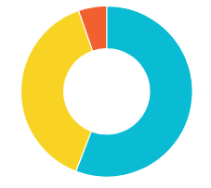
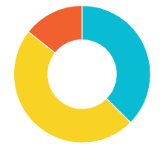


Why is this a focus?
Direct Agents Clients, Q4 2017
Smartphone traffic may rival or exceed Desktop
example1.com
example2.com
Notes:
Key points to hit:
So we are seeing a pattern. The presence of the Local 3 Pack in the SERP will pretty much devastate the expected click through rates of the classic results underneath.
In fact our research shows up to a 69% decrease in CTR for classic results when a 3 pack is present. This makes sense considering the premium position of the 3 pack typically, and the amount of SERP real estate it occupies.
The big overall takeaway is that you have to be in the Local 3 Pack to have the most impact on the I Want To Go moment

Slide 8
Rank and SERPs may vary by device
 | Desktop | Smartphone | Variance
Average Blended Rank | 17.67 | 16.23 | + 1.44
Average Classic Rank | 19.30 | 16.80 | + 2.5
# Ranked on Page 1 | 74 | 79 | + 5
Keywords with organic listings above fold | 102 | 46 | - 56
Notes:
Key points to hit:
So we are seeing a pattern. The presence of the Local 3 Pack in the SERP will pretty much devastate the expected click through rates of the classic results underneath.
In fact our research shows up to a 69% decrease in CTR for classic results when a 3 pack is present. This makes sense considering the premium position of the 3 pack typically, and the amount of SERP real estate it occupies.
The big overall takeaway is that you have to be in the Local 3 Pack to have the most impact on the I Want To Go moment

Slide 9
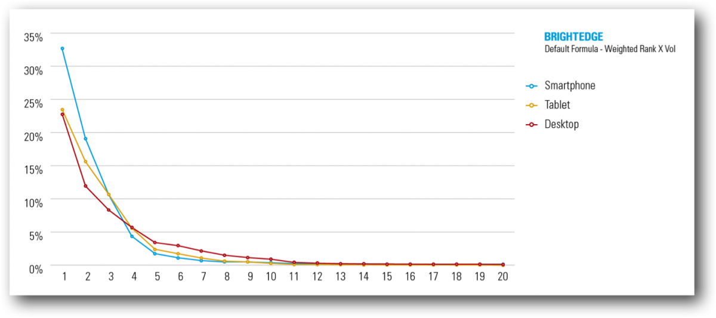
There is a BIG Difference in Smartphone vs Desktop Rank
Smartphone Search Results in Positions #1-3 Receive
44%
More Clicks than in Desktop SERP
Notes:
Key points to hit:
So we are seeing a pattern. The presence of the Local 3 Pack in the SERP will pretty much devastate the expected click through rates of the classic results underneath.
In fact our research shows up to a 69% decrease in CTR for classic results when a 3 pack is present. This makes sense considering the premium position of the 3 pack typically, and the amount of SERP real estate it occupies.
The big overall takeaway is that you have to be in the Local 3 Pack to have the most impact on the I Want To Go moment

Slide 10
FOCUS ON SITE SPEED
Notes:
Rachelle to transition to Jonny

Slide 11
Who is confident that their mobile site is properly optimized for the mobile first index?
Place Holder - POLL
Options:
Completely confident
Fairly confident
Not confident at all
What’s the mobile first index?
Notes:
Jonny

Slide 12
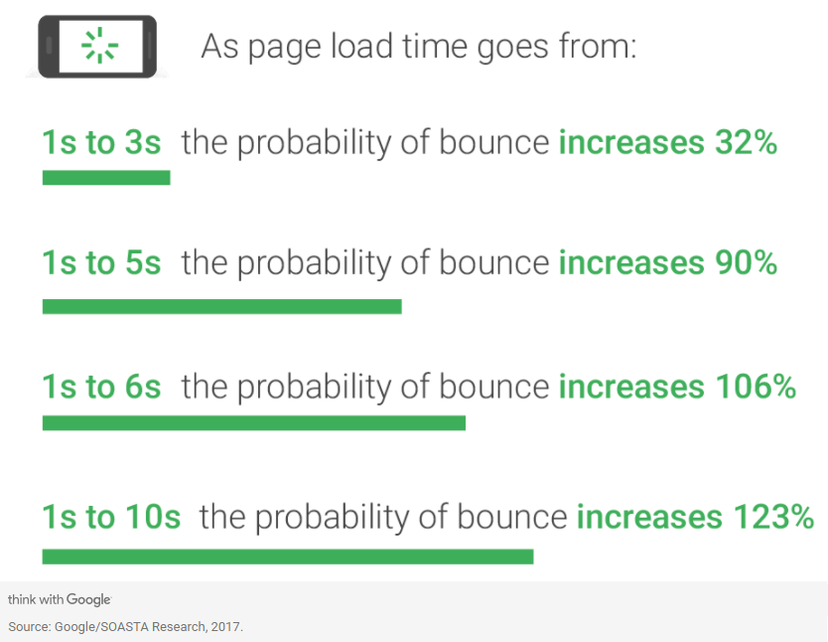
Site speed affects mobile performance a lot!
70% of cellular connections will be at 3G or slower through 2020 (thinkwithgoogle.com)
Notes:
Jonny

Slide 13
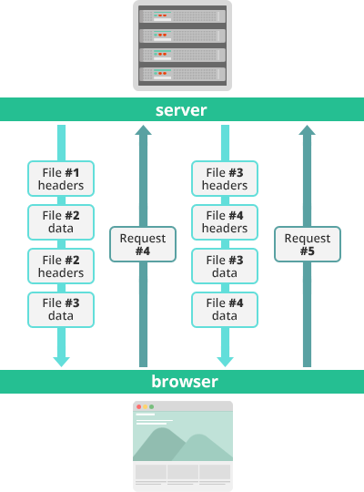
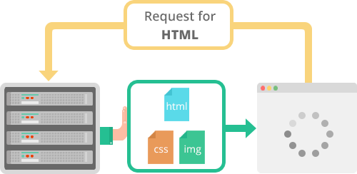
Enable HTTP/2 (Multiplexing)
Multiplex Streams – HTTP/2 allows for multiple requests at the same time, therefore speeding up the process of delivering web pages and content.
Server pushing – allows additional resources to be sent to a client for future use
Prioritization – allows requests to be assigned depending on their level of importance to a particular web page
Header compression with HPACK compressions also reduce overhead
Multiplexed Streams
Server Pushing
Notes:
Jonny

Slide 14
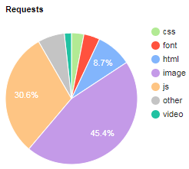
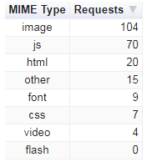
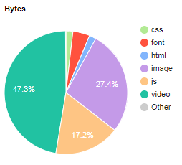
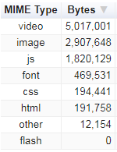
Condense and defer specific content
Once Mobile Responsive, ensure that your site serves up the correct content first, necessary to the page load.
Example speed optimizations:
Defer JavaScript parsing
Combine images using CSS sprites
Minify CSS
Minimize Redirects
Leverage browser caching
Notes:
Jonny

Slide 15
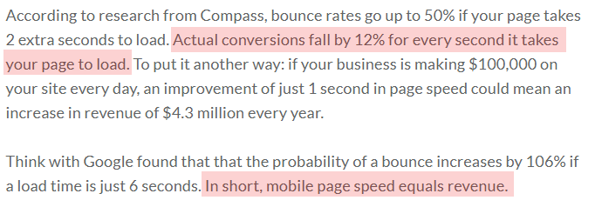
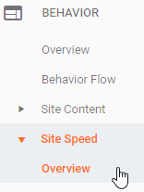
Test and track
Continue to track site speed changes over time
Improvement in site speed should be increase conversion rate, rankings (by improving “time to first byte”), and decreases in bounce rate, especially on mobile
Test site speed: https://developers.google.com/speed/
Track in Analytics:
Source: DeviceAtlas.com
Notes:
Jonny

Slide 16
OPTIMIZE FOR MOBILE
Notes:
Jonny

Slide 17
How many of you actively optimize for mobile (more than implementing a responsive design)?
Place Holder - POLL
Options:
We actively pursue improvements for mobile
Sometimes addressed but not a focus
Very rarely
No changes or none since going mobile responsive
Notes:
Jonny to transition to Rachelle

Slide 18

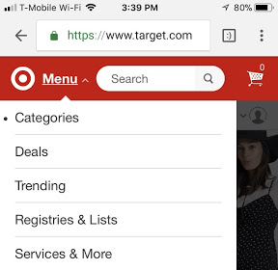
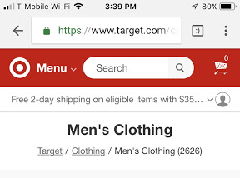
Make sure that you include the essentials
A clear, above the fold, page title
Static, global site search feature
A simple, condensed category menu
A clear, above the fold CTA
Notes:
Rachelle

Slide 19
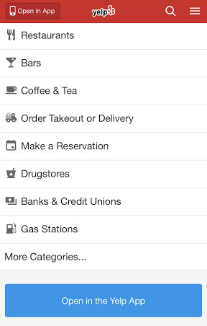

Don’t prevent user navigation
Barrier pages, full-screen interstitials, or any forced action can cause mobile users to bounce from your site at an extremely high rate, regardless of their entry channel
VS.
Notes:
Rachelle

Slide 20
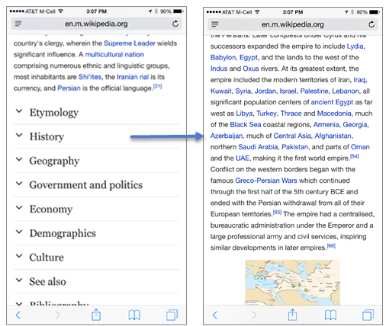
Duplicate optimized desktop content on mobile
“the impact of mobile-first indexing will come into play if your mobile and desktop sites are significantly different”
All content creation and optimizations should be performed on mobile as well
Design website for mobile experience first
Include relevant structure markup on mobile version of the site (if not covered by responsive design)
Employ design tools to make long-form content on mobile digestible by users; e.g. accordions to break apart page sections
Notes:
Rachelle

Slide 21
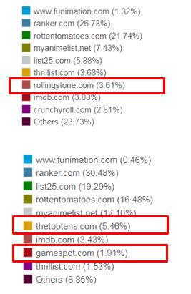
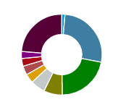
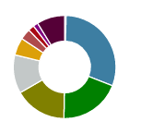
Competitive Landscape may be substantially different
Desktop
Track Mobile closely to drive optimizations:
Target the right terms specific to mobile
Understand future competitive landscape
Accurately represent how market share will distribute with the new mobile index
Mobile
Notes:
Key points to hit:
So we are seeing a pattern. The presence of the Local 3 Pack in the SERP will pretty much devastate the expected click through rates of the classic results underneath.
In fact our research shows up to a 69% decrease in CTR for classic results when a 3 pack is present. This makes sense considering the premium position of the 3 pack typically, and the amount of SERP real estate it occupies.
The big overall takeaway is that you have to be in the Local 3 Pack to have the most impact on the I Want To Go moment

Slide 22
ACCELERATED MOBILE PAGES CAN HELP
Notes:
Jonny

Slide 23
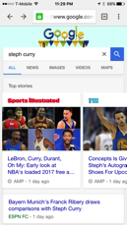
Test AMP for performance and site-speed
AMPs can be made the default version of your site if your m.web site is outdated or vastly different from your desktop version, or if your responsive mobile site is severely underperforming
AMP is an open-source project initiated by tech companies and content publishers
Content loads instantly on mobile
Requires tagging pages for AMP specs
AMP-enabled pages in search results display lightning bolt icon
AMP pages are 4x faster, use 10x less data vs. non-AMP pages
+1sec +50%
load time bounce rate
Top Stories
AMP-enabled
Rich Cards
Notes:
- BrightEdge customer Food Network featured as example of AMP-enabled website: https://amphtml.wordpress.com/2016/08/02/amp-your-content-a-preview-of-amped-results-in-google-search/amp/

Slide 24
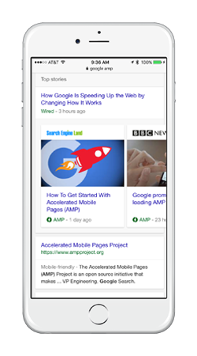
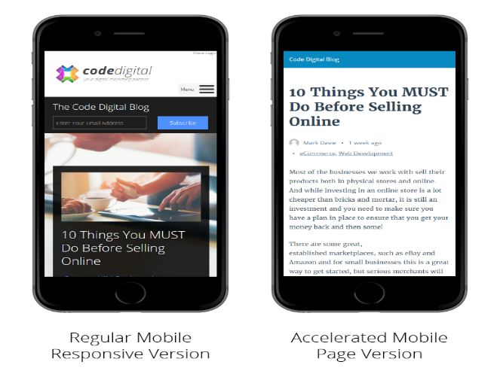

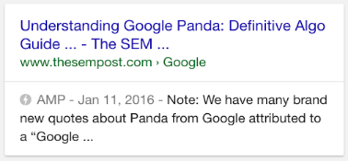
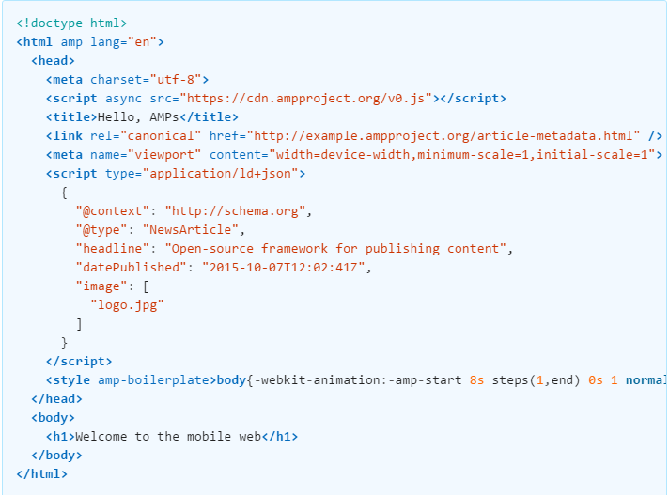
AMP Implementation can render more than one organic result for mobile
An AMP result can render 3 different results for the same page in mobile; e.g. AMP result for Top Stories, AMP result in text results, original mobile version of page in text results
The AMP logo on the SERP entails higher click through rate, as users associate it faster load time
AMPs can be applied to videos, blogs, product pages, etc.
AMP HTML Markup
Notes:
Rachelle

Slide 25
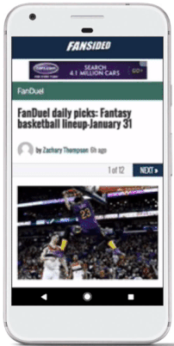
Test AMPs for Paid Media
The use of AMPs should be at least tested for Paid Search ads and GDN
Display Ad on AMP-enabled page
Test performance of AMPs against normal mobile pages utilizing the Adwords Beta (this could be especially impactful for shopping)
AMPs have default placements for ads from GDN and should be utilized for live pages that have proven to drive traffic and increase user retention
Notes:
Rachelle

Slide 26
IDENTIFYING OPPORTUNITY
Notes:
Jonny to transition to Rachelle

Slide 27
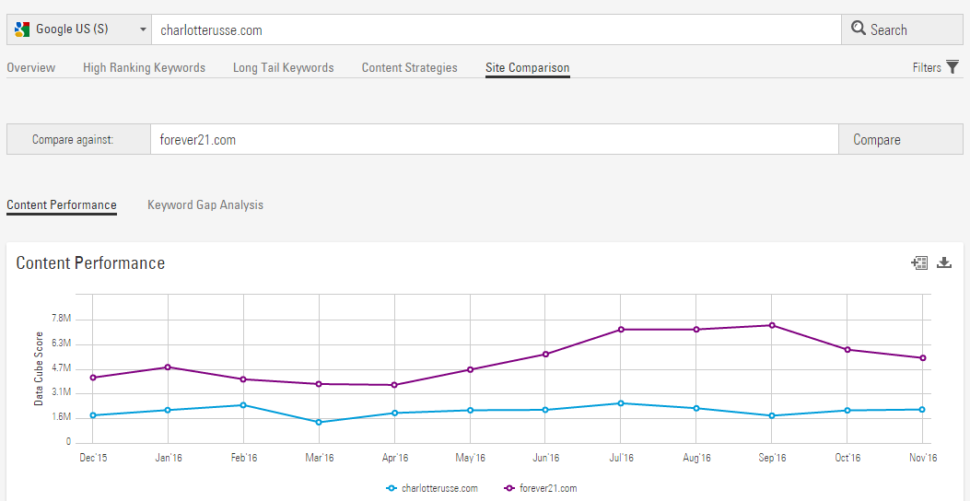
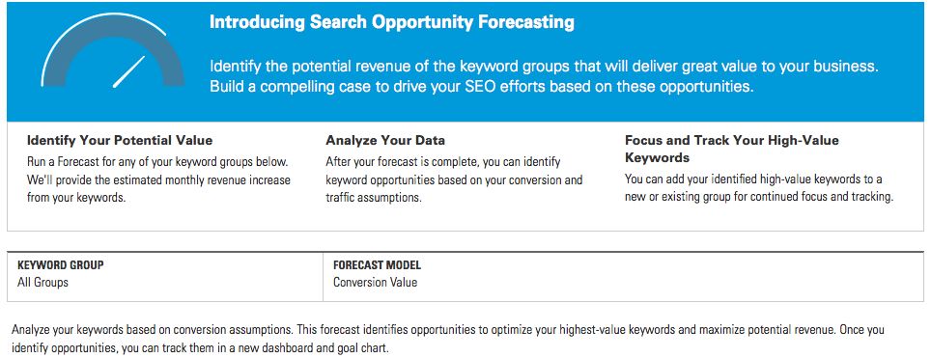
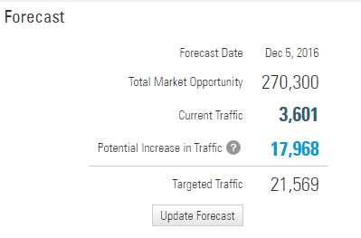
Identify Mobile Opportunity and Show Mobile ROI
Conduct Mobile Keyword Research and Content Gap Analysis in Data Cube Smartphone
Run Mobile Opportunity Analysis to quantify Traffic/Revenue potential (if Mobile is account’s Default Search Engine)

Slide 28
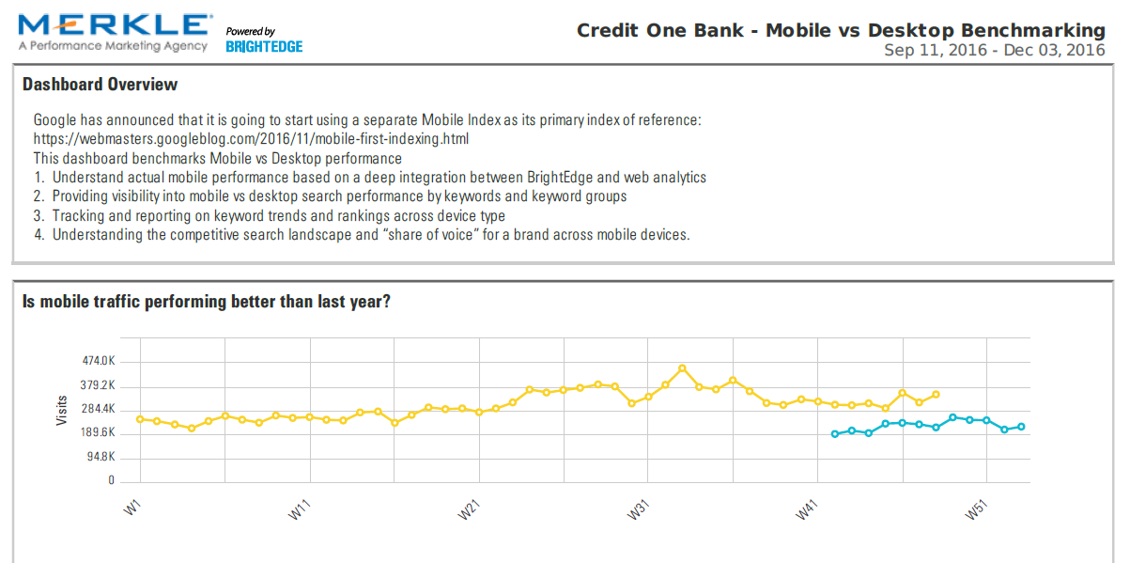
Start benchmarking the growth in mobile

Slide 29
Next Steps
Step 1: Ensure that your mobile and desktop version of your site are as identical as possible. Employ responsive design, to reduce preferential placement of responsive sites in SERPs
Step 2: Make Site Speed a priority
Step 3: Optimize mobile content first (including design changes)
Step 4: Test the use AMPs with both your SEO and Paid Media teams for performance
Step 5: Track and measure the organic keyword opportunity on mobile
Notes:
Jonny

Slide 30
QUESTIONS?
Notes:
Jonny

Slide 31


THANK YOU
NEW YORK CITY
LOS ANGELES

