Slide 1


Solution Guide to Local SEO
#brightedgewebinars

Slide 2
Mark Aspillera Growth Marketing
BrightEdge
Ben Brockhaus
Professional Services
BrightEdge
#brightedgewebinars
Notes:
Add notes for self introduction (< 1min each)
Carolyn to add from web content.

Slide 3
What is Local SEO?
Optimize your site and content strategy to target local audiences
Site Structure: Search engines must be able to find your most important pages
Local 3-Pack Optimization: Following the best practices to give us the best chance at showing up consistently in the Local 3-Pack
On-Page Elements: Successful keyword targeting is thorough and consistent in HTML
Off-Page Elements: Off-page links and visibility are essential to compete in local search
Mobile Experience: Mobile friendliness will significantly impact rankings
#brightedgewebinars
Notes:
[Mark]

Slide 4
Why Local SEO is important
#brightedgewebinars
Notes:
Source - https://blog.hubspot.com/marketing/local-seo-stats
[Mark]

Slide 5
Relevance
Distance
Prominence
Local Search
Criteria
#brightedgewebinars
Notes:
[Mark]
Local results are based primarily on relevance, distance, and prominence. These factors are combined to help find the best match for your search. For example, Google algorithms might decide that a business that's farther away from your location is more likely to have what you're looking for than a business that's closer, and therefore rank it higher in local results. Source: https://support.google.com/business/answer/7091?hl=en
NAP Consistency
Page Authority
Domain Authority
Reviews (recency and volume)
Locally Relevant Inbound Links
CTR
Proximity
Mobile Friendly

Slide 6
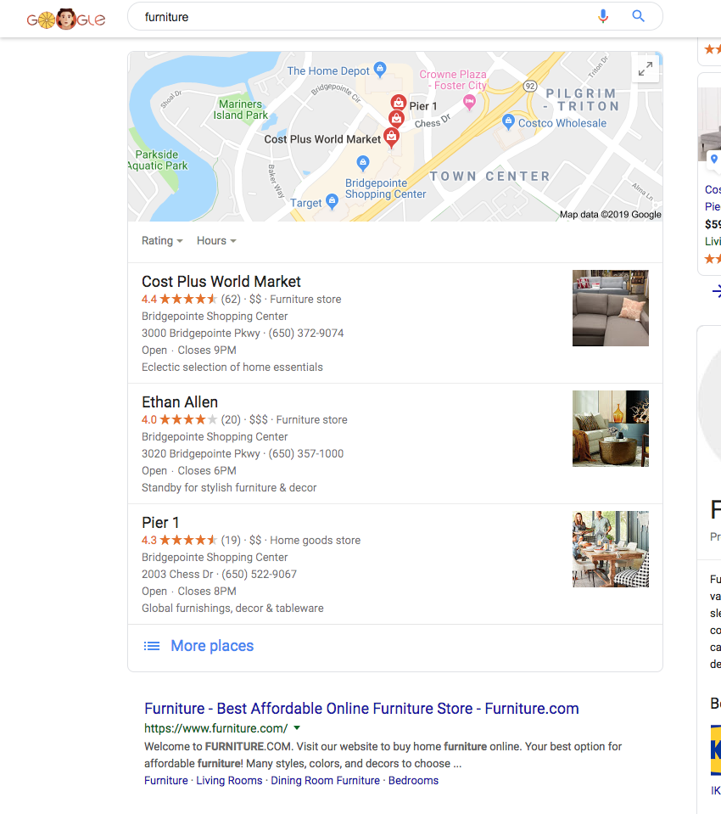


Local 3-Pack gets most of the local clicks
GMB, websites, directions, click to call (on mobile)
—
2/3
Of the organic clicks are received by the listings in local 3-pack
69%
Lower CTR for the classic listings
when there is a local 3-pack
#brightedgewebinars
Notes:
[Mark]

Slide 7
The Result
A complex, ever-changing algorithm with varying results from day-to-day
Many factors that influence both traditional organic and Local 3-Pack results
Requires continued attention to stay above the fold, maintain organic position
#brightedgewebinars
Notes:
Image source - https://www.chatmeter.com/blog/2018-local-ranking-factors/
[Mark]

Slide 8
Local SEO Best Practices
#brightedgewebinars

Slide 9
Best Practices for Local SEO
On-going – Gather recent reviews, monitor listings sites, and consistently refresh unique elements to local pages
Follow this simple framework to win in local markets
Build up reviews on GMB, Yelp, and Facebook primarily – then top review sites for your vertical
Add NAP to Listing and Review Sites (GMB, Yelp, Facebook, and aggregator sites are most important for all verticals)
Create Individual Local pages on your site - make each page unique
Gather NAP for each location (name, address, phone, website, hours, etc.)
Notes:
[Mark]

Slide 10
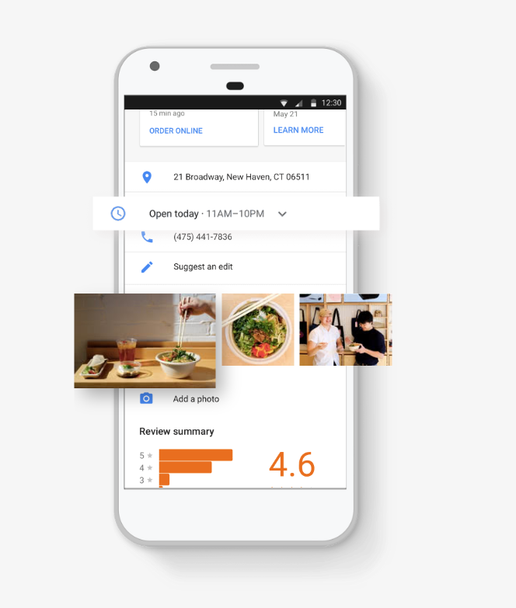
What is NAP and why is it important?
Gather NAP for all store locations
NAP is Name, Address and Phone Number, but more broadly means all location details, such as photos (outside, inside), categories (fits closely to business as possible), website (use individual location page), social sites
Problems if not Accurate:
Can cause duplicate listings
Creates a bad user experience
Makes it harder for search engines to find the proper page
Notes:
[Mark]

Slide 11
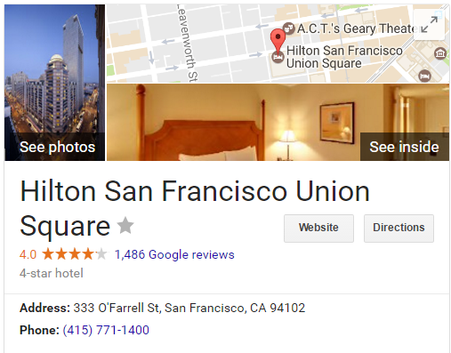
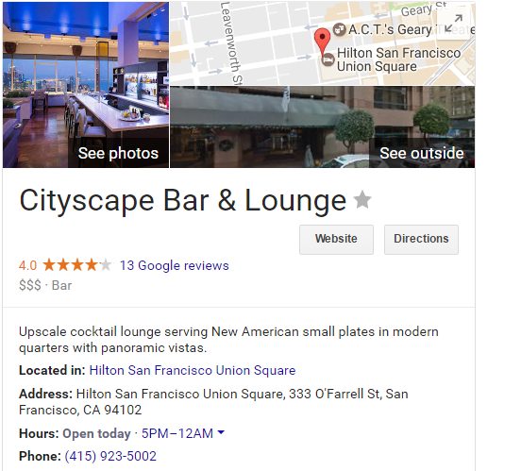
Google My Business Listings – Category Guidelines
DO
Be very specific with Primary Category; for example, Hotel or Conference Center
DON’T
Use categories that are services or amenities; such as, swimming pool or fitness center
Use redundant categories like motel, hotel, or resort hotel
List restaurant or bar as a category. These typically have their own listings
Source: https://support.google.com/business/answer/3038177
Notes:
[Mark]
“Choose the fewest number of categories it takes to describe your overall core business.”
DO Important to be very specific with Primary Category
Use: Hotel, Conference Center, for example
Don’t use categories such as swimming pool, fitness center, etc. Those belong in the Amenities.
Don’t use redundant categories like motel, hotel, resort hotel, etc.
Don’t list restaurant or bar as a category. These typically have their own listings, so it is not necessary.
Important to be very specific with Primary Category https://support.google.com/business/answer/7249669?hl=en
Source: https://support.google.com/business/answer/3038177

Slide 12
Listings
For each Listing Site, make sure:
Listing is verified
Listing is 100% complete
Listing is accurate and consistent with website and other online citations
Notes:
[Mark]

Slide 13
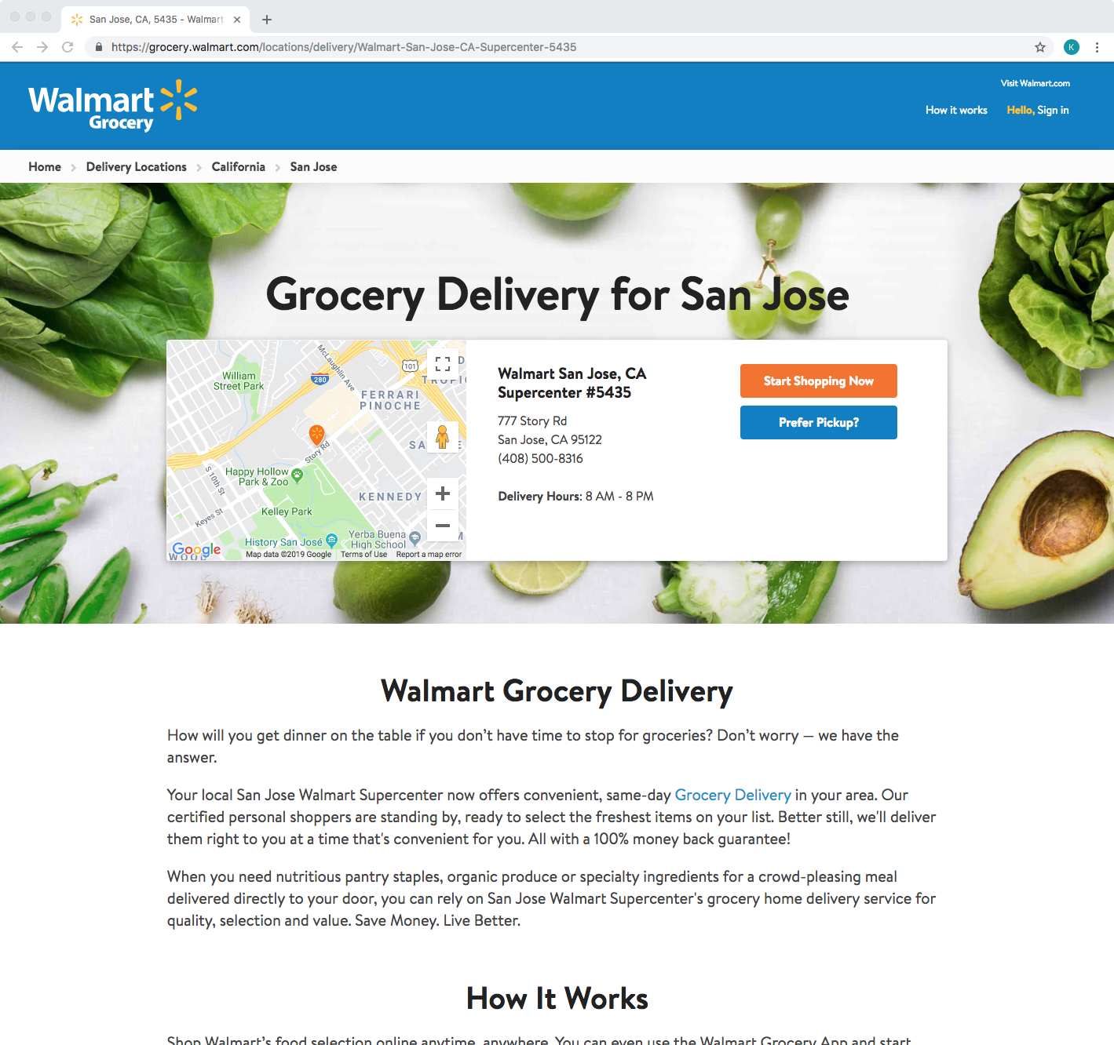
How to build Local Pages on your site
Create a unique local page for each location
Mark NAP with Schema
Local hours
Map
Location Description
Stream reviews
Testimonials specific
Markup 1st party reviews with Schema
Landmarks
Directions
Local events
Notes:
[Ben]
NAP needs to be marked up with Schema
Why — extra signal to search engines on what it is
Local hours
Dept or services can vary
Have a map — Google Map (easy implementation)
Import a stream of reviews
Testimonials specific
Markup 1st party reviews with Schema
Landmarks, directions (two miles north near a certain park) specific to that location
Local events

Slide 14
Mobile Friendly Site
Slow Page Load Time Can Drastically Decrease Conversions
53% of mobile users leave a site that takes longer than three seconds to load
(2018 research by Google)
Notes:
[Ben]
Because of the importance of page speed on user experience, Google rolled out anew page speed update to their algorithm in July 2018. This makes speed a critical factor for everyone.
On Google 30% of mobile searches have “local intent” (searchengineland)
(searchengineland)

Slide 15
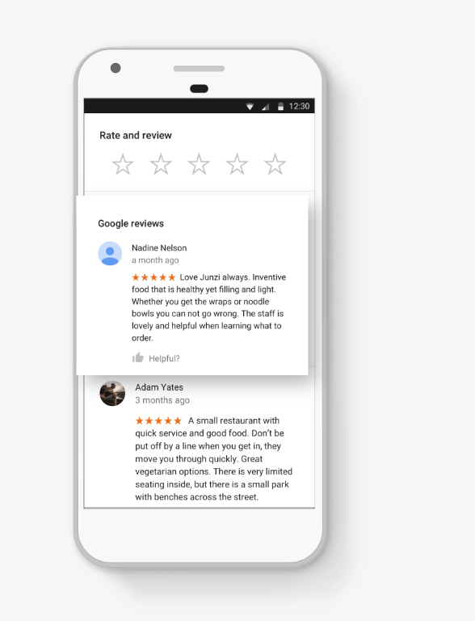
What are Review Sites
Google My Business, Yelp, Facebook, and TripAdvisor (for some) are they most used sites for reviews
Find vertical specific sites
Automotive
Cars.com, Edmunds.com
Healthcare
Healthgrades, WebMD
Hospitality
TripAdvisor, hotels.com, booking.com
Notes:
[Mark]
https://moz.com/learn/seo/citations-by-category

Slide 16
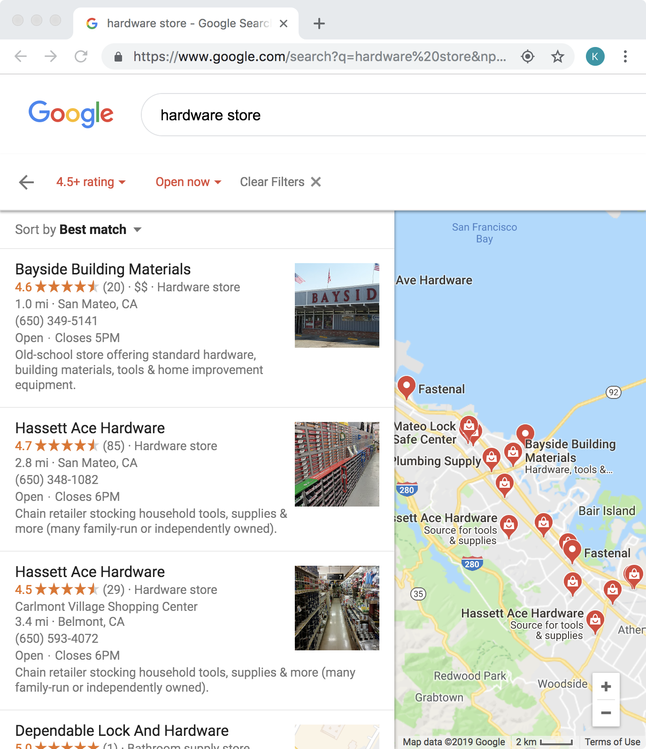
Why reviews are important?
Increase CTR from SERP
Customer trust and validation
—
72% say that positive reviews make them trust a local business more
Notes:
[Mark]
Recency factor – how does this help with ranking in Local 3-pack
Customers require recent reviews as validation
Increase CTR from SERP
Volume and recency help increase rank in local 3-pack
Filter on star rating
Customer validation –
Source -- https://www.invespcro.com/blog/the-importance-of-online-customer-reviews-infographic/

Slide 17


Best practices to get more reviews
Ask!
DO Send customers an email and ask for a review after they have interacted with your location – whether is it staying at a hotel or getting your car serviced
DO contact customers within a few days of of their interaction
DON'T offer incentives - most people will do it for free
DON’T only get positive reviews – it is important to have mostly good (4-5), but mix of medium (3) and even bad (1-2) creates authenticity and trust with consumers and search engines
Notes:
[Mark]
On the flip side, 85% of consumers look for negative reviews in order to make informed purchase decisions. And this number skyrockets to 91% among consumers from the ages of 18-29. Why? Because bad reviews give customers a sense of the worst-case scenario. They want to know what can go wrong to understand just how much it will matter to them. Too many positive reviews can seem fake to some shoppers, so you have to watch out. https://neilpatel.com/blog/your-business-needs-negative-reviews/
67% of B2B buyers want to see a mix of positive and negative reviews (G2 Crowd and Heinz Marketing, 2017)
Up to 80% of reviews originate from follow-up emails urging shoppers to review their purchases (Power Reviews, 2017)

Slide 18
Backlinks
Validates you’re a reputable and trustworthy site
Engage with other local business and community to promote your business and location
Ads or news published in local newspapers
Promote contests, events, or promotions
Nominate for the “Best of” for each city
Sponsor local events
Partner with local bloggers or local influencers to write about location
MY TOPIC
+4
Notes:
[Ben]
In fact, 67% of people rely on their local paper for local news, and we trust it more than what we see on Facebook. Why not take advantage of that and use these local publications to showcase your business? Source: https://blog.monitorbacklinks.com/seo/local-seo/

Slide 19

Things to keep in mind
Ensure each location page is indexed by Search Engines
Have one page with all locations a few clicks from the home page
Each location page needs to have breadcrumbs
Include all pages in your XML sitemap
Notes:
[Ben]
Have one page with all locations a few clicks from the home page
Each location page needs to have breadcrumbs – clear internal navigation — makes it easy for search engines to find each location
Can still have Zip Code entry, but for SEO it is important to also have a list of locations
Make sure all location pages are included in your XML sitemap

Slide 20
Technical Local SEO
Advanced SEO

Slide 21
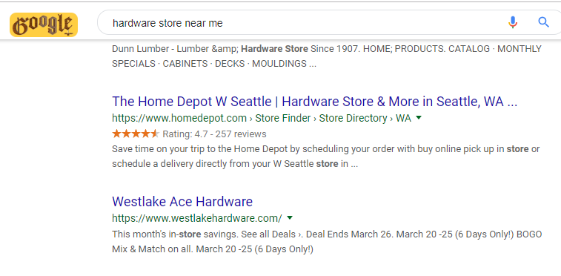
Schema.org Markup
Marking up pages with Schema.org structured data helps search engines better understand the entities/topics presented on a webpage, and can increase real estate/richness on the SERPs
Using Local Business schema on your location pages will allow Google to better understand:
Business name
Phone number
Location
Hours
Business type
Review stars rating
Menus, Departments, Reservations
More
For example, marking up a page with review stars can result in increases of up to 28% CTR from SERPs:
#brightedgewebinars
Notes:
[Ben]
The image schema that allows images to be shown in search results and the Knowledge Graph is a required field for Schema.org protocol
Other markup opportunities exist, including aggregateRating or starRating, which can draw attention to your listing in the results pages.
Showing ratings with your listing can result in increases of up to 28% CTR from SERPs.
aggregateRating reflects user generated reviews on a numeric scale.
starRating is an alternative if you don’t want users to weigh in on your properties. starRating is based on an official rating (e.g. HOTREC, DEHOGA, WHR, or Hotelstars). priceRange, GeoCoordinates, and Corporation should also be considered

Slide 22
Schema.org Markup & JSON-LD
Google has suggested that they prefer markup to be done in JSON-LD format rather than microdata, RDFa, etc.
Using JSON-LD is the easiest structured data to implement on your page, requires least amount of effort from developers
Use Google Structured Data Testing Tool to test and validate structured data:
https://search.google.com/structured-data/testing-tool
<script type="application/ld+json">
{
"@context": "http://schema.org",
"@type": "Hotel",
"name" : "ACME Hotel Innsbruck",
"description" : "A beautifully located business hotel right in the heart of the alps. Watch the sun rise over the scenic Inn valley while enjoying your morning coffee.",
"address" : { "@type" : "PostalAddress",
"addressCountry" : "AT",
"addressLocality" : "Innsbruck",
"addressRegion" : "Tyrol",
"postalCode" : "6020",
"streetAddress" : "Technikerstrasse 21"
},
"telephone" : "+43 512 8000-0",
"photo" : "http://www.acme-innsbruck.at//media/hotel_front.png",
"starRating" : { "@type" : "Rating",
"ratingValue" : "4"},
"priceRange" : "$100 - $240"
}
</script>
#brightedgewebinars
Notes:
[Ben]

Slide 23
Decrease Page Load Times
Things to check:
Page Load Size
Recommendation of under 500 KB
Location Page load time on a first visit
Should be under 3 seconds
Images size
Convert them to compressed .jpg
Javascript
Move CSS rules or JavaScript snippets into an external file
Cache your pages
Simplify redirects
Use a Content Delivery Network, or CDN
#brightedgewebinars
Notes:
[Ben]
[1] https://blog.kissmetrics.com/loading-time/
[2] https://www.portent.com/blog/design-dev/ultimate-site-speed-guide-why-site-speed-matters.htm
Source - https://neilpatel.com/blog/speed-is-a-killer/
Sources to test site:
https://www.thinkwithgoogle.com/feature/testmysite
ContentIQ

Slide 24
Keyword Discovery and
Reporting in BrightEdge

Slide 25
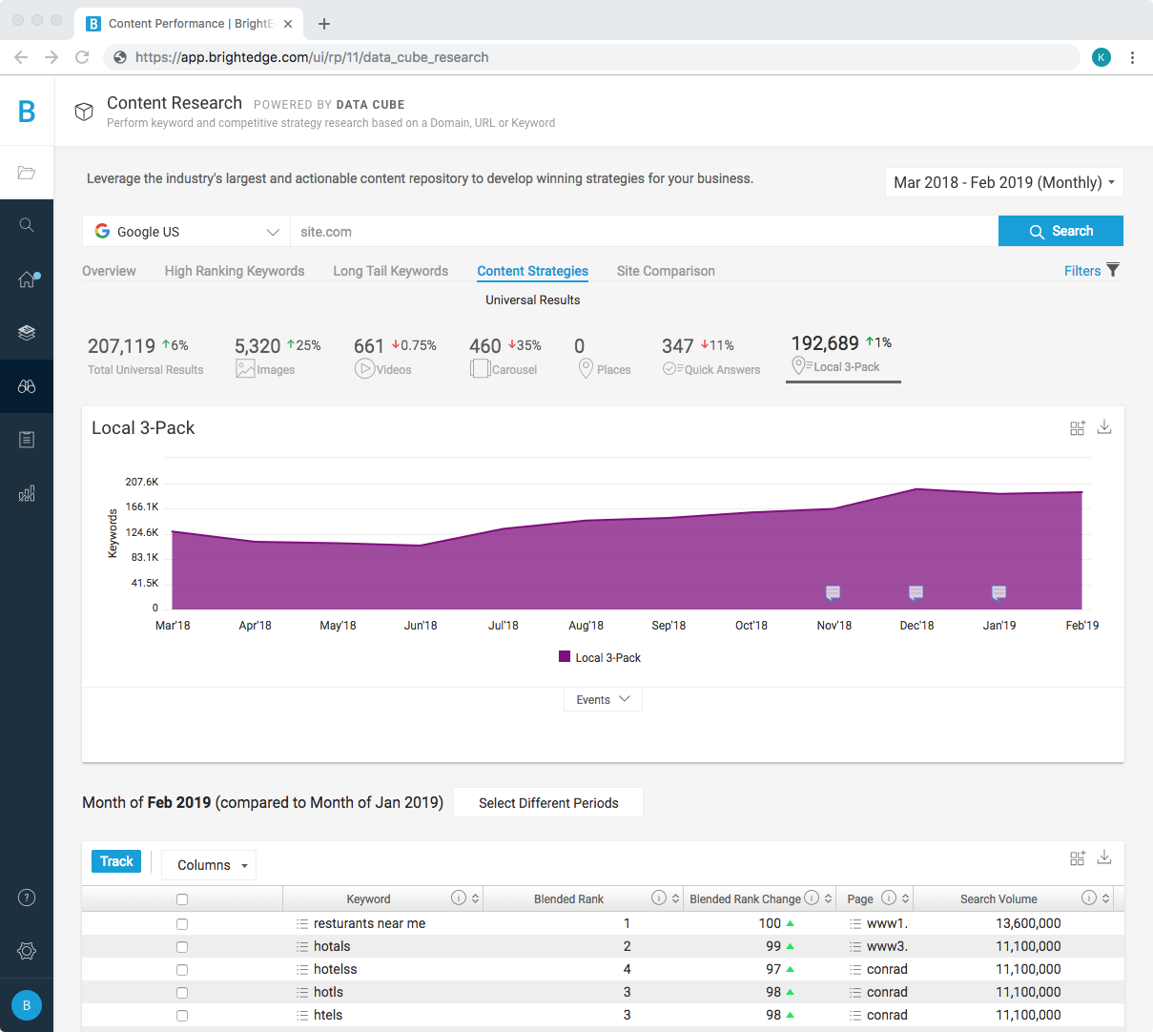
Discover Keywords with Local Intent
Go to Data Cube to discover Keywords with Local Intent
Enter your domain → Content Strategies → Local 3-Pack
Track keywords based on best practices (relevant to business, right spelling, etc.) – add to a Local Keyword Group
#brightedgewebinars
Notes:
[Mark]

Slide 26
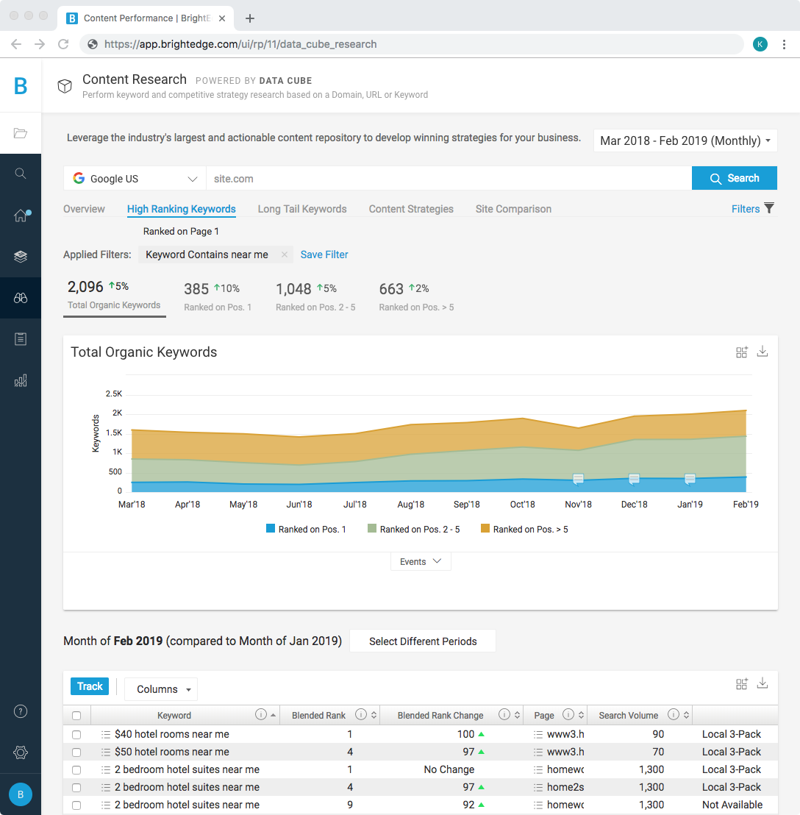
Discover Keywords with Local Intent
Go to Data Cube to discover Keywords with Local Intent
High Ranking Keywords → Filter for Keyword Contains “near me” or “[city name]” or “[landmark]”
Also, look for head terms that are unique to your offering, for example, sewer line repair
Track keywords based on best practices (relevant to business, right spelling, etc.) – add to a Local Keyword Group
#brightedgewebinars
Notes:
[Mark]

Slide 27
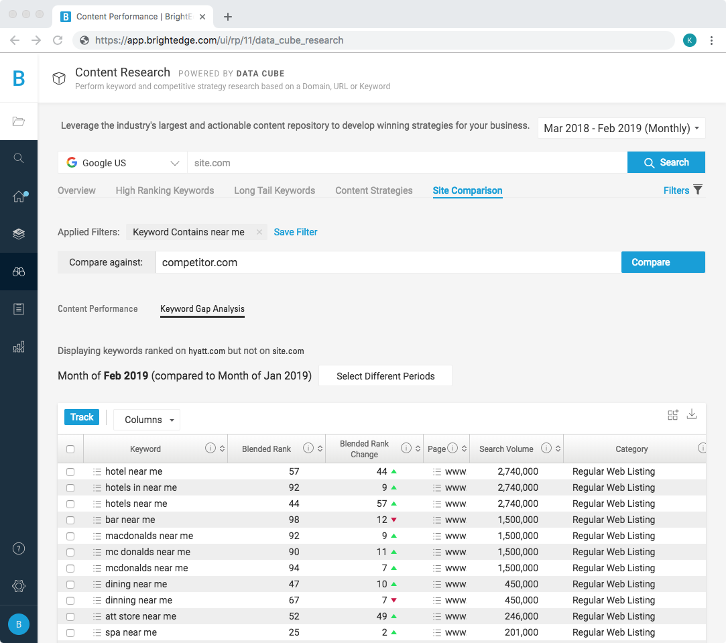
Discover Keywords with Local Intent
Go to Data Cube to discover Keywords with Local Intent
Site Comparison → Enter competitor domain → Filter for the same filters you used previously to find high-value keywords you rank for
Track keywords where your competitor is ranking and your are not that are relevant to your business – add to a Local Keyword Group
#brightedgewebinars
Notes:
[Mark]

Slide 28
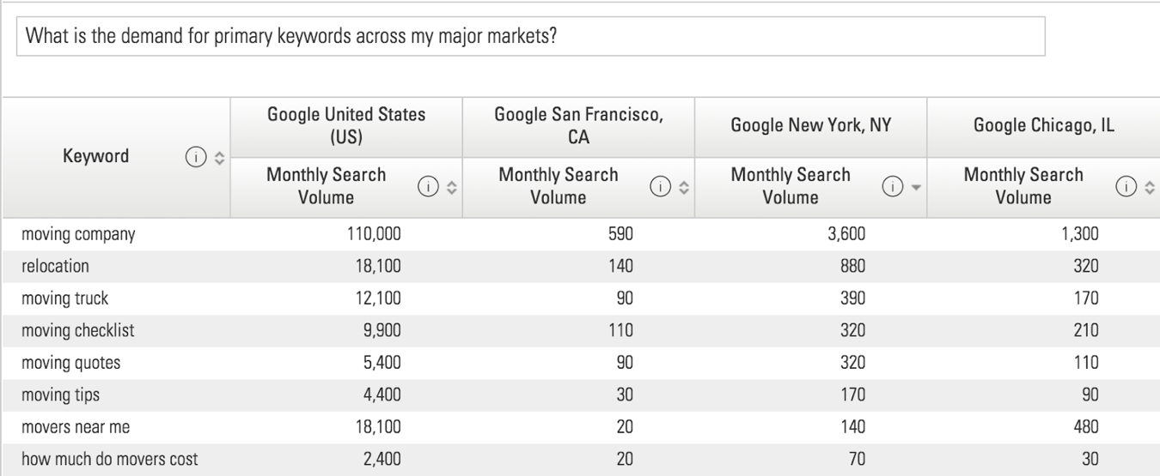
HyperLocal Search Engines
76k local search engines across desktop and mobile
Understand how your organic performance in local search is influencing visits and conversions on-premise. Track organic performance for the specific search engines closest to your brick and mortar locations so that you can optimize to better show up in local search.
#brightedgewebinars
Notes:
[Mark]

Slide 29
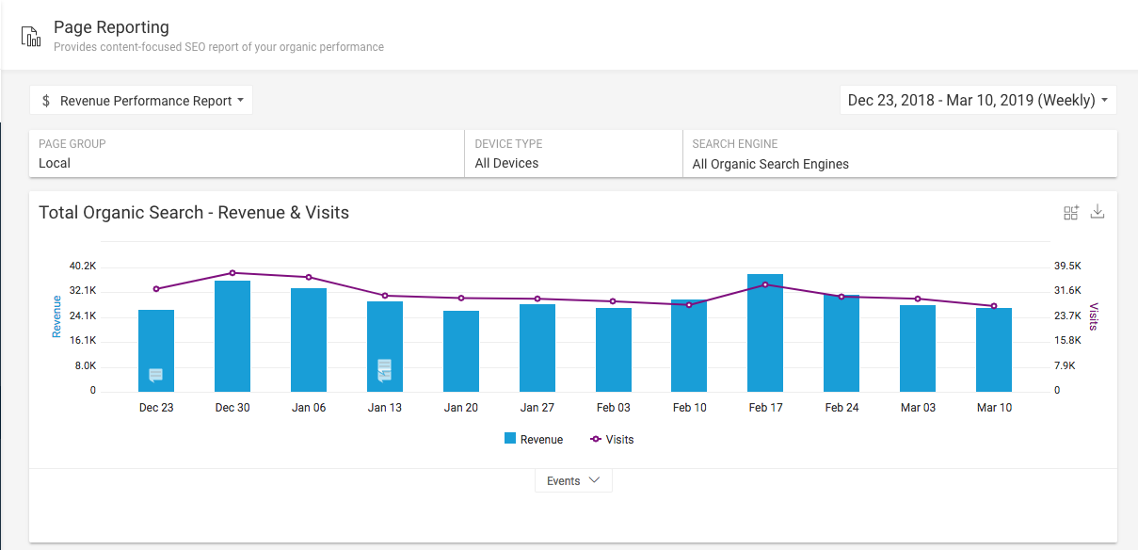
Create Local Page Group
Add all location pages into one group to help monitor and track progress
#brightedgewebinars
Notes:
[Mark]

Slide 30
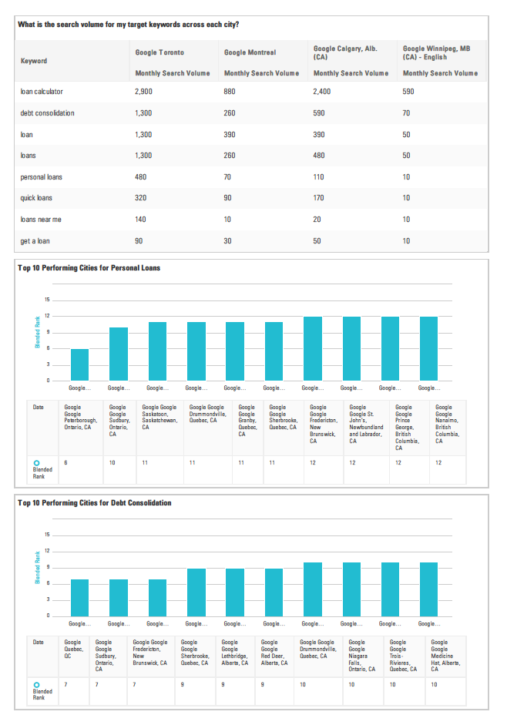
Local Reporting
Create a Dashboard to monitor local progress, find successes, and areas to improve
You can create them by region or location to help simplify the dashboard and reporting out to local stakeholders
Charts to add:
Revenue (or conversion point) against traffic
Keywords ranking on page 1-10
Share of Voice (this week and over time)
Local 3-Pack opportunity vs. secured look at all keywords
#brightedgewebinars
Notes:
[Mark]
Dashboard → Create new Dashboard
You can create them by region or location to help simplify the dashboard and reporting out to local stakeholders
Charts to add:
Revenue (or conversion point) against traffic
Use Local Page Group
Keywords ranking on page 1-10 *use Local Keyword Group
Share of Voice (this week and over time) *use Local Keyword Group
Local 3-Pack opportunity vs. secured look at all keywords

Slide 31
KEY TAKEAWAYS

Slide 32

Key Takeaways
Accurate local data is most critical element
Monitor listings on all major sites
Build reviews – always need to have less than 30 days old
Create unique local pages
Monitor consumer changes with hyper local search data
#brightedgewebinars
Notes:
[Mark]

Slide 33
THANK YOU!
#brightedgewebinars
@brightedge

