Slide 1
Launching Site Enhancements
That Yield ROI
BrightEdge Elevating SEO Series Part 3

Slide 2

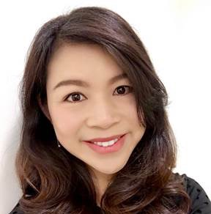
PRESENTERS
Mark aspillera
CAROLYN BAO
Manager, Digital Marketing
BRIGHTEDGE
Sr. Director, Product Marketing
BRIGHTEDGE
Notes:
Under a minute of self introduction
-- Good morning everyone, thank you for attending today’s webinar. My name is Carolyn Bao. I’m the Sr. Product Marketing Director at BrightEdge. As a digital marketer who’s been in the industry for almost over a decade, I’ve learned to appreciate the importance of SEO, and as an ex-customer of BrightEdge, I’m convinced that every digital marketer can benefit from utilizing a comprehensive SEO platform like BrightEdge, to stretch the shelf-life of their digital content, and maximize their business impact.
- Hi everyone. I’m Mark Apillera. [fill in the blank]

Slide 3
01
02
03
04
Why launching site enhancements
Key steps to identify and implement site enhancements
Key players
Tools of the trade
SESSION OBJECTIVES

Slide 4


You know you own a website if you…
Have a backlog of 100+ items that you could tackle each week
Have limited resources at your disposal
Have to work cross-functionally to implement technical or structural changes, optimizations, web growth
Notes:
Although each company may have a slightly different way to structure the web development resources, most of us who run a marketing website share some common traits.

Slide 5
Poll - How is your web development resource structured?
In-house – no dedicated resources
In-house – one developer
In-house – several developers, managed through a program manager
3rd party – local web development agency
3rd party – remote web development agency

Slide 6
ROADMAP TO TUNE YOUR WEBSITE INTO A WELL-OILED MARKETING MACHINE
DCOM methodology
DISCOVER
CREATE & OPTIMIZE
MEASURE
KEYWORDS
*KW research - Data Cube
*KW Groups/ PLPs/ Page Groups/ Data Integration
*KW Prioritization - Intent Signal
CONTENT
* Competitive content gaps – Data Cube & Share of Voice
* Build business cases - Opportunity Forecasting
* Content gaps along Buyer’s Journey
* Optimize: existing content - Insights & Recommendations
* Create: new content - BrightEdge Content
* Launch: site enhancements – Insights & ContentIQ
* Customizable dashboards, trended charts & data-driven optimization – StoryBuilder
* Identify full list of keywords that each page ranks for – Site Report (GSC Data)
TECHNICAL ENHANCEMENT OPPORTUNITIES
– ContentIQ
Notes:
Aviator Sports: started with 50 severe errors (October, 2018)
A lot of current pages didn’t have meta description – all of the keywords should have meta description
Keyword density was flagged by ContentIQ – we enhanced content on these pages & improved.
Previously the pages were stuffed with keywords – 300 word copy…too short for inserting relevant keywords. 10% keyword density.
Removing stuffed keywords for the “Directions” page
Show ”basketball” page screenshot: before & after (Eliot)
Overall the growth of it…and seeing the daily leads & sidebar mentioning Google.
PPC campaign – give our PPC agency to refresh keyword list – monthly

Slide 7
ROADMAP TO TUNE YOUR WEBSITE INTO A WELL-OILED MARKETING MACHINE
DCOM methodology
DISCOVER
CREATE & OPTIMIZE
MEASURE
KEYWORDS
*KW research - Data Cube
*KW Groups/ PLPs/ Page Groups/ Data Integration
*KW Prioritization - Intent Signal
CONTENT
* Competitive content gaps – Data Cube & Share of Voice
* Build business cases - Opportunity Forecasting
* Content gaps along Buyer’s Journey
* Optimize: existing content - Insights & Recommendations
* Create: new content - BrightEdge Content
* Launch: site enhancements – Insights & ContentIQ
* Customizable dashboards, trended charts & data-driven optimization – StoryBuilder
* Identify full list of keywords that each page ranks for – Site Report (GSC Data)
TECHNICAL ENHANCEMENT OPPORTUNITIES
– ContentIQ
Notes:
Aviator Sports: started with 50 severe errors (October, 2018)
A lot of current pages didn’t have meta description – all of the keywords should have meta description
Keyword density was flagged by ContentIQ – we enhanced content on these pages & improved.
Previously the pages were stuffed with keywords – 300 word copy…too short for inserting relevant keywords. 10% keyword density.
Removing stuffed keywords for the “Directions” page
Show ”basketball” page screenshot: before & after (Eliot)
Overall the growth of it…and seeing the daily leads & sidebar mentioning Google.
PPC campaign – give our PPC agency to refresh keyword list – monthly

Slide 8

Steps to managing your Technical website projects
Provide feedback and share results
Measure business impact
Implement
Secure commitment
Discover
#BrightEdgeWebinars
Notes:
Mark, I know that you’ve worked with many customers

Slide 9

STEP 1 - DISCOVER
Build your prioritized backlog
IDENTIFY - Build your backlog
  What’s wrong with your site
  What opportunities are present
PRIORITIZE - Triage the work to be done based on business impact
#BrightEdgeWebinars
Notes:
As a web owner it’s important to build your backlog, because in order to secure web dev resources, you need to know first and foremost what is the backlog you are tackling. Articulating what are issues to fix and what are opportunities to implement for greater growth of the business.
Then the next natural question in strategy phase is: prioritization.
Product tie-ins:
Data Cube, ContentIQ, Insights
Recommendations, Opportunity Forecasting, Insights
Emphasize Insights last, frame as overarching solution to help guide Digital Dani through 1. AND 2. gracefully

Slide 10
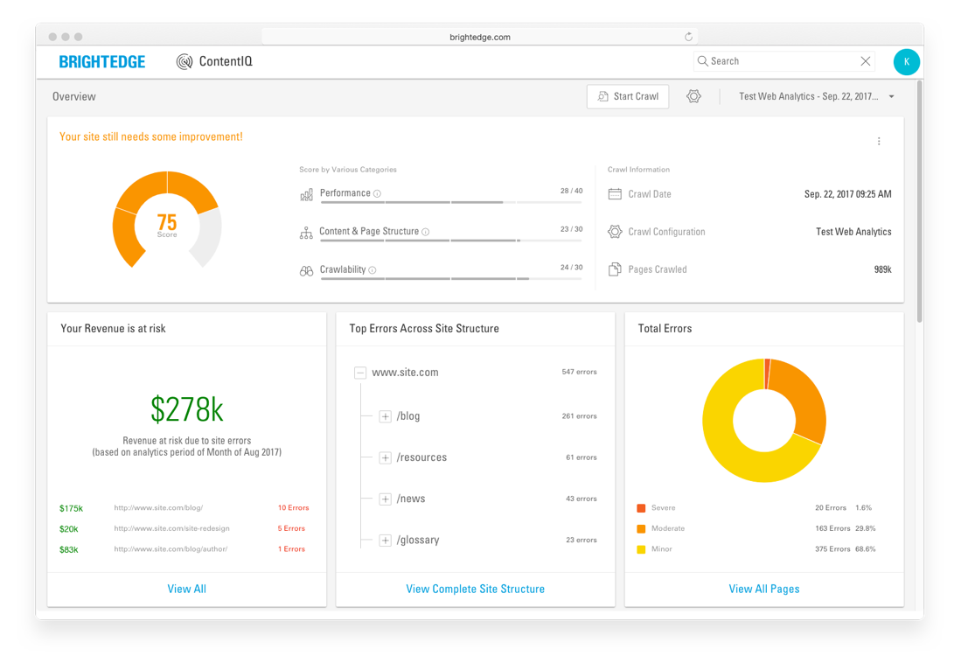
DISCOVER: WEBSITE ERRORS USING BRIGHTEDGE CONTENTIQ
ContentIQ is a Advanced site auditing solution to help identify website errors that cause poor UX and SERP visibility

Slide 11
DISCOVER: TECHNICAL ENHANCEMENT OPPORTUNITIES
Use site auditing solutions like ContentIQ to detect and fix most critical site errors first
1
2
3
Fix site-wide performance issues
Identify key
pages to fix first
Fix severe errors
on the key pages
Page loading speed too slow
No index
No follow
Redirect loops
Missing open graph tags
4xx errors
Prioritize pages with highest revenue or traffic
Selectively prioritize pages that are critical to business priorities
Missing or empty page title
Duplicated page title
Missing H1 tag
Low/high keyword density
Missing or empty meta description tag
Duplicated page content
Notes:
Mark: often you are asked “what’s your top 5”. So you want to be prepared to speak to that right away.
When it comes to prioritization, it can become complicated and overwhelming quickly.
However, perhaps a simple analogy will help.
Mark, I know you recently fixed your car. What’s what experience like and how it helps us to contextualize prioritization for the web?
[Mark] yes, at the very onsite, it’s very overwhelming. It feels like there are lots of things to do at once. When I was fixing my car, I quickly learned that
if you have a flat tire, it is more critical to fix that flat tire right away, than to upgrade the engine. The same philosophy applies to the prioritization of website technical projects.
[Carolyn] that’s right…this is why we developed this quick tool to help you prioritize.
[Mark] yes. First…then…then…then….
Here is a quick 5-step process to take full advantage of ContentIQ:
First make sure you establish baseline understanding of where you stand, before implementing technical SEO improvements. You can set up a weekly or monthly crawl of your entire site – this will make sure that you do not miss any page, and you then prioritize fixes for your entire site
Second, identify severe errors that impose site-wide performance issues, such as page loading speed, redirect loop, etc.
Third, use the page level metrics to identify key pages to fix. Thanks to the “marriage” with Google Analytics, ContentIQ results now include page level performance data, such as visits, conversion, revenue, and time on site.
Fourth, prioritize to fix the severe errors on these key pages, such as missing Title Tag, H1 tag, or duplicated content.
Fifth, use StoryBuilder to build dashboards that communicate your successes – show how making necessary site fixes and optimization efforts affect traffic, conversion and revenue

Slide 12

STEP 2 - SECURE COMMITMENT
The PM Hat™
Get buy-in and resources for your project(s)
  Understand your audience and how they operate
Tools for securing commitment
  Build a business case
  Explain feature requirements in the way they understand
Wear your product manager hat

Slide 13
Reality of The Mismatched Worlds
The “world” according to a web developer
The “world” according to you
Bugs
Web Enhancement Projects
Kill the Bugs!
Other stuff
Notes:
For web developers: they are mainly concerned about making sure that the website is error—free. What’s there on the site continues to work properly. This incentivizes them to put lots of efforts into churning the bug list.
For me, as a web owner, however; I need to ensure there are strategic website enhancements launched, to make bigger impact on the business and improving web visitor satisfaction & demonstrate my leadership. It’s a given that you’ll ensure that the website is error-free.
This natural division causes misalignment of prioritization between you and the web developer.
The level of emphasis that the developer & you give to these projects are therefore, different focus, as shown in this graph.

Slide 14
The key players WITH DIFFERING SKILLSETS
The wEb developer
Goals
  Ensure the website functions as designed
Success criteria
  Ensure “site up” time meets SLA
  Minimize % of bugs
Challenges
  Doesn’t have end-to-end insights into how their work impacts the business
  Go-to person for “things that broke”
  Rarely gets praised for the work they do – no news is good news
  Not always aware of SEO best practices
Core skills
  Technical skills
  Familiar with technical “User Story”
  Good at “closing out the tickets”
The developer
Digital marketing manager
The PM of the Web
Goals
  Drive more ROI from the website through constant deployments of site enhancements
Success criteria
  Increased traffic, conversions and revenue
  Increased website user satisfaction
Challenges
  Develop a prioritized backlog of projects
  Secure commitment from web dev team on enhancement projects
Core skills
  SEO, CRO and web content strategy
  PM skills
  Cheer-leader
  Communication skills
Notes:
Digital marketing manager core skills
PM skills – articulate business business case with data and describe feature requirements in a format that engineers understand
Cheer-leader – connect the technical work with business impact to praise the web dev team & motivate them to do more

Slide 15
Bugs
SLA: typically 24-48 hours
Urgency: Usually self-evident with no need to argue for extensive resource allocation
Communication vehicle: Bug ticketing system (Jira, Wrike, etc.)
Initiator: Website user, web developer, SEO Lead or Web Digital Marketing Lead
Examples
  Buttons don’t work
  Videos won’t play
  404s

Slide 16
WEB ENHANCEMENT PROJECTS
Digital growth opportunities
SLA: determined on case-by-case basis
Urgency: needs to be thoroughly explained & upsold to gain management support occasionally
Communication vehicle: User Story
Initiator: SEO or Web Digital Marketing Lead
Examples
  New page template
  Site redesign

Slide 17
“Be the ‘lawyer’ for your projects
Do the homework – quantify potential impact
Don’t be afraid to elevate up chain of command”
Neil Lunsford, Web Manager
Boston Medical Center

Slide 18
Poll – Where do your web developers spend most of their time?
Bugs
Web essential projects
Web enhancement projects
I don’t know

Slide 19

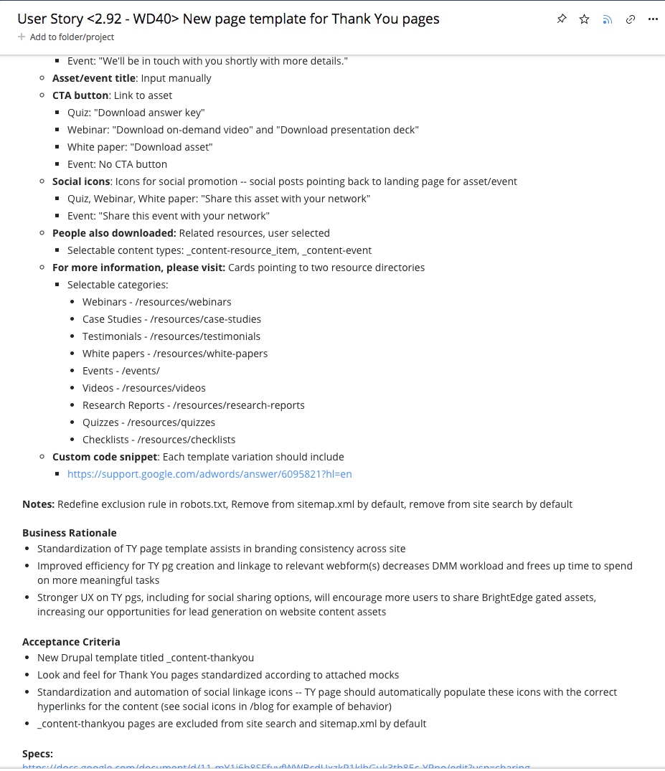
User Story:
Essential tool to secure commitment
Business rationale
Key features/functionalities
Acceptance criteria
Assets – copy & creative
Notes:
Key features/functionalities - What is this request adding, enhancing, or removing from the website?
Business rationale - How will it drive value for the organization?
Acceptance criteria - What needs to be done before it can be called complete?
Materials - All copy, images, mocks and technical specs, meta data
Your job is to distill a complex business need into a set of technical asks any developer can understand immediately, with well articulated business case

Slide 20
DESIGNER
Mock/wireframes
Design specifications
NEW PAGE TEMPLATE
MATERIALS REQUIREMENTS
STAKEHOLDER(S)
Finalize content copy
Sign off on design and implementation
WEBSITE OWNER
Guidance during ideation
SEO best practices
WEBSITE OWNER
User Story
All creative assets and content copy should be finalized by the time project reaches developer
Not having everything ready can result in blockers
Stakeholders: Drive the process of finalizing necessary assets for new content page
Designer: Support the new project asks with wireframe of visual concept, abiding web design guidelines
Web owner: Provide guidance in ideation phase. Develop User Story based on finalized assets
DEVELOPER
Final build

Slide 21
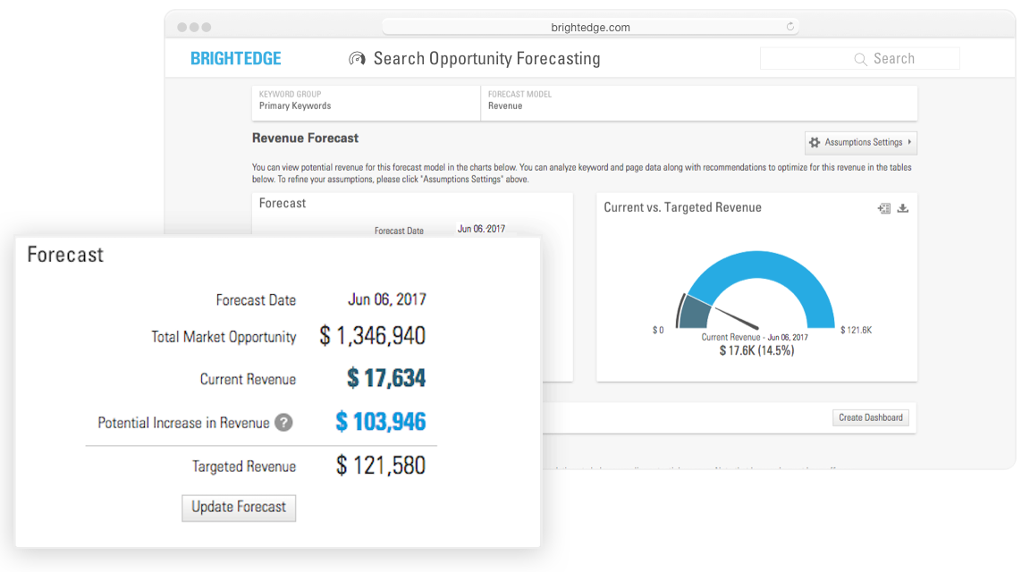
QUANTIFY BUSINESS IMPACT FROM NEW PROJECTS
Build stronger business cases using BrightEdge Opportunity Forecasting
Notes:
“Digital content capability” solutions page

Slide 22

Step 3 - IMPLEMENT
Drive your projects forward
Continue wearing the PM Hat™
Complications can (and will) arise. Take initiative to weigh in and mediate
Know where you are in the sprint cycle.
Project manage non-technical stakeholders on timing and materials needed from them
Participate in QA and deployment
Notes:
When it comes to complex technical projects, complications can and will arise. As an owner of web it benefits everyone for you to be on top of project developments and issues. You should be available to help resolve anything from creative decisions to, if necessary, QA and bug testing.
Speaking the Language: Even if you aren’t a direct part of the website’s ”scrum” team it’s a good idea to get accustomed to how your organization’s web developer(s) work. Does your engineering team use scrum development process? Learn up on that process so you can speak authoritatively to your project stakeholders about timing, expectations, and requirements.

Slide 23
Keywords/Pages on Page 1
Share of Voice Increase
SEO KPIs
Organic Sessions
STEP 4 - MEASURE
New Visitors
Conversions
Executive audience
Revenue

Slide 24
DASHBOARDS OF SITE KPIS
Monitor if core KPIs are moving toward the right direction for the site and for the projects

Slide 25

STEP 5 - PROVIDE FEEDBACK, SHARE WINS
Keep people engaged, show your results
Elevate data—not just up, but laterally
Share numbers not just with stakeholders, but team members
Notes:
Obviously you need to communicate web results to stakeholders and leadership early and often. That said, there’s also soft benefits to sharing the same data laterally, not just vertically. Often times people on the developer or engineering side aren’t provided with any feedback about how the web projects they work on. It can be beneficial to share those numbers with team members periodically and keep them in the loop, even if it’s a simple email with bullet points and screencaps.
Additionally, if your organization’s engineering team has recurring department presentations, like a Friday Showcase, it could be worthwhile to connect with the program manager and ask to participate from time to time, especially when some time has elapsed since the launch of a major project, like the launch of a new site feature or section. By presenting successes to the larger engineering group you help to elevate the work of the web developer(s) within their peer group.

Slide 26
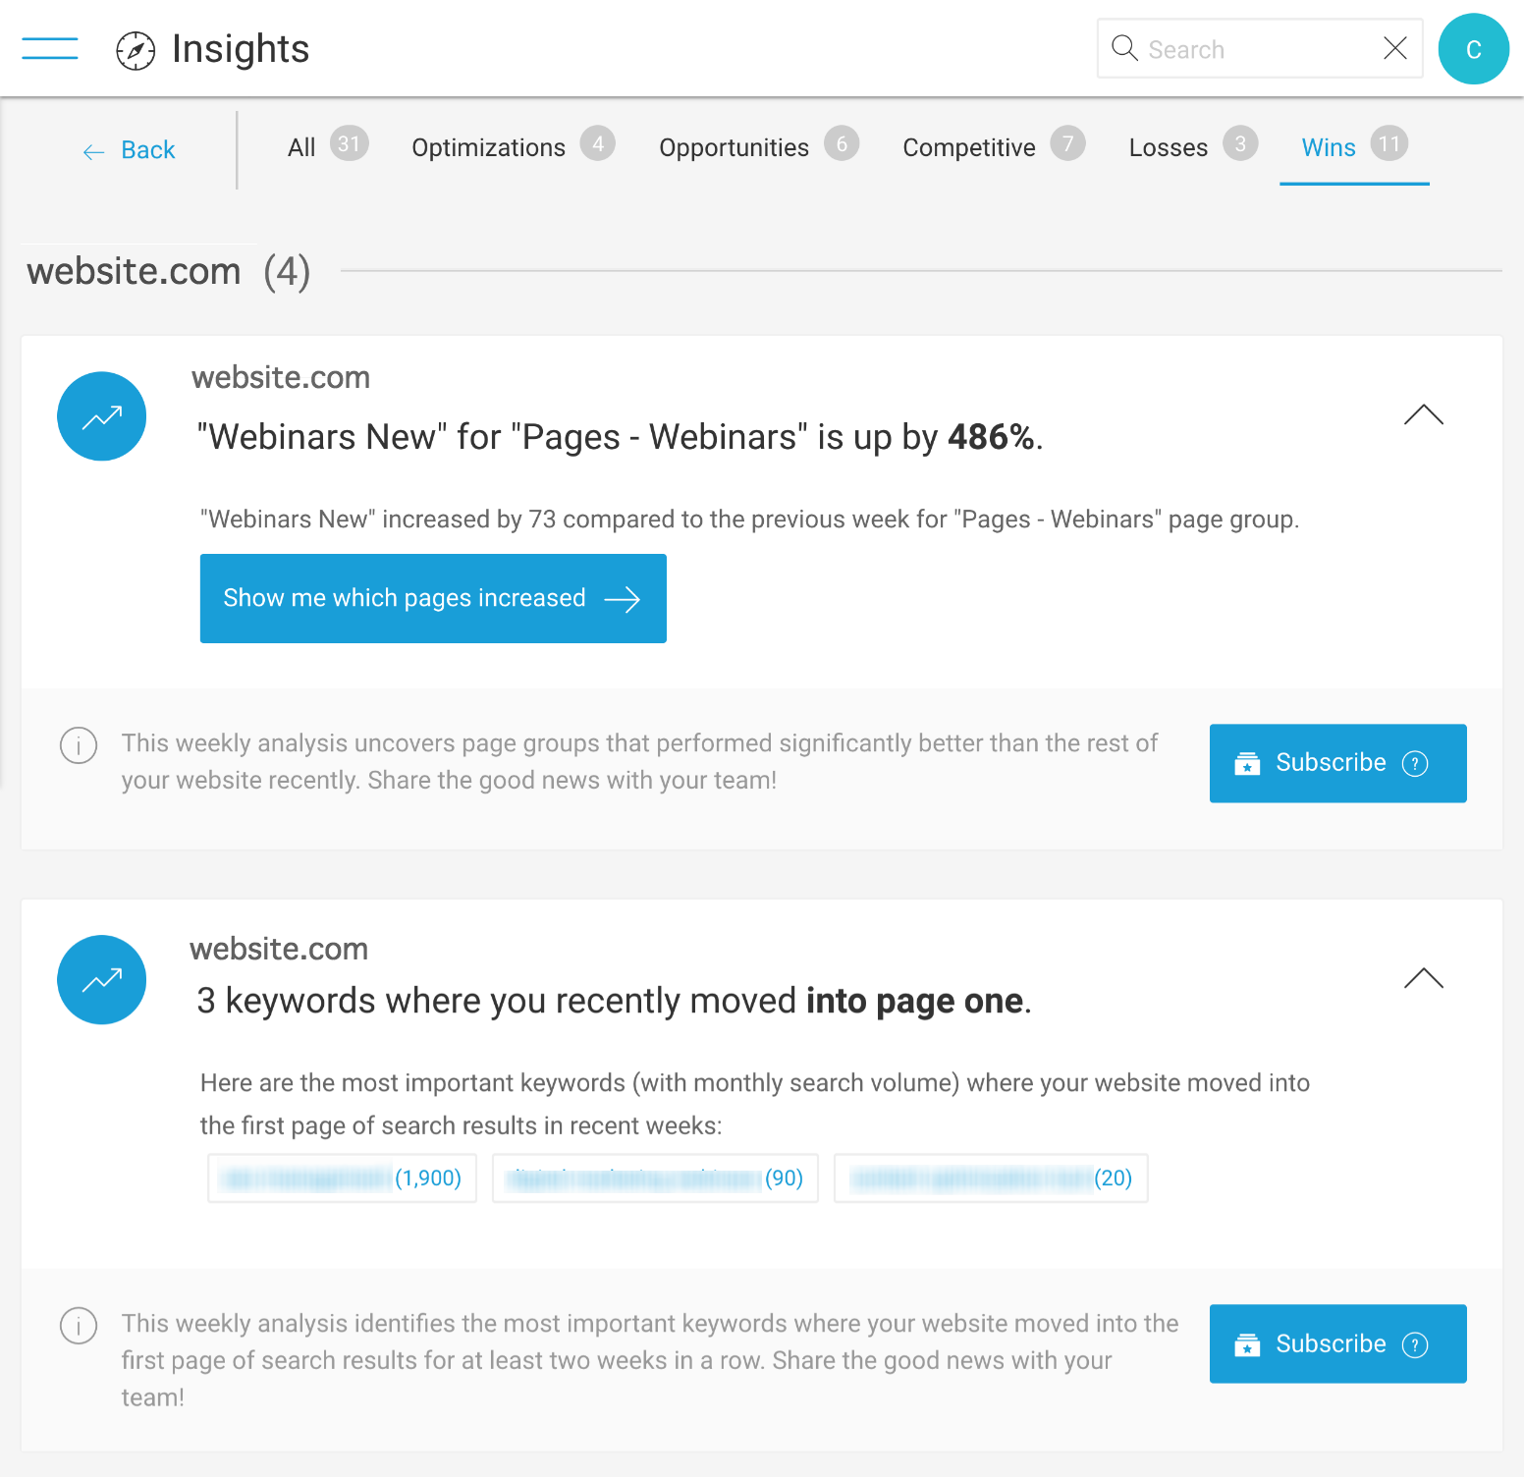
CAPTURE WINS QUICKLY
AI-powered BrightEdge Insights surfaces SEO wins for you easily
Notes:
Here’s an example of a slide from a deck we put together to report on Q4 2017 SEO results for BrightEdge.com. The use case was both for internal sharing within the marketing team, EOY presentation to C-level, and sharing with R&D team for Developer Showcase. We organized the main KPIs along the lines of our conversion funnel and then condensed it all down into a single page that could be easily shared in slidedecks, emails or almost any other format.

Slide 27
Build your prioritized backlog
Wear the PM hat
Empathize with the web developer
Learn the process
Measure and report
Share project wins laterally and vertically
KEY TAKEAWAYS
Notes:
Take the lead: You may not have the technical expertise of a web developer to build new features, nor the level of executive authority of a C-level or VP-level contributor, but as web owner you have the best overall knowledge of your site from a holistic business perspective.
Learn the process:
Measure and Report

