Slide 1
Media and Publishing
Marketing & SEO
November 29, 2018
BrightEdge

Slide 2
BrightEdge Research
Universal SERP Appearance Sept 2018
US DESKTOP
Quick Answers: | 19.40%
Images: | 26.03%
Videos: | 27.24%
Local Three-Pack: | 13.54%
Carousel: | 1.25%
SiteLink: | 5.39%
Keywords Having Universal Listings: | 97.8%
Images and Videos have grown, while Quick Answers has declined in Desktop
In Mobile Quick Answers and Images have declined greatly in recent months
Main Takeaways
Every keyword has a unique intent.
Google knows it by presenting unique SERP with different mix of universal listings for each keyword. Universal listings are found on 98% on desktop and 83%+ on mobile.
  It’s critical to not only understand your rank, but also all the elements that are present on page 1 of the SERP
US MOBILE
Quick Answers: | 18.84%
Images: | 14.66%
Videos: | 24.68%
Local Three-Pack: | 14.81%
Carousel: | 1.22%
SiteLink: | 3.86%
Keywords Having Universal Listings: | 83.0%
Notes:
Key Findings
Google SERPs are getting much more visual with more images and video thumbnails

Slide 3
BrightEdge Research
Desktop and Mobile Cross-SERP Click Curves
CTR
Mobile
Desktop
Rank

Slide 4
BrightEdge Research
Mobile Click Curves by SERP Type
CTR
Rank

Slide 5
BrightEdge Research
Query-to-Click Ratios Vary Between Device and SERP Type from 55% to 107%
Users have different needs for info depth, for example between Local 3-Pack at 55% on Mobile and Quick Answers on Desktop at 107%
Voice on Mobile is also a big factor influencing and dampening clicks

Slide 6
Digitization
Notes:
Physical things became digital – books, magazines, newspapers, records, movies, TV shows
As mentioned the digitization of news and media has had a tremendous impact on those in the industry. Customers have become less inclined to buy and read print publications and more likely to get their news and entertainment through online publications. Brands, therefore, need to continue to invest in websites, apps, and social media to stay relevant with the customers.

Slide 7
Content Marketers as Publishers
Notes:
Physical things became digital – books, magazines, newspapers, records, movies, TV shows
As mentioned the digitization of news and media has had a tremendous impact on those in the industry. Customers have become less inclined to buy and read print publications and more likely to get their news and entertainment through online publications. Brands, therefore, need to continue to invest in websites, apps, and social media to stay relevant with the customers.

Slide 8

Original Content, Exclusivity, Subscription
Notes:
As distribution and storage became ubiquitous, instant, and virtually free the pendulum has swung back to “content as king” as can be seen with massive sift to original content creation and licensing at Netflix, Hulu, Amazon, and now even Comcast. Creating and controlling exclusive content has become a hallmark of successful digital publishers of all types.

Slide 9

Personalization
Notes:
Digitization allows 1-to-1 media experiences that are configurable by the end user delivered in a format that suits the device they will consume it on. This increases engagement by maximizing relevancy and enables logic-based recommendations for additional and adjacent content.

Slide 10

Mobile Media and AMP
Notes:
Mobile Commerce – BrightEdge Research shows that on average 62% of site traffic is now mobile and that 70% of commerce journeys start in the SERPs.
BrightEdge research indicates that 62 percent of queries take place on mobile devices, and those in media and publishing need to be cognizant of this trend as well. People digest their news and articles regularly on the go, while commuting, on lunch breaks, and just when out during their daily lives. Keeping the mobile intentions of your readers in mind while producing content can help ensure that they can easily engage with your material while online.
This trend has been popular for the past few years, but it still requires careful consideration by those in the media and publishing industries. AMP sites have begun to dominate the news articles posted online, making it a significant aspect of any successful strategy by those in media and publishing.

Slide 11


Site Search
Notes:
Site Search – Up to 30% of ecommerce visitors use site search, and those users are 5.5X more likely to purchase, according to Econsultancy. Brands provide such inconsistent site search utility that many people use Google to side-search a site, which works well but also exposes competing listings and ads. Brands need to invest in better site search solutions in terms of technology and content.

Slide 12


Social Media and UGC
Notes:
An estimated 2/3 of American adults report using social media to get at least some of their news, which is an increase from the 62 percent that reported doing so in 2016. This includes 1 in 5 reporting that they use social media for this purpose, “a lot.” Publishing and media clients, therefore, need to consider how they can use the social platforms to better engage with their target audiences and use them to promote their products, stories, and features. Using posts and videos can excite people about the content these brands want to promote and encourage more people to engage with the organizations, both in print and through digital publications.

Slide 13

Voice Search and Browsing
Notes:
An estimated 20-30 percent of mobile queries are now made using voice. This impacts all industries, including those in media and publishing as they fight for the attention of consumers. This will become particularly significant for those in media and publishing to cover regular news events. Personal assistant devices, which are completely voice activated, are often used to inquire about daily headlines and related news. As customers begin to use these types of searches regularly to get headlines and other types of news, the organizations must make sure that their publications have been optimized for these intentions.

Slide 14

Customer Journey Analytics
Notes:
Customer Journey Analytics – Sites must figure out how to collect and use their vast amounts of site data to reduce friction and accelerate customers along the buyer’s journey.

Slide 15
Video Sizzler
SERP & YT
SERPs
Google
Blog Post
BE.com & Partner
Web Site Page,
Webinar Page, CTA
Gated Asset
Lead
MAL/MQL
Social Post
LI + FB & TW
Demo
SQL

Slide 16
Use Case 1: Large Site Technical Audit
ContentIQ
Notes:
Establishing excellence in technical SEO is critical to maintaining content performance. ContentIQ empowers SEOs and digital practitioners to keep on top of it and ensure their SEO site health is up to spec.

Slide 17
Use Case 2: Voice of Customer and Queries
Data Cube
Notes:
BrightEdge Data Cube helps ecommerce brands to understand the voice of the customers and the words they use to search for goods and services.

Slide 18
Use Case 3: Identifying Untargeted Keyword
Page Reporting
Notes:
Site-wide conversion metrics are important in ecommerce, but so is the ability to go deeper. Page Reporting drills down into traffic and conversion data to track traffic and conversions on specific products and categories.

Slide 19
Use Case 4: Track and Elevate Organic
StoryBuilder
Notes:
Commerce sites like the configurable multi-dimensional structure that allows them to understand and highlight the key details and delivery those targeted dashboards by email to stakeholders around the company.

Slide 20
eCommerce Content Benchmark
BrightEdge Data Cube Metrics | Avg for eCommerce
The average Data Cube score for the industry is: | 439,720
The average number of position one listings is: | 739
The average page 1 listings is: | 8,723
The average total universal content results is: | 986
The average number of images is: | 696
The average number of Quick Answers is: | 61

Slide 21
eCommerce Click Curves
 | 1 | 2 | 3 | 4 | 5 | 6 | 7 | 8 | 9 | 10 | 11 | 12 | 13 | 14
Mobile | 18.0% | 11.5% | 8.5% | 6.5% | 5.8% | 3.1% | 4.4% | 2.4% | 1.4% | 1.1% | 0.9% | 4.3% | 1.7% | 1.1%
Desktop | 29.9% | 12.6% | 9.8% | 7.4% | 6.5% | 3.4% | 4.8% | 2.6% | 1.7% | 1.4% | 1.1% | 1.4% | 1.5% | 1.4%

Slide 22
2019: Map 20 SEO Strategies to Business Objectives and Capacity
Video,
YouTube
Optimization
Blog
Voice
App
Optimization
ABM/SEO
Integrated
Style
Guide w
SEO
Content
Hubs
SEO Maturity
Conversion,
Values
Migration
Rational-
ization
Business Objective
Offense Defense Elevate
Local
Technical
Page Load
Integrated
Search
Longtail
Longtail
Mobile,
AMP
High
Ranking
Striking
Distance
Gap
Analysis
Quick
Answers
FAQ,
Glossary
Next Week Next Month Next Quarter
Time Horizon

Slide 23
2019: Media and Entertainment
Video,
YouTube
Optimization
Voice
Style
Guide w
SEO
Content
Hubs
SEO Maturity
Business Objective
Offense Defense Elevate
Local
Technical
Page Load
Longtail
Longtail
Mobile,
AMP
Quick
Answers
FAQ,
Glossary
Next Week Next Month Next Quarter
Time Horizon

Slide 24
Notes:
Scranton Gillette

Slide 25
Notes:
Time

Slide 26
Notes:
Wiley

Slide 28
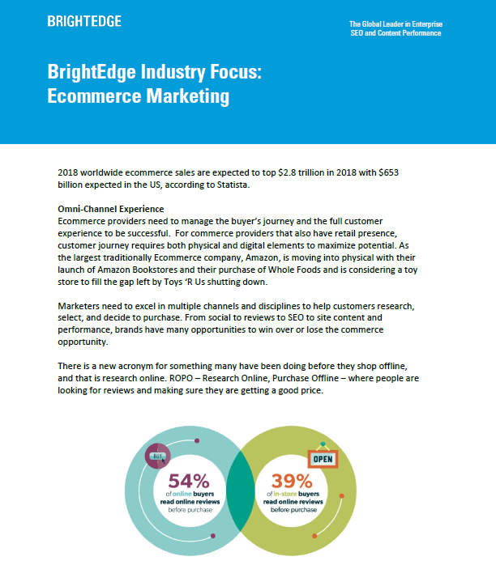

Slide 29
Questions?

