Slide 1


Triage Rank or Traffic Drops
Dec 2018
Notes:
Hi welcome to the webinar ----
Just some housekeeping items – if the audio or visuals get stuck please try to reload your browser, if that doesn’t work close your browser and log back in.
Please ask questions at any time using the question widget on your left
We will share the recording with you after the event via email – Also the website will have the on-demand asset about 48 hours later

Slide 2


PRESENTERS
Katie O’Leary Sr. Product Marketing Manager
Josh Patrice Sr. Director of Professional Services
@ballcath

Slide 3
Notes:
Katie
Where does keyword research fit within SEO workflow.
Research to determine what to do – build the backlog and tackle
Leverage BrightEdge to take action – create, optimize, implement technical fixes
Reports – measure to continue to improve and figure out what to tackle next
- In this webinar we will focus on Reporting –

Slide 4

Ever been surprised by rank and traffic drops first thing in the morning?
#BrightEdgeWebinars
Notes:
Katie

Slide 5


Steps to managing Technical website projects
Provide feedback and share results
Measure business impact
Implement
Secure commitment
Discover
#BrightEdgeWebinars
Notes:
Katie

Slide 6
01
PROCESS TO DIAGNOSE RANK OR TRAFFIC DROPS
Notes:
Katie

Slide 7

five pillars of traffic Drops
Colleagues
Consumers
You
Search Engines
Competitors
#BrightEdgeWebinars
Notes:
Katie

Slide 8

YOU: WHAT AND WHY IT HAPPENED
Validate reporting data and analytics tags
Has your CMS had any recent updates?
#BrightEdgeWebinars
Notes:
Katie
Double check the data flow
Check in your web analytics platform if data is still being pulled in – meaning is the analytics tag still on your site or for some reason was it removed
Check to see if CMS has had any recent updates. If so this could cause:
Templates to revert back to an older template
Text to change an older version
Broken pages (4xx error)

Slide 9
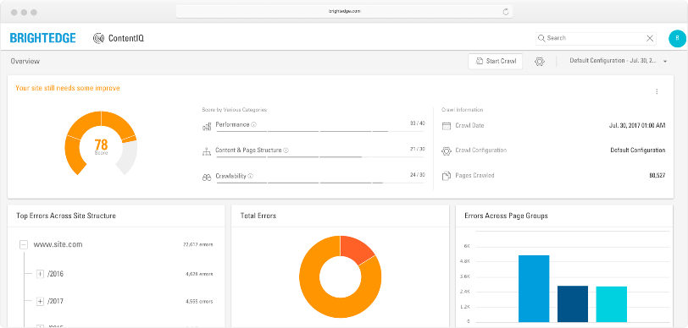
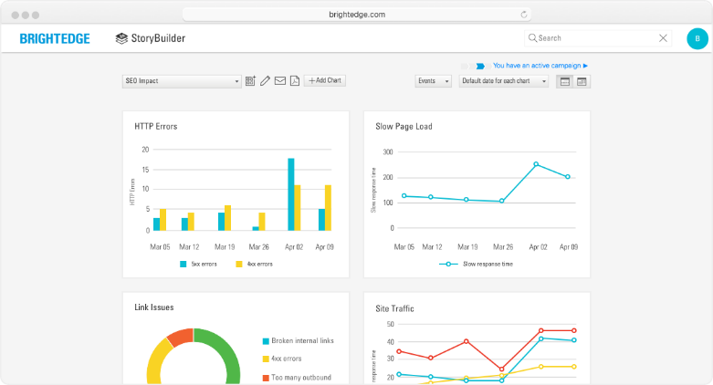
YOU: HOW TO FIX IT
Check all integrations and analytics tags
Reference source data and report to validate data
Run ContentIQ site audit
Check to see if pages are indexed
Check to see if pages blocked via robots.txt
3. Check Google Search Console to check for errors in your sitemap
Notes:
Josh
ContentIQ -Check errors
Less than optimized pages that need to be brought up to date
Make sure pages are indexed
Shows you the last time the page was crawled or indexed
Help Article on how to check this in BrightEgde
Might not be in your sitemap.xml
Or was blocked via robots.txt

Slide 10

COLLEAGUES: WHAT AND WHY IT HAPPENED
Was there a template change on your site?
Made a URL change or updated a directory
Added or removed navigational links
Internal links removed
Check site traffic by channel (BrightEdge Site Report) to see if organic traffic is is proportional to other channels – for example is paid traffic up but organic is down?
#BrightEdgeWebinars
Notes:
Katie

Slide 11
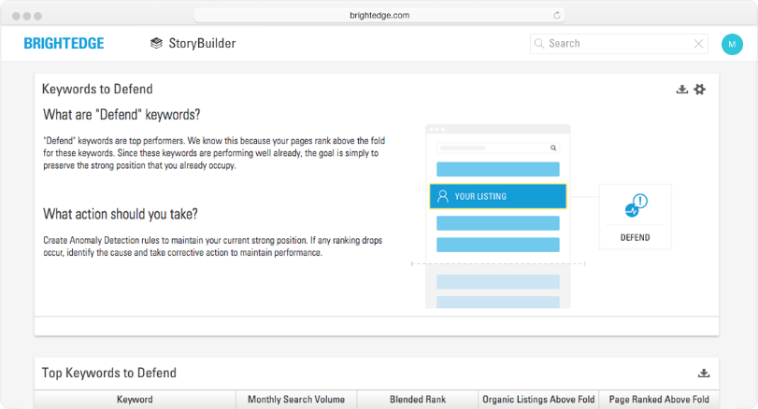
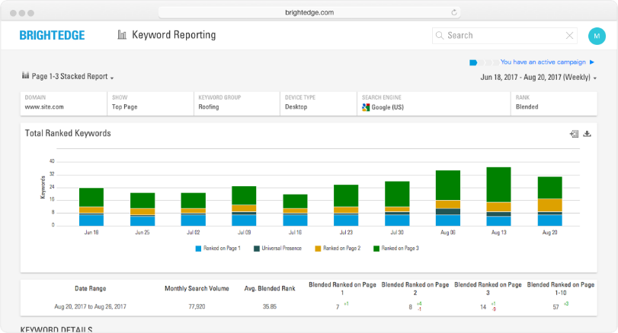
COLLEAGUES: HOW TO FIX
Using ContentIQ run a technical site audit to pinpoint issues
Customize crawl for internal inbound links
Customize to crawl specific directory
Check your backlinks report to identify if a high-authoritative domain removed a link
Run Intent Signal Dashboard in StoryBuilder to identify your mix between paid and organic keyword opportunity
Collaborate with your paid team on which keywords to target
Notes:
Josh
Made a URL change or updated a directory
Added or removed navigational links
Internal links removed
ContentIQ helps you identify if there are any broken internal links ‘

Slide 12

COMPETITORS: WHAT AND WHY IT HAPPENED
Are new competitors are showing up in the SERP or taking more market share?
Are competitors outperforming you from a content perspective?
#BrightEdgeWebinars
Notes:
Katie

Slide 13
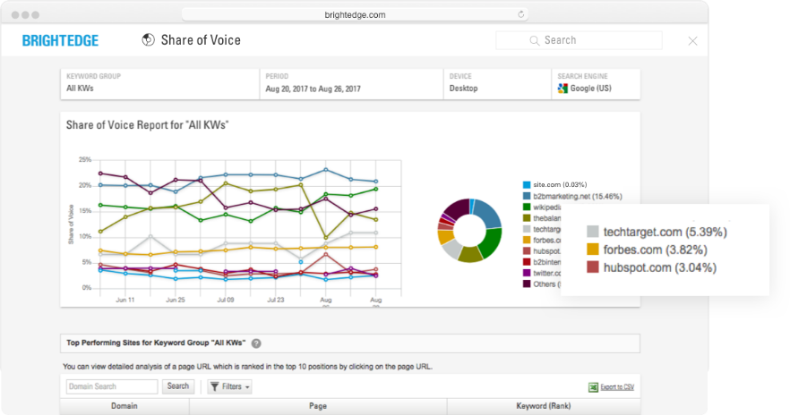
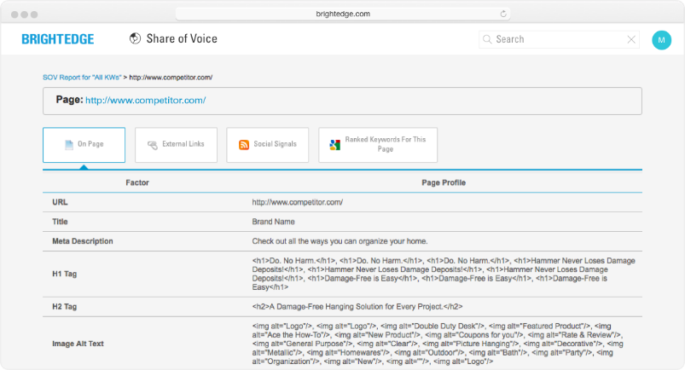
COMPETITORS: HOW TO FIX
Check Share of Voice (SOV) to understand if new competitors have shown up
Using SOV see what content is winning in the SERP over yours — different content type (category vs. blog), better-optimized, longer-form, more-helpful content
Check Recommendations for a prioritized list of actions to take and assign tasks to colleagues
Notes:
Katie

Slide 14

CONSUMERS: WHAT AND WHY IT HAPPENED
Has the consumer behavior changed?
Has vocabulary in use changed?
Has search volume dropped?
Is this drop aligned to seasonality?
#BrightEdgeWebinars
Notes:
Katie
Has the consumer behavior changed
What if rankings stay the same but traffic and impressions are down? This would be a signal that either searchers are starting to use different language (keywords) or could point to a general downward trend in consumption (less market demand).
Look in BrightEdge to see search volume over time to understand whether interest in a topic is different over the last few years.
Is this drop aligned to seasonality?

Slide 15
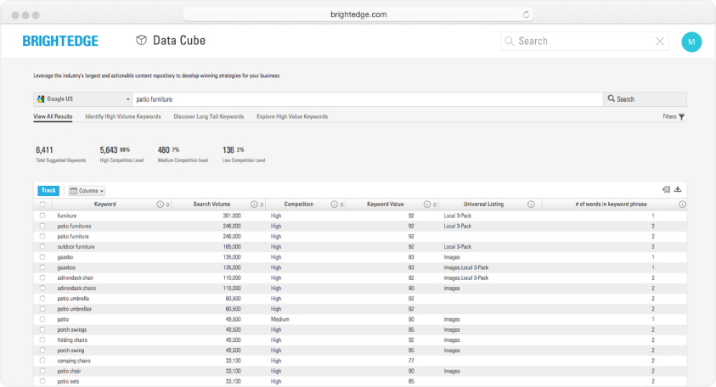
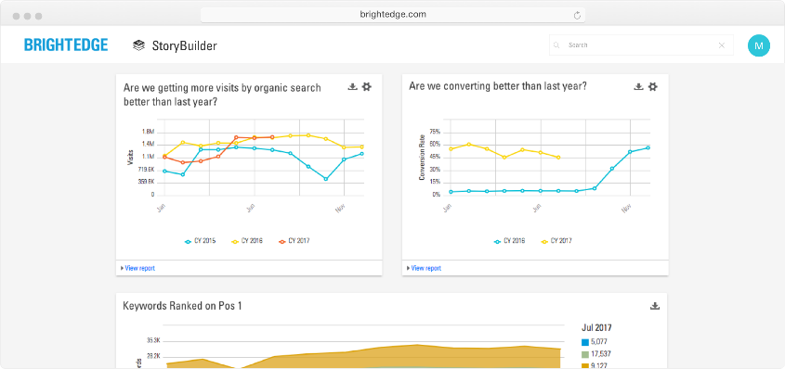
CONSUMERS: HOW TO FIX
Update your content and language to match the intention of your consumers
Use Data Cube to understand related terms. Find the keywords with the highest demand
Using StoryBuilder review year-over-year traffic to see if this dip aligns to normal site behavior – recommended to go back multiple years
Notes:
Katie
Update your content and language to match the intention of your consumers
Use Data Cube to understand related terms. Find the keywords with the highest demand.
We do also have a webinar on how to conduct keyword research that goes in to the details on how to make sure you create content based on the right word
Check to see if any high authoritative backlinks have been removed
You didn’t lose the link but someone who was linking to you stopped
Or old site removed
Someone linking to you was also getting links from a bad neighborhood that was recently penalized
Using StoryBuidler review year over year traffic to see if this dip aligns to normal site behavior – recommended to go back multiple years if possible

Slide 16

SEARCH ENGINES: WHAT AND WHY IT HAPPENED
Check the Clicks and Impressions Report in BrightEdge to see if clicks are dropping but not impressions
Using Keyword Reporting check to see if new content types are showing up, such as a Quick Answer or Local 3-Pack
Has the page load time increased?
Has your average rank or rank for a specific category been continuously dropping – meaning the search engine started preferring different pages
#BrightEdgeWebinars
Notes:
Josh
Check clicks and impressions report to see what is dropping
Drop in clicks but not in impressions — means that rank didn’t change much (maybe 2-4) but there was possibly a change on the SERP; such as, an Ad, knowledge graph, or new competitor
Using Visual Parsing, Recommendations or Incognito view
New content types showing up that typically can take majority of clicks for the page?
Quick Answer or Local 3-Pack
View how to see this in BrightEdge – Help Article -- https://support.brightedge.com/hc/en-us/articles/115003637443-Overview-of-Universal-Search-Results
Check Web Analytics
Examine if page speed slowed down so high bounce rate or lower time on page. The search engine started preferring a different page.
Final check would be a major shift in algo changes — see if anything happened in world of search https://webmasters.googleblog.com/

Slide 17
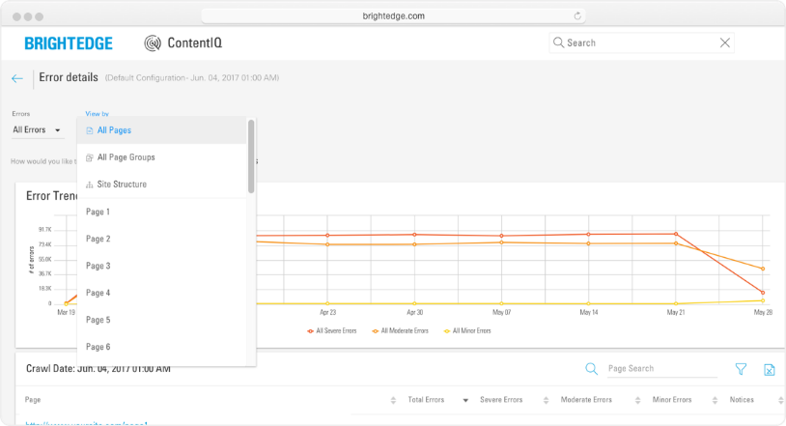
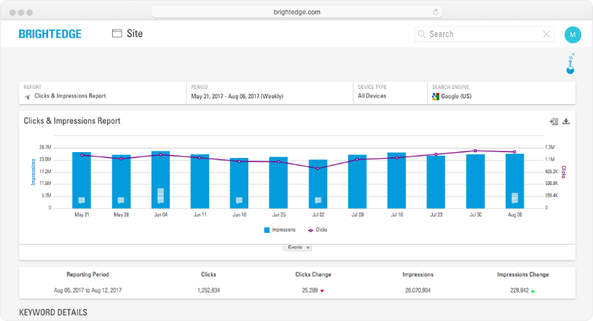
SEARCH ENGINES: HOW TO FIX
Create or optimize content for new SERP elements
Examine if page speed slowed down, which will also mean high bounce rate and low time on page
If slow Page Speed - run a ContentIQ crawl to identify if the cause; for example, large image sizes
Final check would be a major shift in algo changes — see if anything happened in the world of search
Notes:
Josh

Slide 18
06
KEY TAKEAWAYS

Slide 19

Key Takeaways
Important to make sure the data is accurate
Narrow down the cause of the issue using a combination of SEO, Web Analytics, and GSC metrics
Run a technical site audit to locate site wide issues, page speed, and severe errors
Once narrowed issue down, use StoryBuilder to create the business case to secure resources to fix
#BrightEdgeWebinars
Notes:
Katie

Slide 20
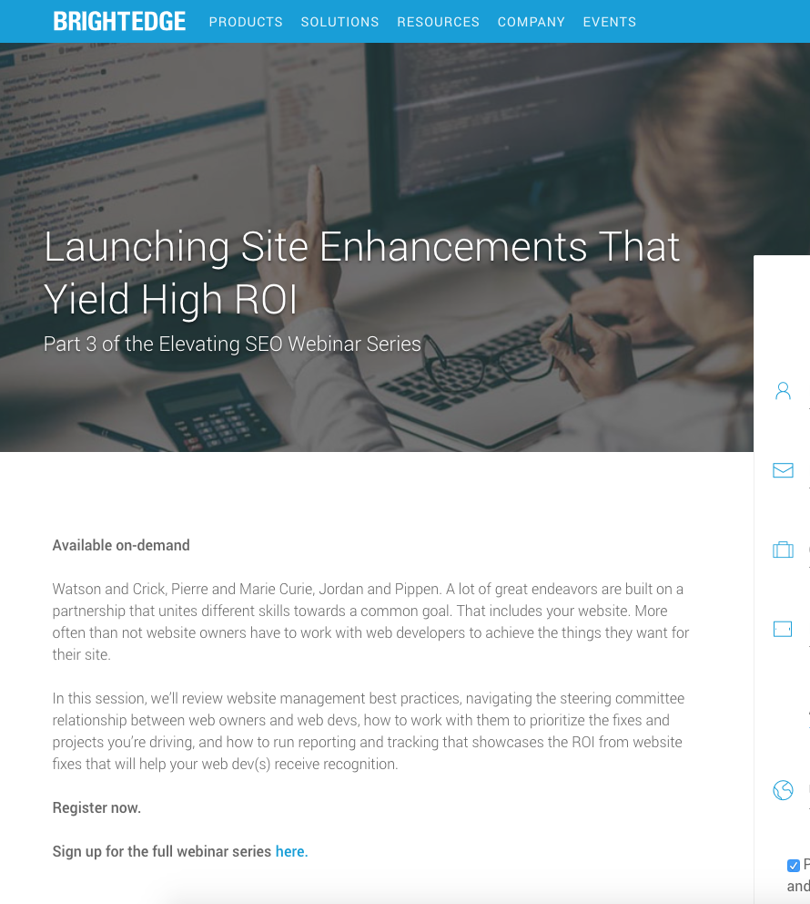
NEXT STEPS
Work with your web developer to implement needed changes
https://www.brightedge.com/resources/webinars/launch-site-enhancements-yield-high-roi
#BrightEdgeWebinars
Notes:
Katie

Slide 21
Q&A

Slide 22
THANK YOU!

