Slide 1
Financial Services
Marketing & SEO

Slide 2
BrightEdge Research
Universal SERP Appearance Nov 2018
US MOBILE
Quick Answers: | 19.83%
Images: | 22.99%
Videos: | 24.21%
Local Three-Pack: | 22.72%
Carousel: | 0.84%
SiteLink: | 4.25%
Keywords Having Universal Listings: | 94.85%
Images and Videos have grown in both Mobile and Desktop, while Quick Answers has declined in Desktop from a peak of 24.5% in February 2018
In Mobile Local 3-Pack is up dramatically
US DESKTOP
Quick Answers: | 21.61%
Images: | 26.03%
Videos: | 27.24%
Local Three-Pack: | 13.54%
Carousel: | 1.22%
SiteLink: | 5.39%
Keywords Having Universal Listings: | 95.57%
Notes:
Key Findings
Google SERPs are getting much more visual with more images and video thumbnails

Slide 3
BrightEdge Research
Desktop and Mobile Cross-SERP Click Curves
CTR
Mobile
Desktop
Rank

Slide 4
BrightEdge Research
Mobile Click Curves by SERP Type
CTR
Rank

Slide 5
BrightEdge Research
Query-to-Click Ratios Vary Between Device and SERP Type from 55% to 107%
Users have different needs for info depth, for example between Local 3-Pack at 55% on Mobile and Quick Answers on Desktop at 107%
Voice on Mobile is also a big factor influencing and dampening clicks

Slide 6

Digitization
Notes:
Physical things became digital – books, magazines, newspapers, records, movies, TV shows and now lectures and discussions.
The industry has moved past the era of all service transactions happening either in person in a branch office or over the telephone. Today’s clientele as well as prospective customers expect self-service from any location.

Slide 7

Machine Learning and AI
BLOCKCHAIN
DIGITAL COIN
Notes:
In recent years we’ve seen financial technology transform the industry, introducing a higher level of predictive analytics and mapping. It should be no surprise that this same tech focus would extend to the marketing of the fintech solutions themselves.
Blockchain

Slide 8

Personalization
Notes:
Spurred by consumer-centric media and ecommerce platforms like Netflix and Amazon, consumers have a greater expectation for digital experiences that programmatically learn what they want and need and tailor themselves to become more relevant.

Slide 9

Channel Integration and Mobile
Notes:
With digitization comes mobile connectivity. End users increasingly expect the ability to manage their finances securely as well as consume content over their mobile devices. New potentially disruptive fintech solutions are usually app-based.

Slide 10

Notes:
One of the reasons digital content investments haven’t been prioritized as much as in other industries is because of the high level of federal regulation on what can and cannot be said. This can result in longer lead times and decreased cadence as marketing content must be reviewed for compliance with existing regulation before publication.

Slide 11

Financial Literacy
90% of US consumers want financial training
Notes:
Ninety percent of U.S. consumers want personal finance courses to be part of high school education according to a survey from Equifax, suggesting older generations feel unprepared to equip younger people with the financial skills they need. As a result, the potential demand for informational content about financial literacy to fill the gap is great.

Slide 12

Customer Journey Analytics
Notes:
Customer Journey Analytics – Sites must figure out how to collect and use their vast amounts of site data to reduce friction and accelerate customers along the buyer’s journey.

Slide 13

Conclusions
Financial services trends:
  Digital and online
  Self-serve
  Mobile emergent
  Compliance
  Personalized
  Financial literacy
SEO and content marketing even more critical skills for financial services

Slide 14
Use Case 1: Large Site Technical Audit ContentIQ
Notes:
Establishing excellence in technical SEO is critical to maintaining content performance. ContentIQ empowers SEOs and digital practitioners to keep on top of it and ensure their SEO site health is up to spec.

Slide 15
Use Case 2: Voice of Customer and Queries
Data Cube
Notes:
BrightEdge Data Cube helps ecommerce brands to understand the voice of the customers and the words they use to search for goods and services.

Slide 16
Use Case 3: Identifying Untargeted Keyword
Page Reporting
Notes:
Site-wide conversion metrics are important in ecommerce, but so is the ability to go deeper. Page Reporting drills down into traffic and conversion data to track traffic and conversions on specific products and categories.

Slide 17
Use Case 4: Track and Elevate Organic
StoryBuilder
Notes:
Commerce sites like the configurable multi-dimensional structure that allows them to understand and highlight the key details and delivery those targeted dashboards by email to stakeholders around the company.

Slide 18
Financial Services Content Benchmark
BrightEdge Data Cube Metrics | Avg for eCommerce
The average Data Cube score for the industry is: | 192,450
The average number of position one listings is: | 348
The average page 1 listings is: | 2,595
The average total universal content results is: | 333
The average number of images is: | 24
The average number of Quick Answers is: | 56

Slide 19
Financial Services Click Curves
 | 1 | 2 | 3 | 4 | 5 | 6 | 7 | 8 | 9 | 10 | 11 | 12 | 13 | 14
Mobile | 22.3% | 13.6% | 8.2% | 4.9% | 2.7% | 1.9% | 1.2% | 1.1% | 0.9% | 0.6% | 0.6% | 1.2% | 1.3% | 1.0%
Desktop | 37.0% | 14.8% | 9.5% | 5.6% | 3.0% | 2.1% | 1.3% | 1.2% | 1.1% | 0.8% | 0.8% | 0.7% | 1.2% | 1.3%

Slide 20
2019: Map 20 SEO Strategies to Business Objectives and Capacity
Video,
YouTube
Optimization
Blog
Voice
App
Optimization
ABM/SEO
Integrated
Style
Guide w
SEO
Content
Hubs
SEO Maturity
Conversion,
Values
Migration
Rational-
ization
Business Objective
Offense Defense Elevate
Local
Technical
Page Load
Integrated
Search
Longtail
Longtail
Mobile,
AMP
High
Ranking
Striking
Distance
Gap
Analysis
Quick
Answers
FAQ,
Glossary
Next Week Next Month Next Quarter
Time Horizon

Slide 21
2019: SEO Strategies for Financial Services
Video,
YouTube
Optimization
Voice
Integrated
Search
Conversion,
Values
Longtail
Business Objective
Offense Defense Elevate
FAQ,
Glossary
Technical
Page Load
Mobile
Quick
Answers
Next Week Next Month Next Quarter
Time Horizon

Slide 22
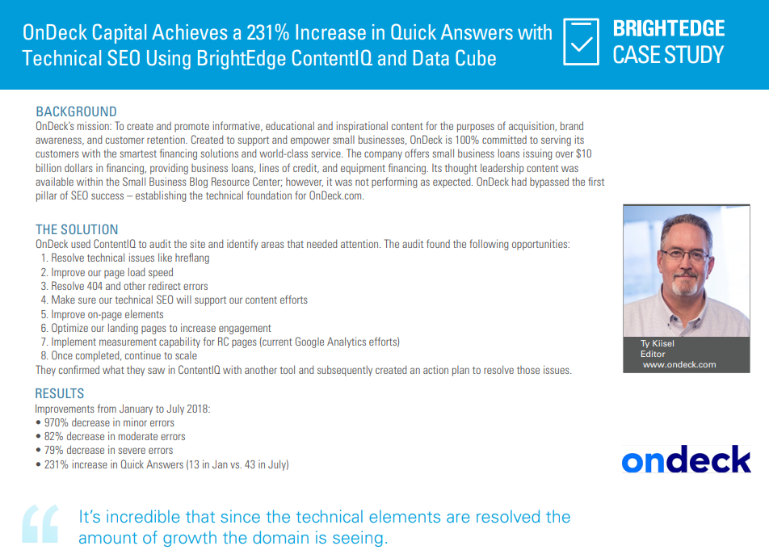

Slide 23


Slide 24
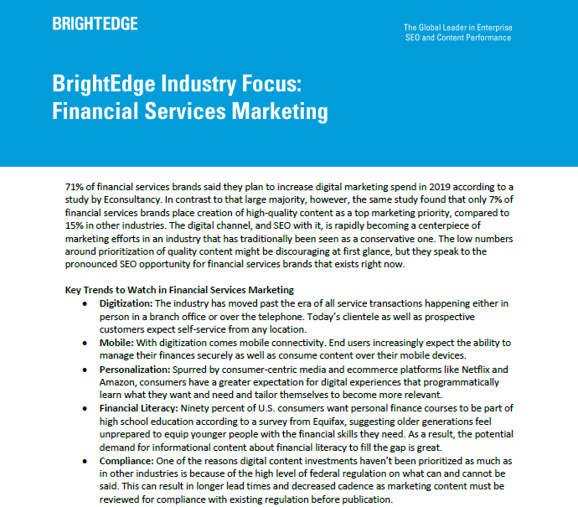

Slide 25
Find more webinars at:
https://www.brightedge.com/resources/webinars

