Slide 1
Building the Roadmap to SEO Success: Maxim Integrated
Dec 2018
#BrightEdgeWebinars

Slide 2
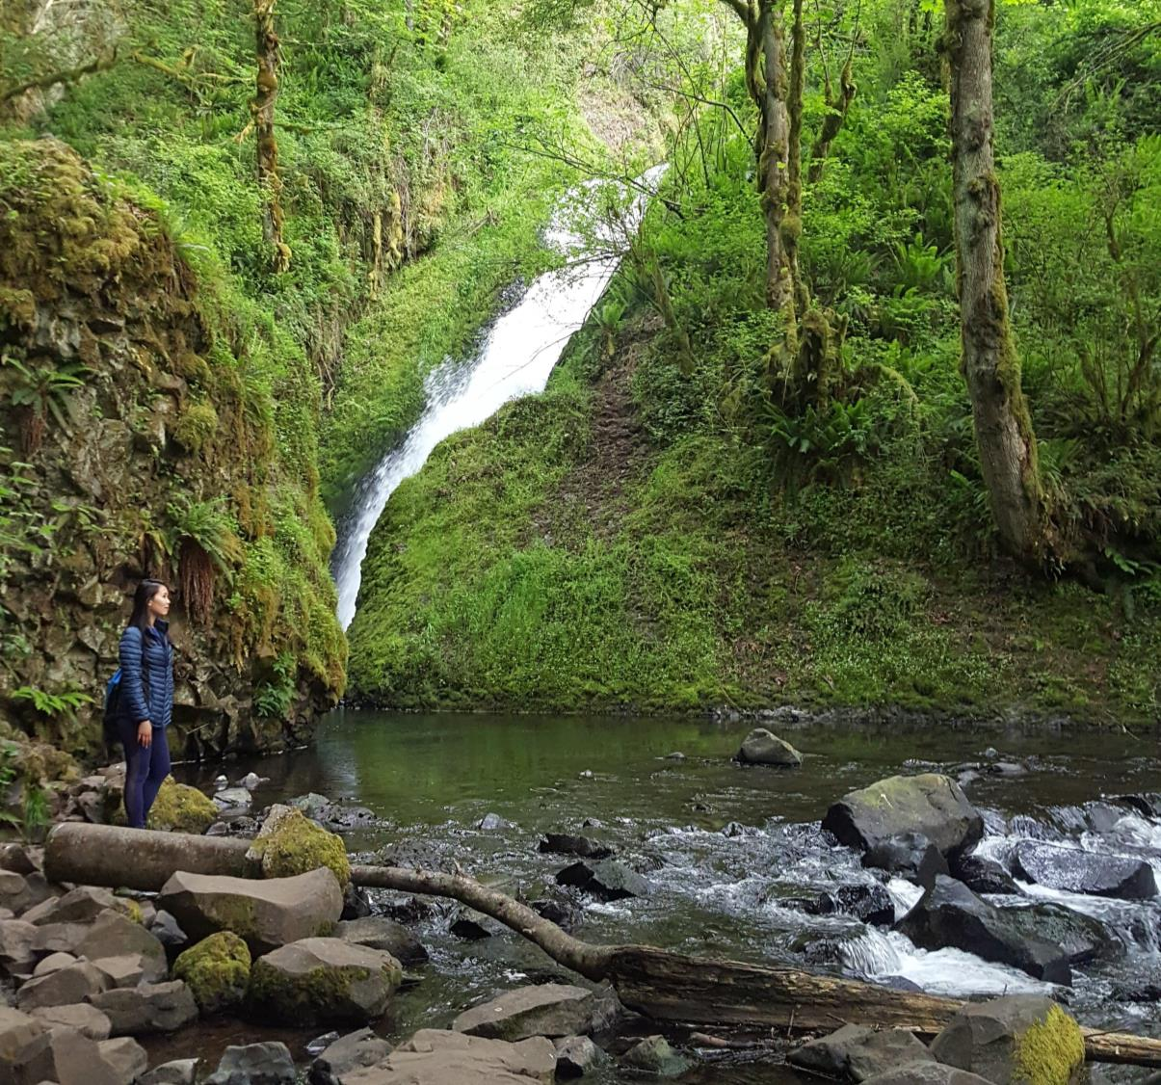
ABOUT ME
Jeanne Quach
5+ years in Digital Marketing
Managing Analytics, SEO
Ecommerce Experience
#BrightEdgeWebinars
Notes:
• Do not remove logo or social element.
• To insert new image: left click on image, click change picture, select picture, click insert
• Change header and copy points
• To insert new image: left click on image, click change picture, select picture, click insert

Slide 3



B2B Semiconductor company
7000 employees
Customers: design engineers
#BrightEdgeWebinars
Notes:
Our customers are design engineers that create products like mobile phones, wearable technology, automotive systems, and automated factories. They’re looking for technologies, sensors, and power chips that we create, which go into their products.
• Do not remove logo or social element.
• To insert new image: left click on image, click change picture, select picture, click insert
• Change header and copy points
• To insert new image: left click on image, click change picture, select picture, click insert
This Photo by Unknown Author is licensed under CC BY-SA-NC

Slide 4



OVERVIEW
Challenge: Limited Resources & Knowledge
Tactics: Education, Optimization, Advocacy
Result: SEO progression in key groups
#BrightEdgeWebinars
Notes:
Do not remove logo or social element.
• Do not change text
• Presentation transition to follow format
• To insert new image: left click on image, click change picture, select picture, click insert
Image 1: https://overblown.co.uk/why-do-like-multitasking/
Image 2: Brightedge deck
Image 3: https://johndrury.biz/what-is-your-criteria-for-success/ https://johndrury.biz/wp-content/uploads/2016/02/Success-1080x675.jpg

Slide 5



BRIDGE SEO GAPS AND BRING VALUE TO KEY GROUPS
Bridging the SEO gaps through:
To bring value to:
Business Units
Executives
Marketing
IT
Enabled by
Education
Optimization
Advocacy
Empowerment
#BrightEdgeWebinars
Notes:
Here I am illustrating what tactics we can use to bring our internal stakeholders the value they’re looking for. It’s important to identify this value upfront and determine how SEO can help satisfy it.
Do not remove logo or social element.
• Do not change text
• Presentation transition to follow format
• To insert new image: left click on image, click change picture, select picture, click insert
Image 1: http://www.2ndwatch.com/wp-content/uploads/2015/12/Bridge.jpg
Image 2: http://belimitless.com/wp-content/uploads/2014/02/teambuilding.jpg

Slide 6



The Challenge: Limited resources/knowledge, big aspirations
THE GAME PLAN
EDUCATION
OPTIMIZATION
SEO
ADVOCACY
EMPOWERMENT
Analytics Ecommerce Page Redesigns Website Redesign IT Projects
AREAS OF INVOLVEMENT
#BrightEdgeWebinars
Notes:
I mainly worked solo in the past on minimal, surface level SEO changes like title tags and meta descriptions. Things that were ingrained in the page were very hard to change as it calls for more people to be involved. And most do not understand SEO much. If you are also stretched thin and balancing multiple responsibilities, you can turn that into an opportunity to sprinkle SEO in with everything you do. It’s a slow dissemination that can build a healthy foundation of knowledge for people in the company.
This Photo by Unknown Author is licensed under CC BY-NC-ND
Do not remove logo or social element.
• Change title and copy points
Do not change colors or text format
https://www.flickr.com/photos/kriztofor/3724503239
Project 50 #33 - Watering Can | Flickr - Photo Sharing!
3500 × 2343 jpeg
flickr.com

Slide 7
OVERVIEW
Challenge: Limited Resources & Knowledge
Tactics: Education, Optimization, Advocacy
Result: SEO progression in key groups
#BrightEdgeWebinars
Notes:
Do not remove logo or social element.
• Do not change text
• Presentation transition to follow format
• To insert new image: left click on image, click change picture, select picture, click insert
Image 1: https://overblown.co.uk/why-do-like-multitasking/
Image 2: Brightedge deck
Image 3: https://johndrury.biz/what-is-your-criteria-for-success/ https://johndrury.biz/wp-content/uploads/2016/02/Success-1080x675.jpg

Slide 8



EDUCATE INTERNAL AUDIENCES
& YOURSELF
Digital Marketing
Editors
Marketing
Business Units
CSM
Knowledge
Base
from the inside out
#BrightEdgeWebinars
This Photo by Unknown Author is licensed under CC BY
Notes:
Of course, you also want concerted efforts to actually educate your future SEO allies. What we did was start from the inside out. I gave digital marketing the first crash course, and then editors, who are in marketing but edit the content that comes from the main product owners, then we did a session for all of digital marketing, and lastly, in separate BU meetings, I’d give a quick training session where we saw fit. I was able to utilize our CSM to help us out with the deck and creating dashboards that would best resonate with a beginner. My CSMs are always happy to hop on a call to help with the training too, so be sure to speak to yours to prepare the best possible training material for your company.
And remember to educate yourself on what your audience needs and cares about. This will be closely tied to how much attention they give you. Before my big SEO presentation to executives and the business units this year, I Joined forces with a key business unit. One who I saw a lot of success with and understood the importance of SEO. I was able to get into their brains to understand what makes them tick, and one of the business managers even joined me on stage to talk about the How To portion.
Do not remove logo or social element.
• Change title and copy points
Do not change colors or text format
Find the “bottleneck” target audience, and educate yourself on their ins and outs so you can properly advocate for SEO in their language

Slide 9



OPTIMIZE YOUR CONTENT, PUT PRACTICE IN MOTION
Start small
Track your pages and keywords
How can we tell this story?
#BrightEdgeWebinars
Notes:
Next comes the heavy lifting. With the BUs, we were able to start some optimization projects. Remember to track your keywords and pages beforehand so you can monitor the progress afterwards. It’s important to keep this question in mind “ How can we tell this story ?” before and during optimization. It will help greatly when you move to this next step, which is Advocacy.
Cloud Photo by Unknown Author is licensed under CC BY
Do not remove logo or social element.
• Change title and copy points
Do not change colors or text format

Slide 10
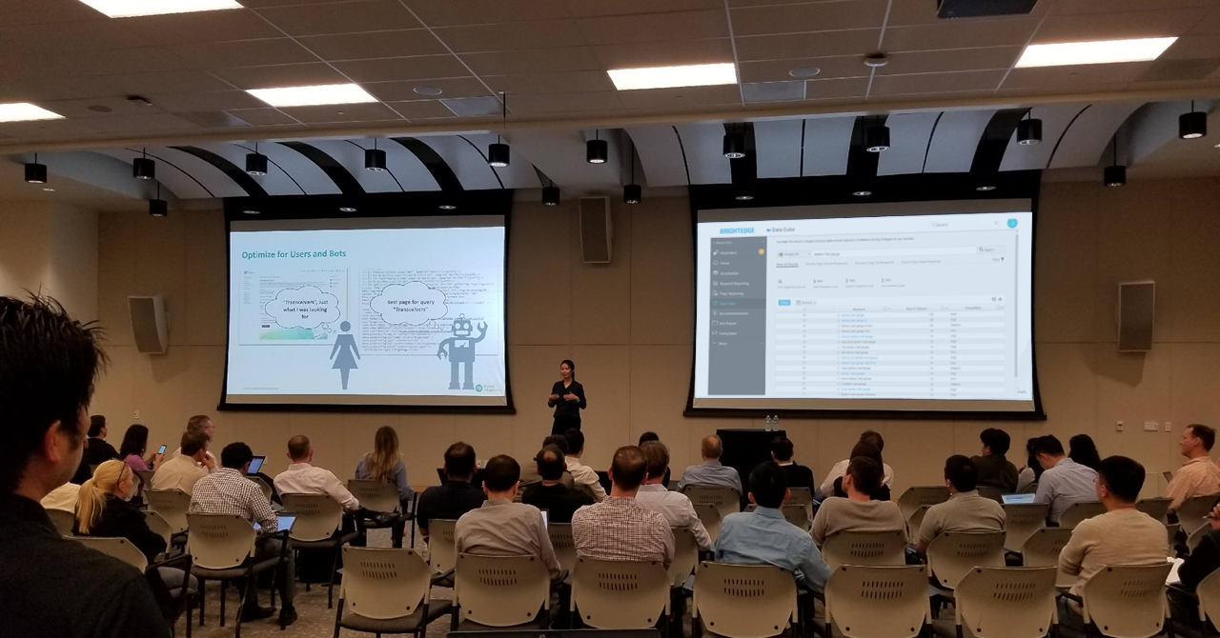


ADVOCATE – SPREAD THE WORD. SHARE THE SUCCESS
Build advocacy momentum
  Word of mouth
  Presentations
  SEO trainings and overviews
#BrightEdgeWebinars
Notes:
Now this can also involve elements of education. In fact, it should. But with this effort, we want to have a selling cap on. You want to sell them the value of SEO and talk about their bottom line. Show them how SEO practices will help move the needle. Show them also how they can contribute. Our business units do not have direct access to our CSM, so its definitely a bit of a further removed action on their part. So lucky enough, one of the business units we worked with were so pleased with the results of our SEO efforts, that the VP presented during a company wide meeting about SEO and how it has helped him. I rode this wave of momentum by working with his team to put together the presentation you see pictured, where executives and business units attended to learn more about SEO, which they just heard about around a month before in the company wide meeting. My BU partner joined me on stage as well and he was really able to speak their language and take them through the process his department went through. By even having his name on the speaker list had increased the attendance for sure.
Do not remove logo or social element.
• Change title and copy points
Do not change colors or text format

Slide 11
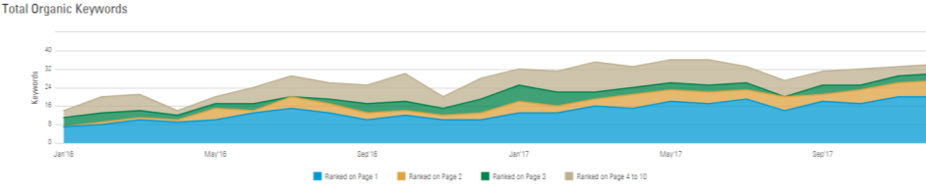
ADVOCATE - SIMPLIFY THE DATA & TIE IT TO VALUE
+76%
Organic Traffic
% growth in
Page 1 | +13 keywords
Page 2 | +7 keywords
conversions
registrations
downloads
sales
customer count
#BrightEdgeWebinars
Notes:
Simplify the data to answer more questions than you raise. Tie it to what is valued by your target audience.
This is where education on your audience comes into play. Most others are not SEO savvy, so the simpler and more relevant you can make your pitch, the more they will absorb the information. Go into it trying to answer more questions than you’re raising.
Show off everything you possibly can in terms of what’s valuable to your audience. Be it conversions, registrations, downloads, sales, customer count, make it rain and get them excited. This is where you need to do some self education on your audience and figure out what they need to see how well SEO can help deliver their needs. You may even use this as a filtering mechanism to see which groups would gain the most value from an improved search presence.

Slide 12

ADVOCATE, CONSTANTLY KEEP SEO ON EVERYONE’S MINDS
Maxim Presentation
Jeanne’s Presentation
SEO in regular meetings
Email communications, new features
Update with the CTO
- IT Evangelist
Source:
Notes:
After our BU partner put SEO on such a high pedestal, we were sure to capitalize on that and start crafting a dedicated SEO training for the company. And I’m trying to continue bringing SEO up in meetings or sending emails about new BrightEdge features. As you come across new findings or tactics, share them too. Keep that word of mouth and email marketing going.
We also have a serendipitous evangelist in the IT group. This new director joined the company and I had a one on one session on SEO. After that, he began pitching SEO in meetings. A huge power move is convincing the leaders of organizations or departments because that trickles down and then the priority is properly set. I am starting to get folks in IT involved with using content IQ
Do not remove logo, social element, or blue faded rectangle.
• Add new fact, cap and bold to highlight words
• Don’t forget to add source or speaker if needed
http://www.pngall.com/wp-content/uploads/2016/10/Calendar-Transparent.png

Slide 13





EQUIP – GIVE TOOLS FOR SELF-SERVICE, LEARNING, & SUCCESS
BrightEdge Login
Data Cube
Help Section
ContentIQ
SEO
Prep Kit
#BrightEdgeWebinars
Notes:
Catered guidance = speak directly to their workflow. As mentioned before, I was able to understand what’s involved in their day to day work and where they actually get to create things that eventually become title tags, and image descriptions. There was actually a considerable amount of different terminology that they used, so it was helpful figuring all that beforehand so I could speak as much of their language as possible and minimize low value questions.
Do not remove logo or social element.
• Change title and copy points
Do not change colors or text format

Slide 14
Bridging the SEO gaps through:
To bring value to:
Product engagement, sales
Revenue growth, brand awareness
Marketing reach, conversions
Site performance improvement
Business Units
Executives
Marketing
IT
Enabled by
Education
Optimization
Advocacy
Empowerment
#BrightEdgeWebinars
Notes:
Do not remove logo or social element.
• Do not change text
• Presentation transition to follow format
• To insert new image: left click on image, click change picture, select picture, click insert
http://www.2ndwatch.com/wp-content/uploads/2015/12/Bridge.jpg
http://belimitless.com/wp-content/uploads/2014/02/teambuilding.jpg

Slide 15
OVERVIEW
Challenge: Limited Resources & Knowledge
Tactics: Education, Optimization, Advocacy
Result: SEO progression in key groups
#BrightEdgeWebinars
Notes:
Do not remove logo or social element.
• Do not change text
• Presentation transition to follow format
• To insert new image: left click on image, click change picture, select picture, click insert
Image 1: https://overblown.co.uk/why-do-like-multitasking/
Image 2: Brightedge deck
Image 3: https://johndrury.biz/what-is-your-criteria-for-success/ https://johndrury.biz/wp-content/uploads/2016/02/Success-1080x675.jpg

Slide 16
RESULTS FROM OUR EFFORTS:
MORE ATTENTION, MORE INTENTION
Business Unit X
Healthy SEO Competition
+48%
Executive-mandated SEO goals
Weekly 3 hour analytic meetings
Organic Traffic
+18%
Faster IT response time
SEO focused job roles
Customer Count
+40%
Revenue
#BrightEdgeWebinars
Notes:
By bringing more attention to SEO and the value it gives us, we’ve seen more intention behind SEO-oriented actions.
Do not remove logo or social element.
• To change graphs, click on existing chart, go to chart design, click edit data in excel, edit excel document and hit save
• Update percentage numbers
Do not change colors or text format
Nothing quite like some healthy competition. But you know, they compete, but they’re a team. They educate each other. This helped leverage something that was initially a disadvantage: we have several different groups of product owners focused on their own goals. I mean the CEO even commended this business unit for their efforts.

Slide 17
KEY TAKEAWAYS
Start small, educating from the inside out
Identify and work with your key internal partners
Optimize, tailor, and sell
Continue refreshing the SEO conversation
#BrightEdgeWebinars
Notes:
Do not remove logo, social element or image.
• Change title, do not change text format
• Add key takeaways
• Try to keep to 4 main points
Do not change colors or text format

Slide 18
Q & A
#BrightEdgeWebinars
Notes:
What dashboards and reporting did you find most valuable to use to disseminate SEO value?
Can you give an example of an optimization project you worked on early with one of the BUs? What strategy and results?
Can you go into more detail on how you identified the first BU leader to partner with? How would others replicate this?
How do you structure your one on one conversations with executives? Do you walk them through first party case studies? Or SEO 101?

Slide 19
THANK YOU!
Jeanne.Quach@maximintegrated.com
#BrightEdgeWebinars

