Slide 1


Intro to SEO
The 22 Most Basic
Questions & Answers

Slide 2

What Is SEO?
The discipline of making your content more visible at Google.

Slide 3
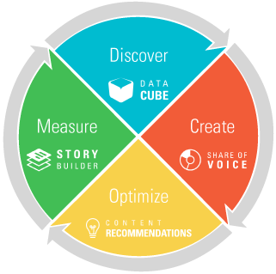
How do you do SEO? DCOM methodology
DCOM for SEO
Put the DCOM in your dotcom
Notes:
When I train new BrightEdge employees in onboarding, I like to use this simple, small data, framework.
That’s what BrightEdge calls winning the moments that matter.

Slide 4
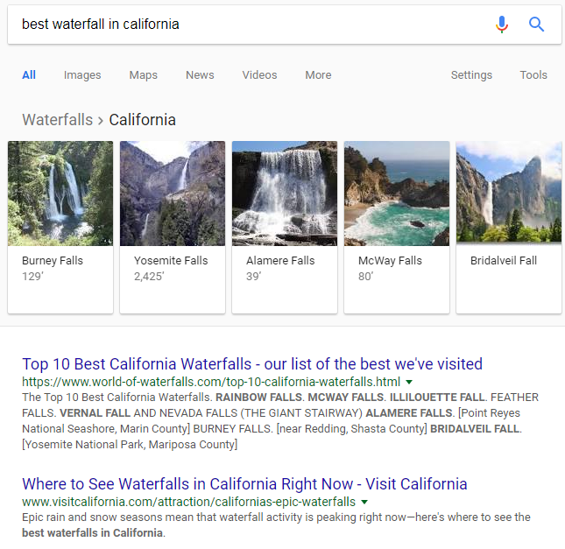
What are SERPs and rankings?
SERPs are search engine results pages.
Rankings are the position content sits in on the SERPs.
Better ranked content gets about twice as many clicks for each position up.

Slide 5
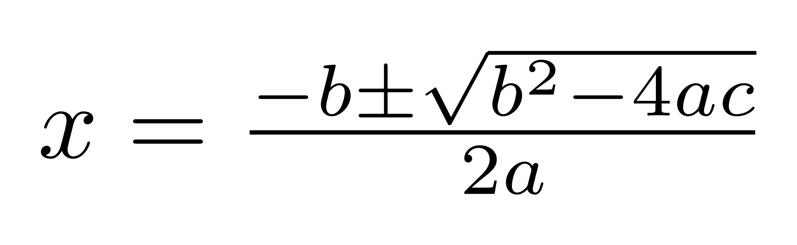
What is an algorithm?
A formula that decides the ranking order of search results.

Slide 6
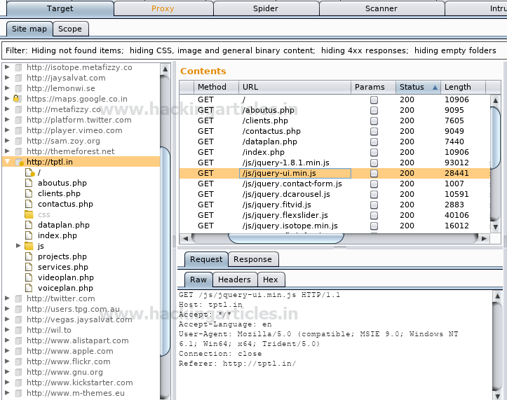
What is a crawler or search bot?
It is code that visits sites and collects the text and image information for its index.

Slide 7
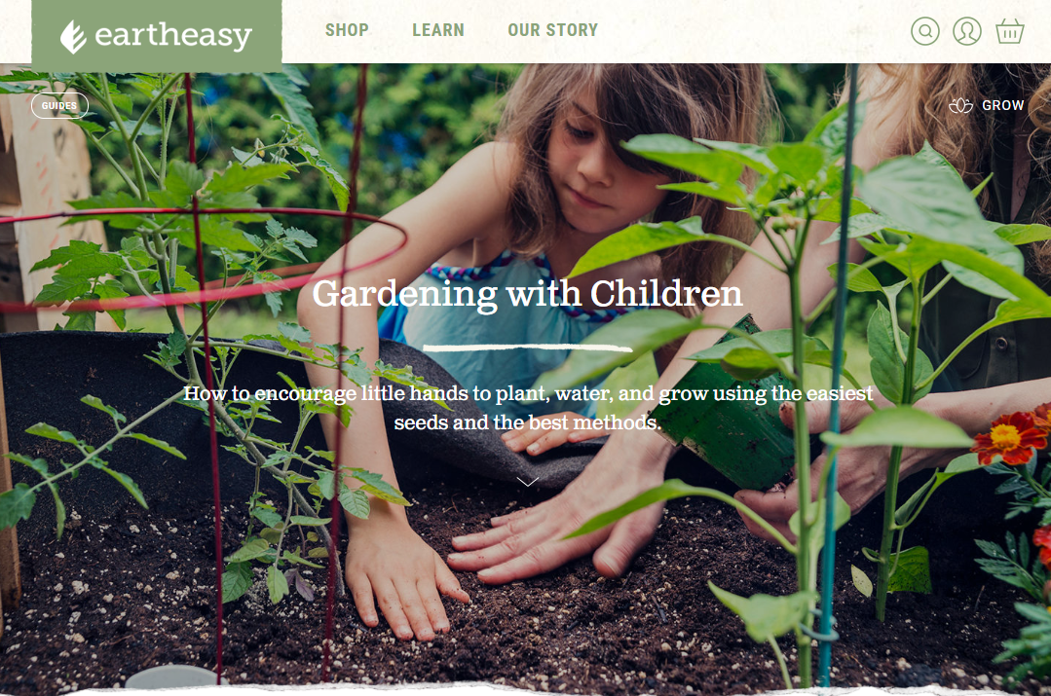
How big should my site be for SEO?
Small sites should expand to 500 pages and then 1000 and then 2000.

Slide 8
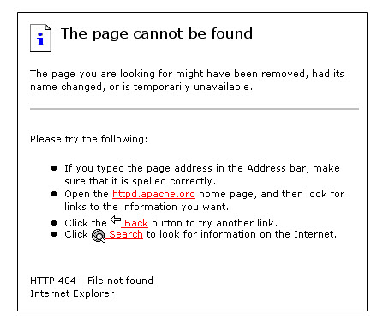
What are site errors? How bad are they for SEO?
Broken links and images, slow or never-loading pages; very, very bad.

Slide 9
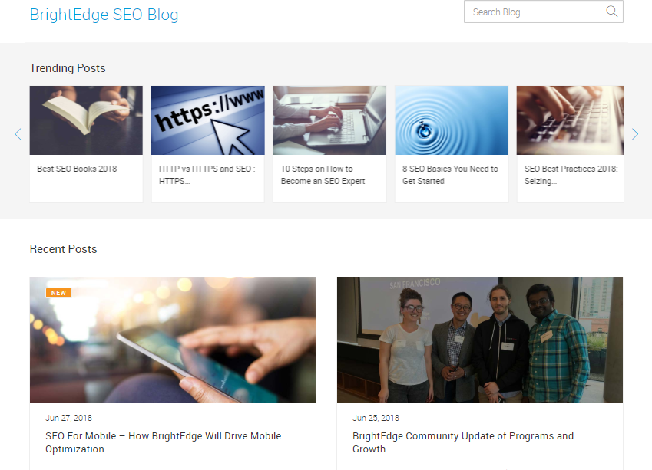
Should I have a blog? How often should I publish?
Yes.
You should publish at least twice a week.

Slide 10
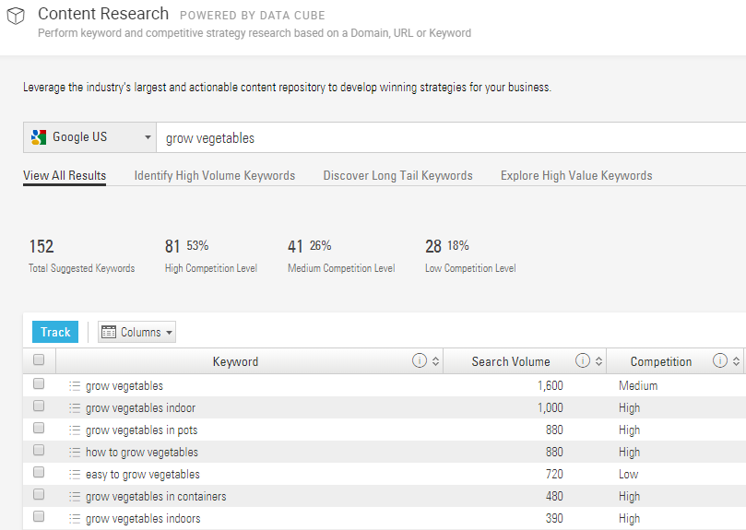
Where do I start?
Discover valuable keywords you have content for or could make content for.
Use BrightEdge Data Cube
Talk to employees
Interview customers
Look at competitor sites
Search on Google

Slide 11
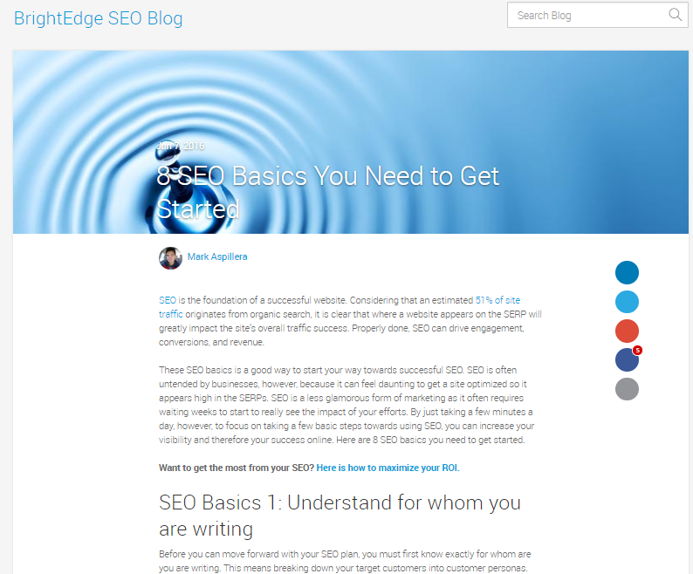
How much do I write?
More quality text is usually more authoritative. Try to make blog posts on major target keywords over 2000 words.

Slide 12
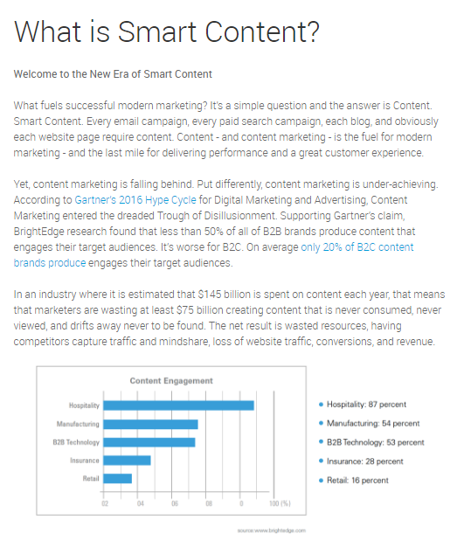
Do headlines matter?
Yes, put the keyword in the headline and the subheadline.

Slide 13
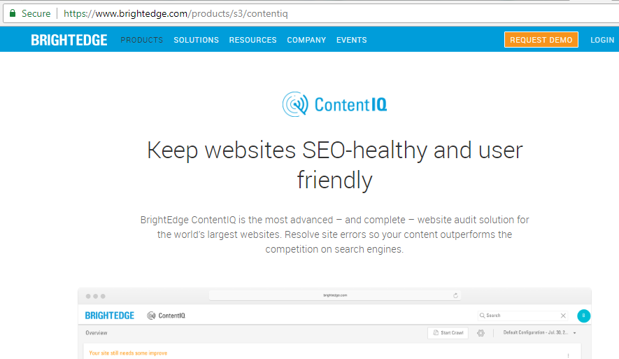
Do URLs matter?
Yes, they matter in the sense that they indicate the logic of the site. Keep them organized and short and avoid excess tracking appendations.

Slide 14
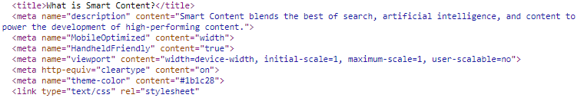
What is meta data?
These are markup tags that you put in your source code mostly for the search engines.
The <Title> tag should contain the target keyword and avoid filler words.
The <meta name=“description”> tag will often show up in the SERPs and should have a concise explanation and a call to action, a little bit of marketing polish.
The <meta name=“keywords”> tag is not used in the US, but is still used outside US.
OG tags are open graph tags that are used for social posting.

Slide 15
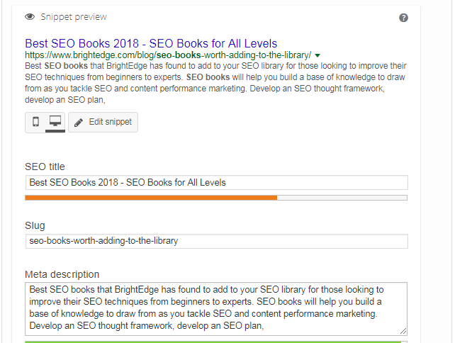
How do I edit metadata?
You need access to your company’s CMS or content management system, examples include WordPress, Drupal, and others.
Most CMSes create markup code from the normal visual editor interface.

Slide 16
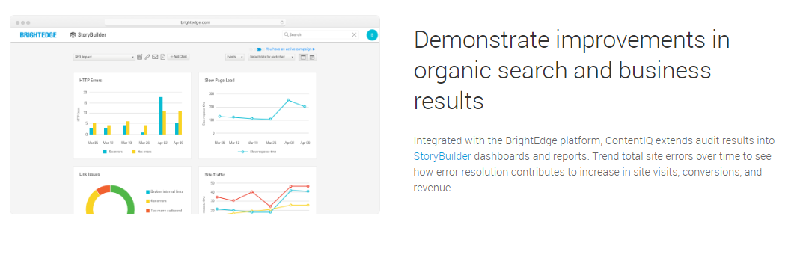
How do I use images?
Include them on every page.
Thin the images to less than 60k file size each.
Put the keywords in the filename, e.g. snowtires.jpg.
Add alt-text using the keywords on each image.

Slide 17
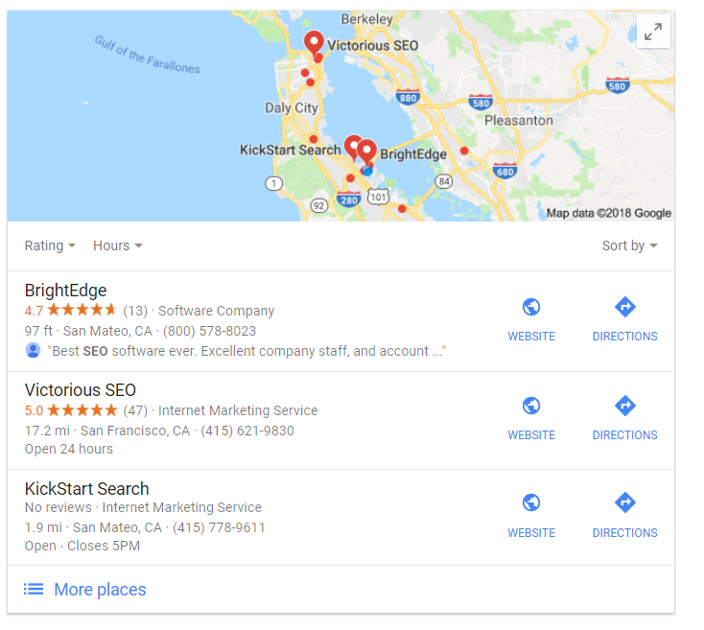
How do I do local SEO?
Make sure the NAP, name, address, and phone, is correct and consistent in every instance on your site and on social sites.
Make separate pages for each location.
Add local placename-rich content.
Add local images.
Secure local reviews.

Slide 18
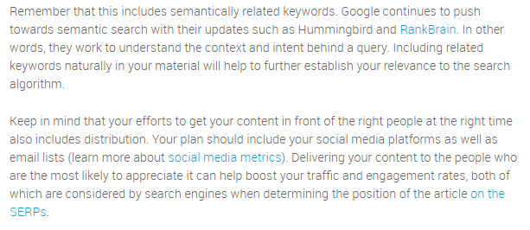
Do internal links matter?
Yes, they do.
Link to and from each page you publish.
Use anchor text (the blue hyperlinked text) topically aligned to the destination page.

Slide 19
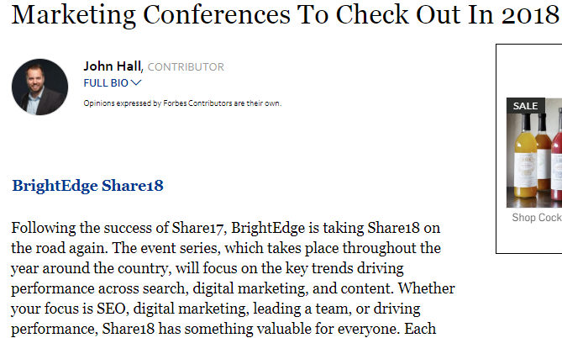
How do I get external links?
Publish great original content.
Promote it in social and email.
People will link to it.
Ask people you know to link to it.

Slide 20

What are content clusters?
Multiple pages addressing a related topic: caring for pets, traveling by backpack, whitewater rafting.
Multiple pages build breadth, depth, and authority.

Slide 21

Do I know enough to start?
Yes, start writing, optimizing, and publishing.
Results will follow.

