Slide 1

A BrightEdge webinar featuring:
Authorship to Authority
Organizing Your Expert Person Data To Drive Rank and Results
Erik Newton Jeff Selig
VP of Growth and Head of SEO VP Earned Media and Analytics

Slide 2
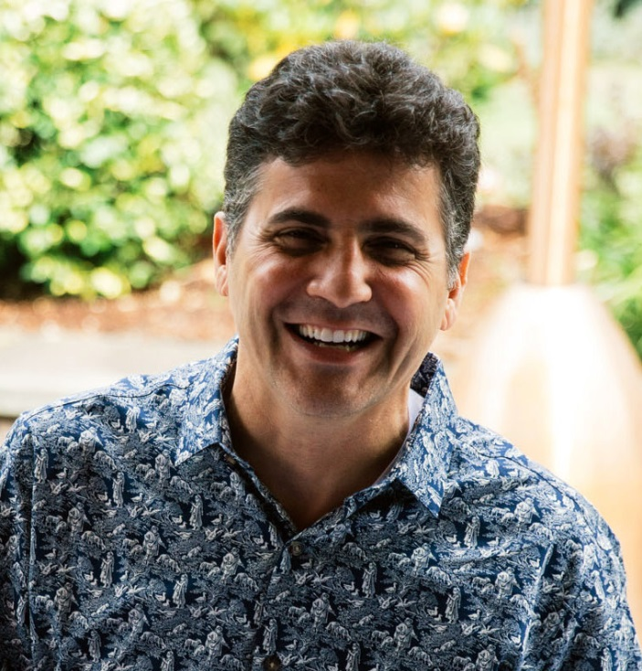
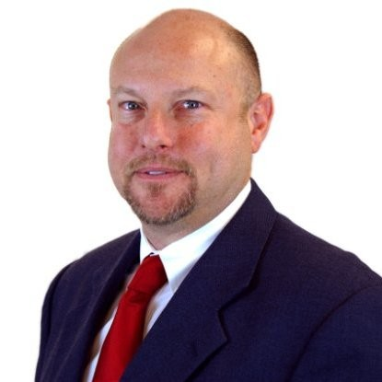


Your Speakers
Erik Newton
Jeff Selig

Slide 3
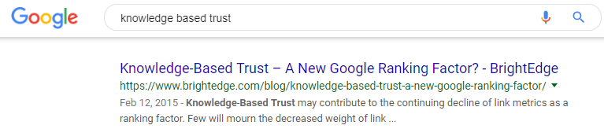
Context for Authority
Google guidance:
Quality
Relevance
Authority
Veracity

Slide 4
What We Will Cover Today
Attendees will learn how to:
  strengthen your business presence
  create content that builds trust w your customers
  activate your subject matter experts (SMEs)
  unify your press releases and site content with authority
  increase your SERP visibility
  apply SEO best practices to your content
  build your authority within your target audience

Slide 5
What Defines Success
better findability and SERP dominance
    “brand” factor (trust)
    authority rank
  better “clickability”
deeper engagement
ROI
links will grow organically with content placement

Slide 6
Who, What, Why, Where, & When
who you ask is
as important as what you ask

Slide 7

content builds trust in every stage of the customer life cycle

Slide 8
Build Expertise, Authority, and Trust
Google Quality Rater Guidelines
“4.3 A high Level of Expertise/Authoritativeness/Trustworthiness (E-A-T)
high quality pages and websites need enough expertise to be authoritative and trustworthy on their topic Keep in mind that there are “expert” websites of all types, even gossip websites, fashion websites, humor websites, forum and Q&A pages, etc. In fact, some types of information are found almost exclusively on forums and discussions, where community of experts can provide valuable perspectives on specific topics ”
rating website, content, and author
https://static googleusercontent com/media/guidelines raterhub com/en//searchqualityevaluatorguidelines pdf

Slide 9

trust = authority

Slide 10
authority is
known credible topic expert

Slide 11
Page Quality Rating
Purpose of the page
Main Content Quality and Amount:
Website and Author Information: information about who is responsible for the MC: Find information about the website as well as the creator of the MC
Website and Author Reputation: reputation about who is responsible for the MC: Links to help with reputation research will be provided
https://static googleusercontent com/media/guidelines raterhub com/en//searchqualityevaluatorguidelines pdf

Slide 12

known credible topic expert

Slide 13
Digital Footprint
area of expertise?
  vertical focus
  consistent presence
what signals are in place?
  links from high value sites
  citations / co-citations
  associations / affiliations
  social mentions / positive sentiment

Slide 14
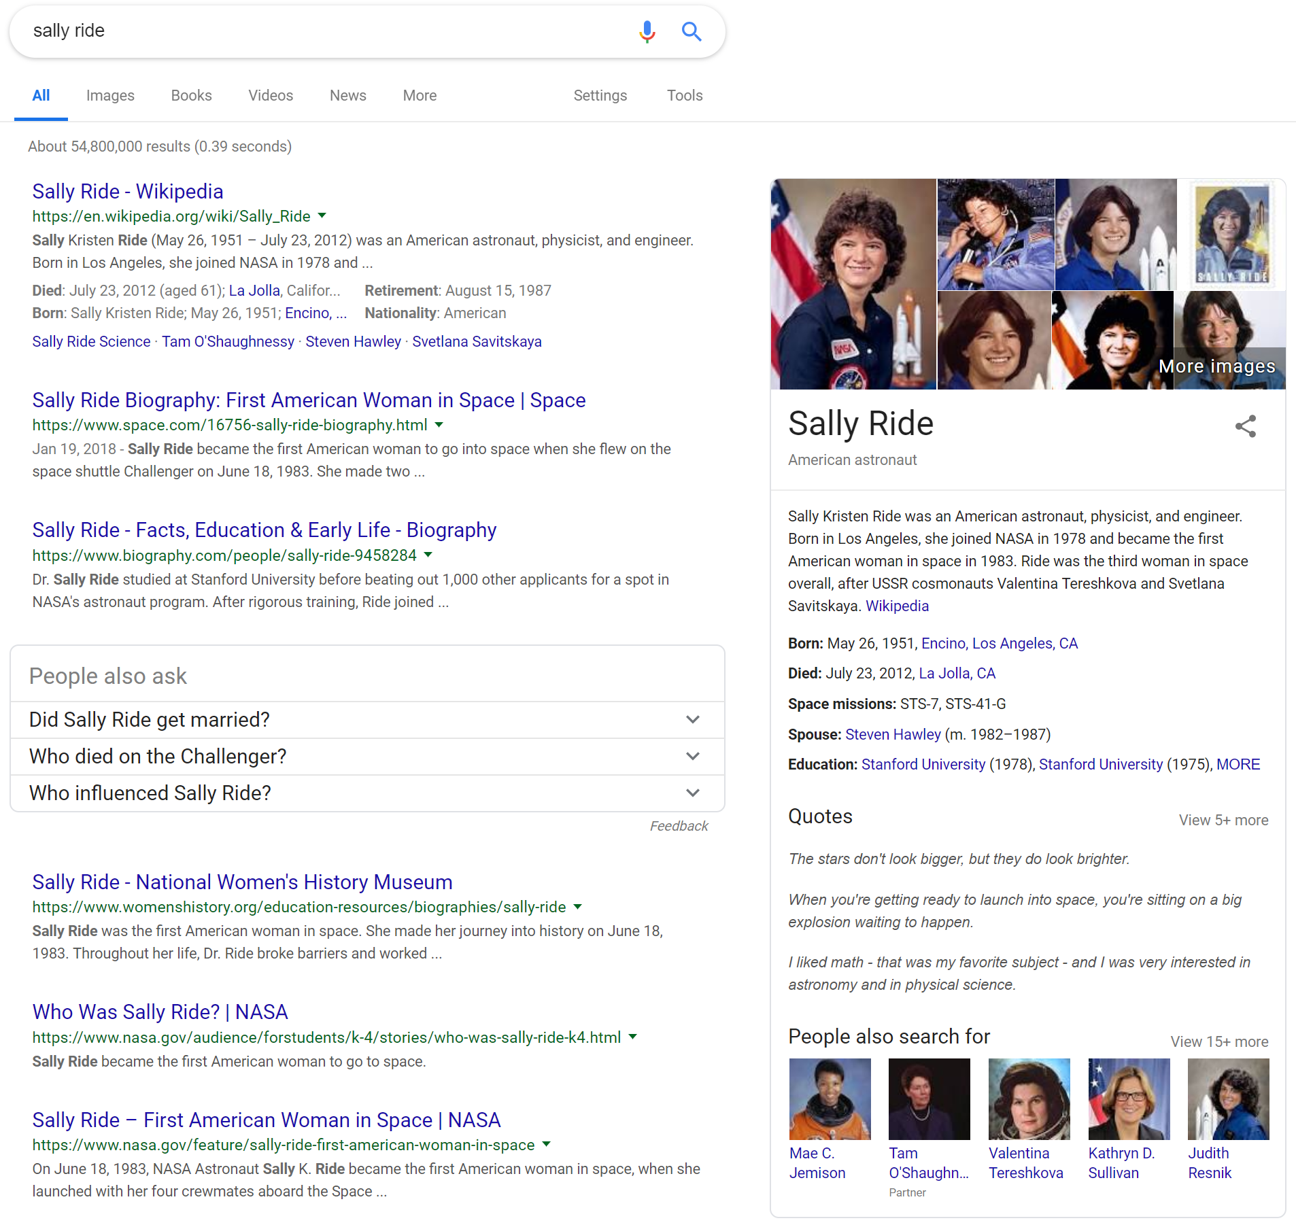
Known Credible Topic Expert
Biography at NASA
Appearances on C-SPAN
Sally Ride on IMDb
Works by or about Sally Ride in libraries (WorldCat catalog)
"Sally Ride collected news and commentary". The New York Times.
Marc J. Daniluke (July 23, 2012). "Sally Kristen Ride". Find a Grave.
Sally Ride Science Festivals
Sally Ride Girls Science Camps
Sally Ride Science company website
Benson, Robert Alan (March 19, 2006). "Ride urges emphasis on math, science studies". Q&A.
Williamson, Marcus (July 25, 2012). "Sally Ride: The first American woman in space". Obituary.
Notes:
The planetarium IS Neal

Slide 15
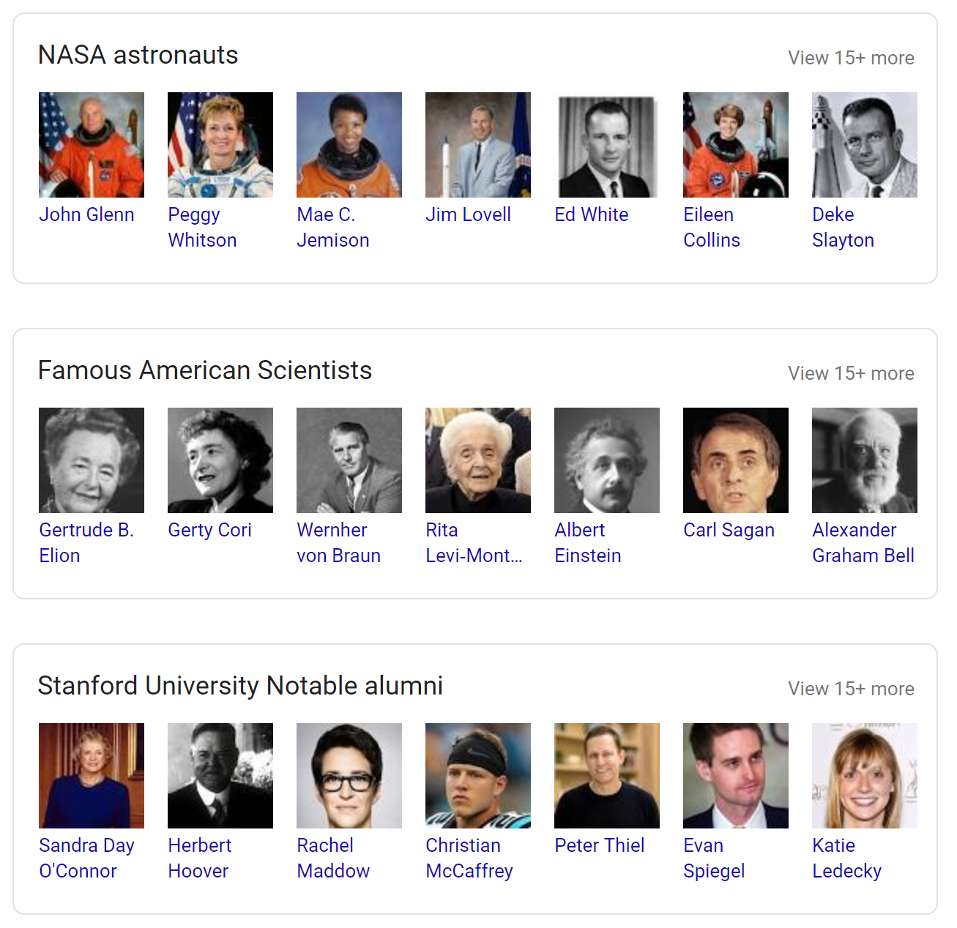
Entity
connecting;
known entities
to known identities
Identities
Entity
Identities
Entity
Identities

Slide 16

Activating Your SMEs

Slide 17

What Are Their Street Creds?
academic credentials
awards
nominations
honors
recognitions
patents
citations

Slide 18

identities and their content

Slide 19
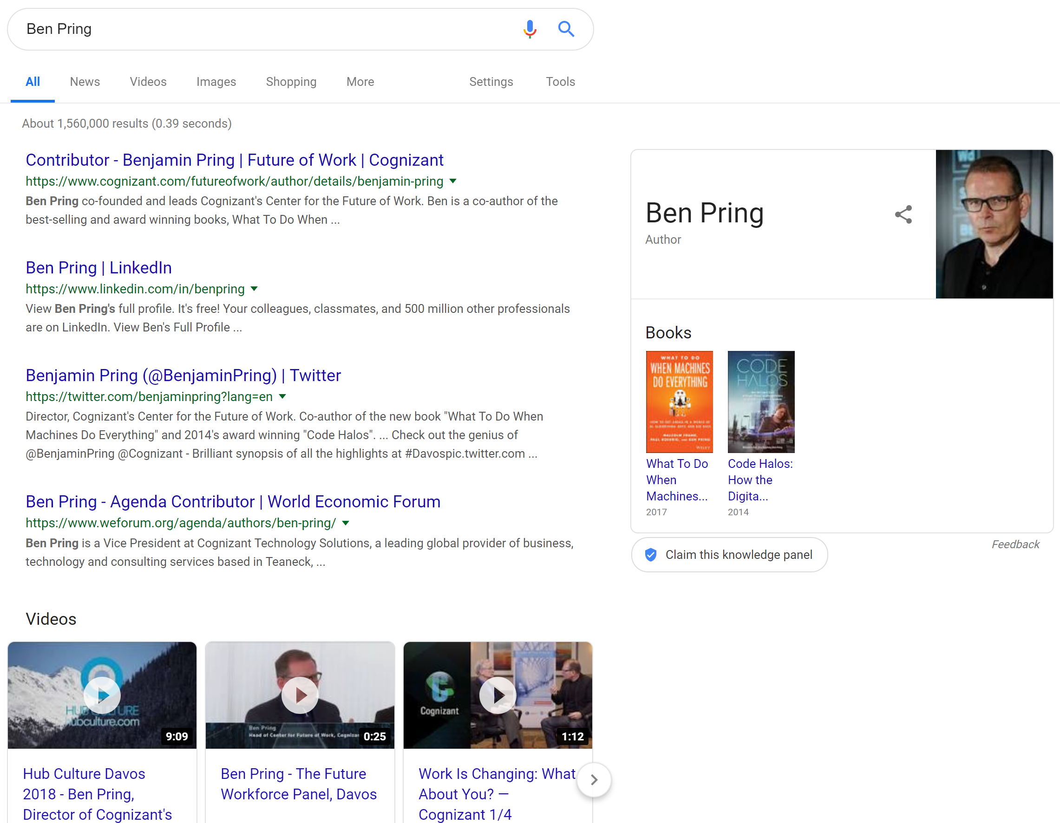
Social: Case Study
Cognizant's Ben Pring: Author of "What To Do When Machines Do Everything: How to Get Ahead in a World of AI, Algorithms, Bots, and Big Data"
Cognizant built off the momentum of Ben Pring's expertise by creating a pillar theme of their business around his subject with their think tank "Center for Future of Work.”
hashtag for this theme/campaign is #FutureofWork

Slide 20
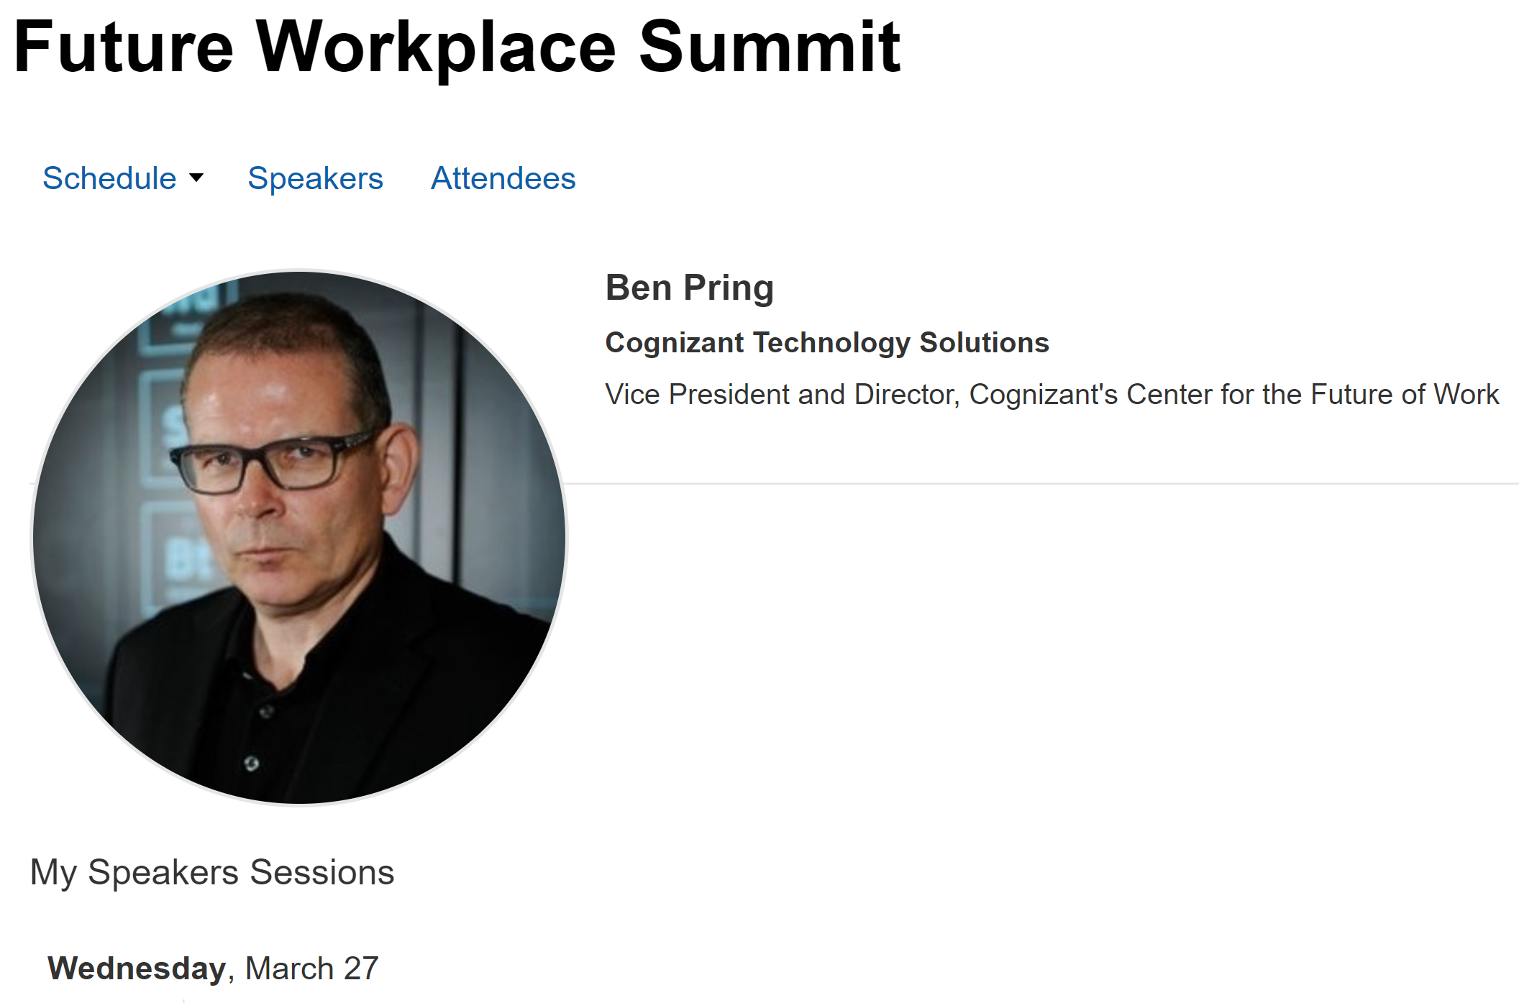
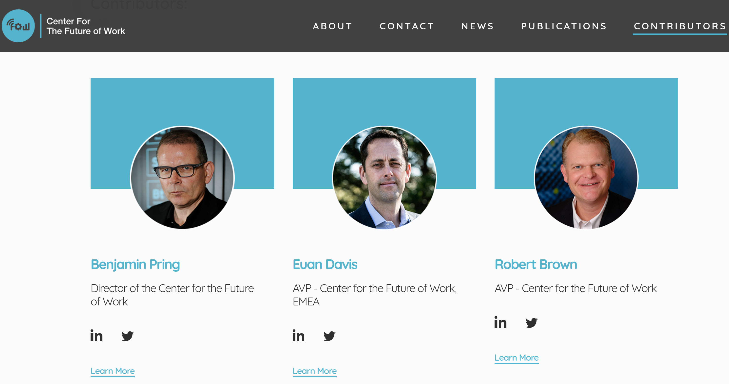
Social: Case Study
they promote his book and speaking events through social, tying posts both back to the pillar theme of automation and artificial intelligence helping create jobs, and Ben's expertise in this arena
the Future of Work blog, built around his subject matter expertise, has been expanded out to include lesser known experts, who then write summaries or larger content pieces with similar names and themes to Ben's book

Slide 21
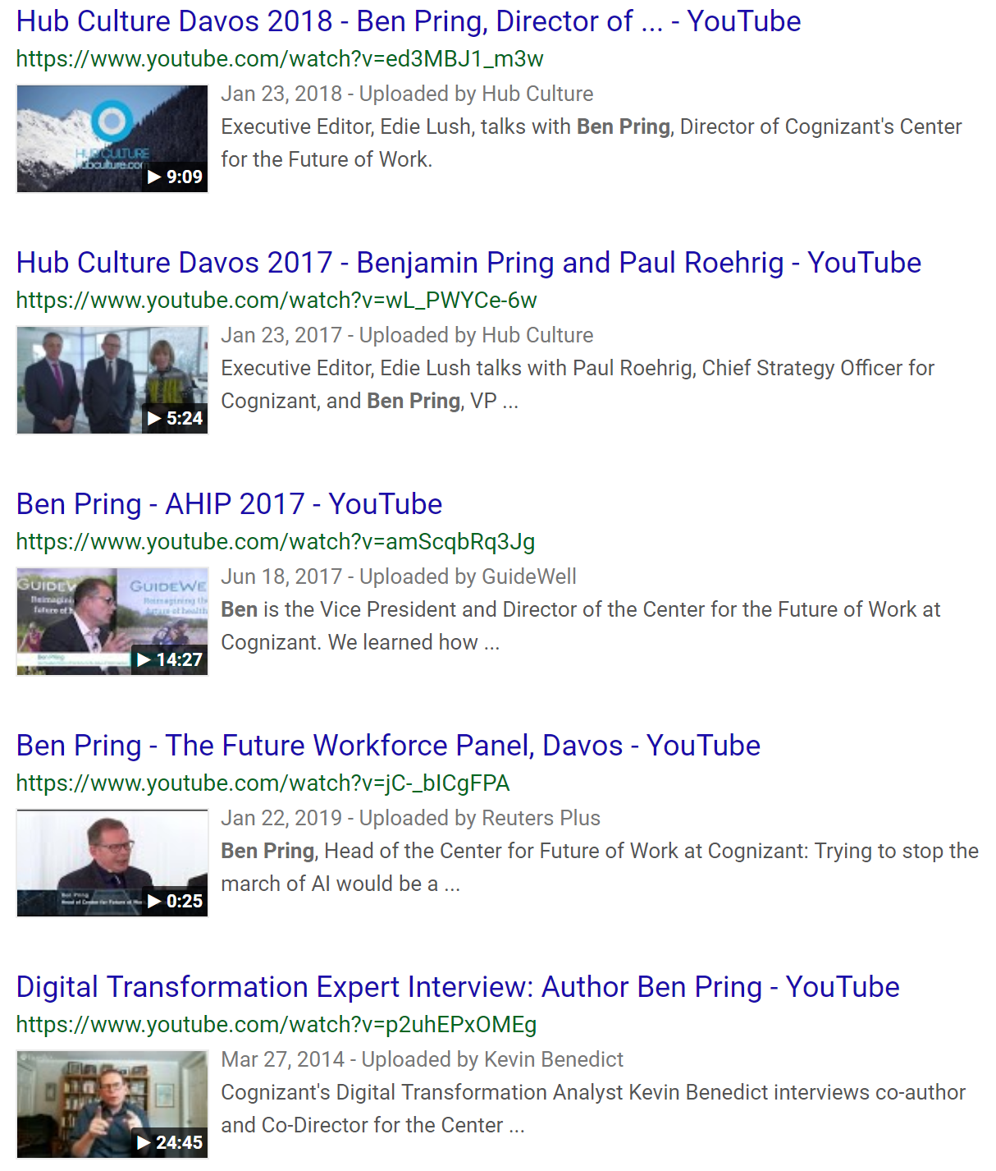
Social: Case Study
Cognizant created YouTube playlists where they interview additional experts about how they automation and AI will help the human workforce. Ben Pring is the hierarchy over all of these content pieces. Cognizant ties these videos back to his book/leadership through naming conventions and website links
in social, when a content piece features Ben or his book, it's explicitly called out. When posts, videos, and content pieces are not created by Ben, they are tied back to the #FutureofWork tag - thus sealing the association to their resident expert

Slide 22

How To Think About
Content Development

Slide 23
make questions central to your content strategy

Slide 24

Aligning Your SME Stars Program

Slide 25
Next Steps: SME Activation
SME identification, education, and onboarding
build SME dossiers including:
  academic credentials
  awards
  nominations
  honors
  recognitions
  patents
  citations
build out bio and author pages
  utilize json-ld schema for Person https://schema.org/Person

Slide 26
Next Steps – Where To Use SMEs:
  Text Boxes
  Staff Quotes
  Press Release
  Social Posts
  Community/Forum Sections of your site and others
  Videos
  Images

Slide 27

Thank You
Any Questions?
Jeff Selig
VP Earned Media and Analytics
Direct 617-254-5000 x 1101
jselig@OverdriveInteractive com
Download the deck ovrdrv.com/sme

