Slide 1
Leveraging video to help support your SEO strategies
Have you included video in your SEO strategy? If you haven’t you are leaving something out.

Slide 2


What you will learn today...
Why you should consider using video?
Video 101: Planning Out Your Video
Tools to Optimize Your Video and Increase Performance
Q&A

Slide 3

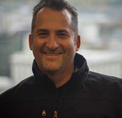
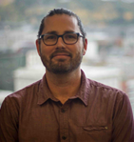


Your hosts for today’s webinar...
Tanu Javeri SEO Manager
Kevin Beares Consultant
Ben Brockhaus Sr. SEO Analyst

Slide 4




Why you should consider using video?
80%
According to Google 80% of online searches are followed by a video search.
SERP are changing with video carousel being a big part of the result.
Businesses that include video in their strategy can increase their chances of turning up on the first page of Google SERPs by a factor of 53.
75%
Video traffic is also expected to boom in the coming months, with video traffic predicted to account for 75% of all mobile traffic by 2020.

Slide 5

Why should I optimize my videos?
1B
On an average day, people around the world watch one billion hours of video on YouTube
70%
of videos are recommended by Google’s algorithm
Neal Mohan, Reported by CNET

Slide 6

Recommended process to consider...
RESEARCH
OPTIMIZE
ANALYZE
What keywords?
What content?
Which pages?
YouTube or Domain?
Embedded or Pop-up?
Video title?
Link building?
Time of video? (2-4 min)
Content around video?
Video schema?
Video transcript?
Visual ranking?
Page rank impact?
Number of play / engagement?
Which types of videos?

Slide 7

What video content should you consider?
What stage of the user journey is being targeted?
Video tends to work better in early learn pages, understanding solution or product features. But the video does not work on the conversion pages such as trial forms.
What is the user intend/need you are trying to address.
Define your goals you want to achieve from this video marketing.
Are you looking to drive conversions or spread brand awareness?
Put some thought into whether the video is informative and engaging
is it relevant to the page that it is displayed in.
What video content should you consider?

Slide 8
4 Video Test for SEO improvement
Test 1
Does if having a video content on the page made any significant changes?
Identified a page that ranked on page 4 of the SERP’s in spite of being well optimized.
Placed a video content relevant to the textual content to the page.
Result:
Increased rankings and visibility in universal search. The Page started to rank on page 1 and the video thumbnail in the SERPs displayed the desired video and linked back to the page.
Test 2
Understand the impact of method of delivery
Measured user engagement and organic performance when the videos contents are displayed/delivered on the page via different formats.
A link that would take user to YouTube,
A pop-up
An embedded file that actually plays the video on the page itself.
Result:
Embedded video saw user engagement increased, which decreased bounce rate and improved page ranking.
Test 3
Category of video content
Tested assorted video content on the same page.
Result:
Whenever the content of the video addressed a user need and was relevant to the page textual content the page rankings improved.
Test 4
YouTube videos or domain hosted videos
There is no universal truth. Google does displays both YouTube and domain hosted videos in the thumbnails on the SERPs.
Different sites will see different results.
Result:
When the video was already present in YouTube and then embedded on the page, the URL improved in rankings.

Slide 9
Optimizing for YouTube
A recommended approach to videos on YouTube

Slide 10
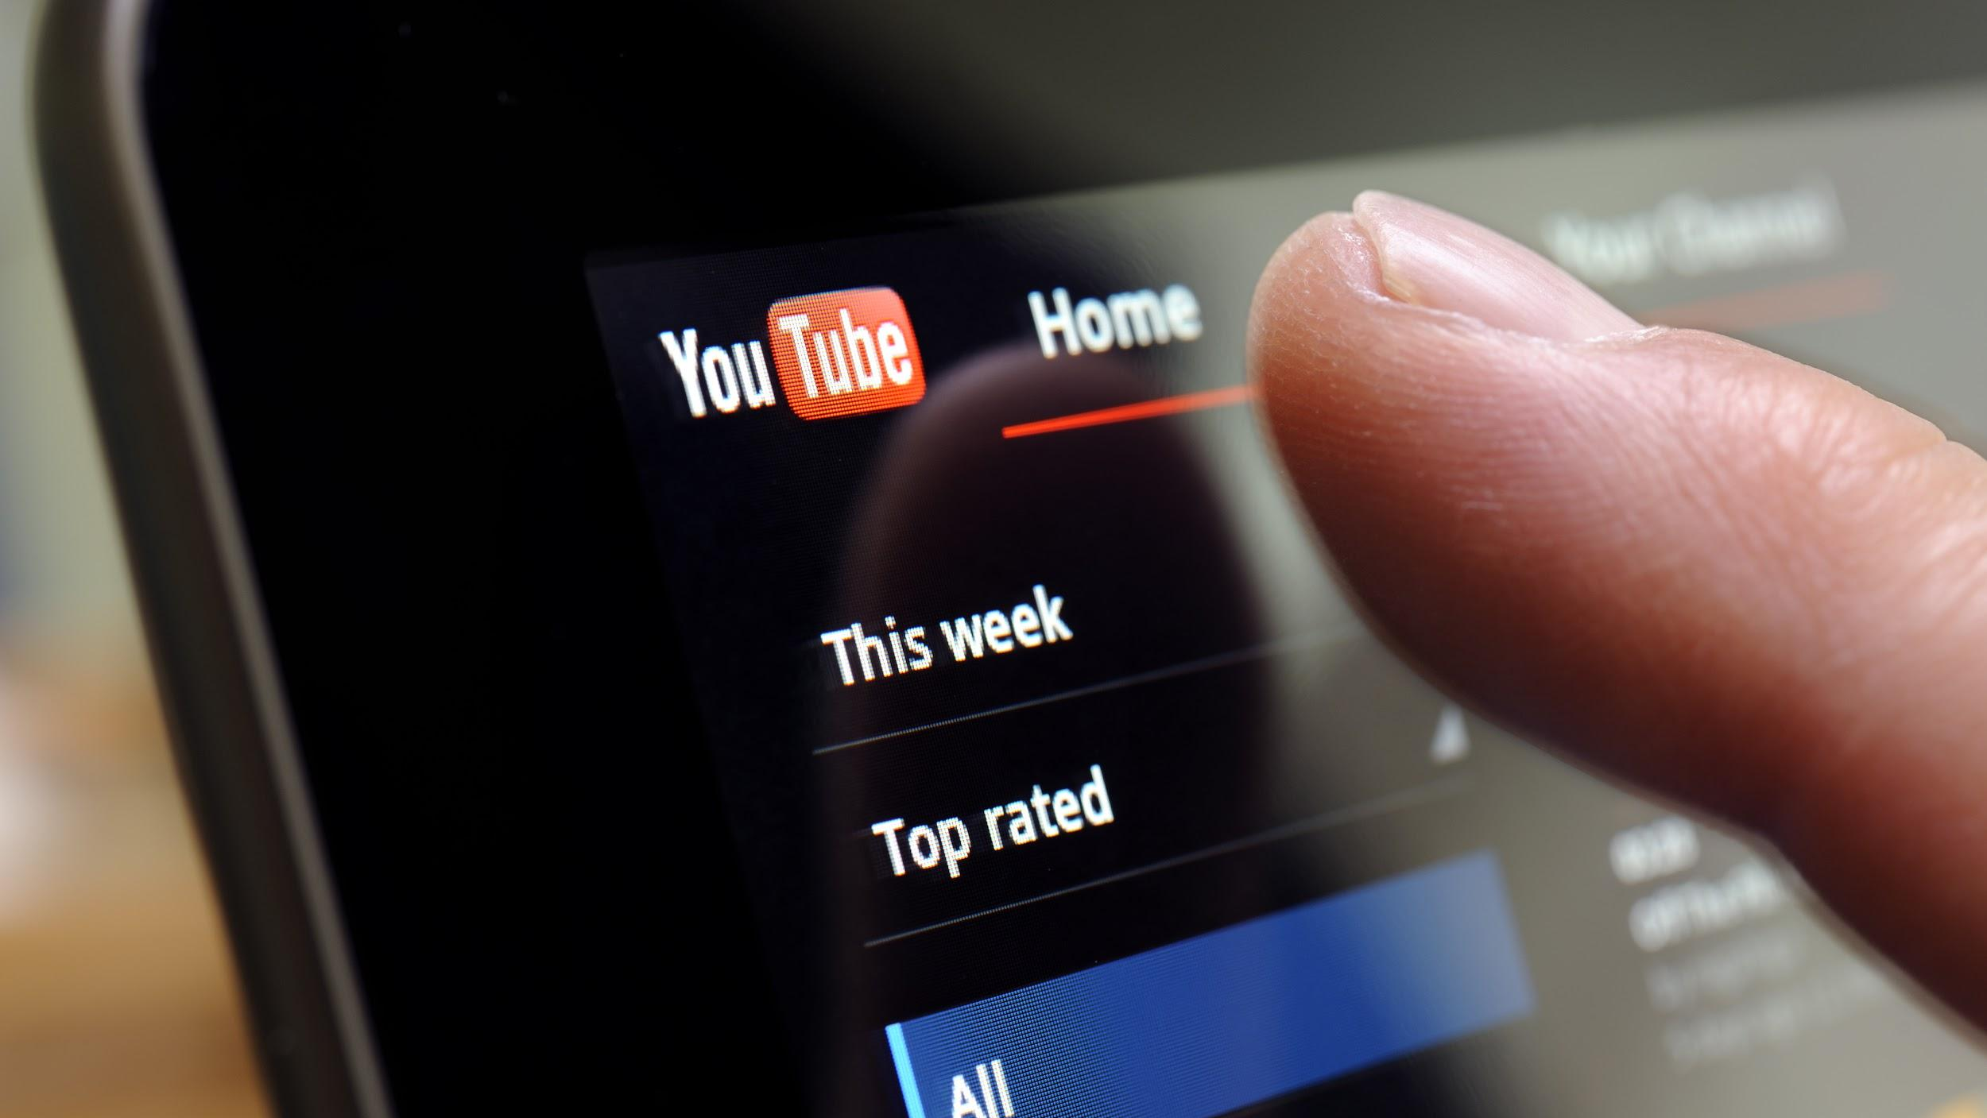
Why you may want to consider YouTube?
2nd
1.9B
1B
Second most popular site in the world
100%
Over 1.9 billion users worldwide
Users view more than 1 billion hours of video each day on YouTube.
Mobile video consumption rises by 100% every year
Source: https://biteable.com/blog/tips/video-marketing-statistics/
Notes:
Source:

Slide 11

Getting your video to show up on YouTube...
Channel presence Research industry keywords to optimize for a strong channel. The more subscribers, the better!
Encourage people to subscribe
Create playlists
Publish regularly
Keyword Rich Video Titles, Tags & Description – Use highly searched topics (also a great place to include a video transcript)
Be smart with your Thumbnails They have a big impact on CTR!
Clear, engaging, interesting
1280x780 resolution, 16:9 aspect ratio
CTR impacts ranking!
DID YOU KNOW?
YouTube has dIfferent ranking factors than Google
How do you get your videos to show up on YouTube?

Slide 12
Getting your video to show up on YouTube...
DID YOU KNOW?
People interacting with your video matters!
Comments, Likes, Views, Time Watched,
% of Video Watched (video retention)
Subscriptions Driven
Shares on Twitter, Facebook, LinkedIn, etc.
YouTube has dIfferent ranking factors than Google

Slide 13
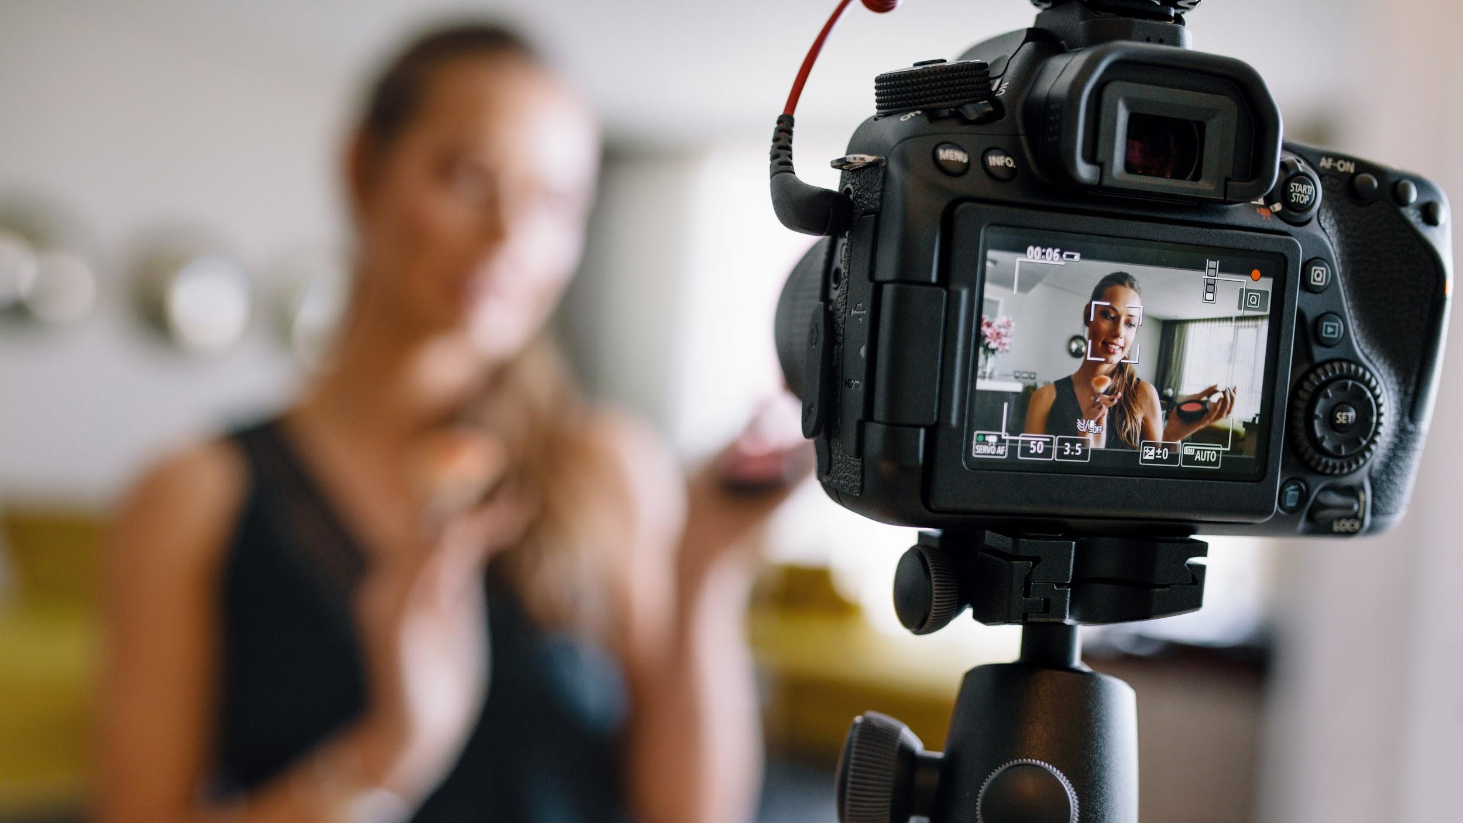

Video quality matters!
Putting time and effort into creating quality videos pays off...
HD
3min+
HD Videos are more likely to rank on YouTube page 1
High production videos tend to perform better, generate more user interaction
(Backdrop, mic, lights, etc.)
Longer videos perform better, nobody wants to watch a 30-sec video

Slide 14


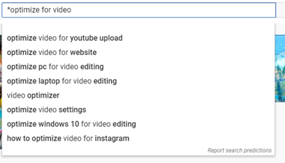
How do I pick YouTube video topics?
Keyword research for videos is key!
Definitely leverage the BrightEdge platform
YouTube suggest, including * wild card searches
Manual searches - site:youtube.com inurl:watch title:topic

Slide 15
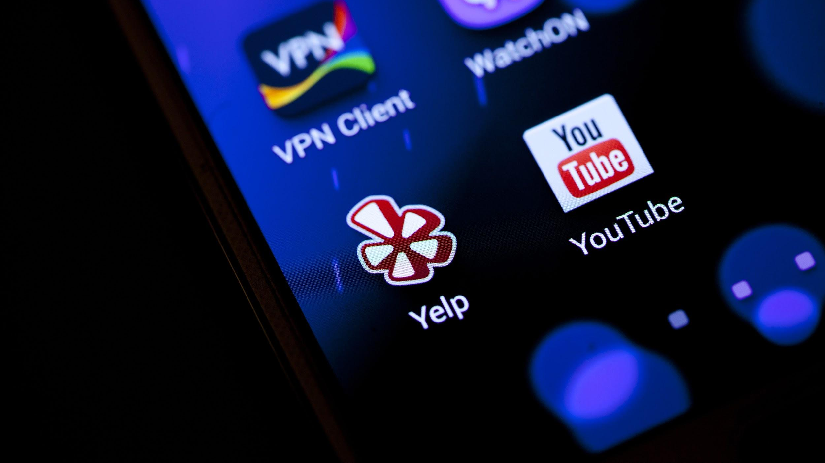

More best practices...
Ensure that your video is planned out and optimized upon release
Once YouTube algorithm decides your video isn’t optimized, it is difficult to recover
Socialize video immediately
Add Close Captioning
Mute your video on page load
Provide the transcripts for your users (ideally with the video)

Slide 16







How to socialize/amplify your video...
Add Social Share buttons on the Video URL to make it easily shareable. More Social Signals = Better SEO
Work with Social Team to share quality, important videos across social media platforms
Add video to multiple platforms such as Vimeo, YouTube, etc.
Ensure video URLs have optimized Twitter card and Open Graph meta tags to optimize how video is shared on social media
Consider working with partners to further promote video, build backlinks
Link to new video URLs from internal sources when possible (homepage, blog, etc.)

Slide 17
A Short Demo
A quick demo on how the BrightEdge Platform can help you!

Slide 18
Time for questions! Ask away...
Tanu Javeri SEO Manager
Kevin Beares Consultant
Ben Brockhaus Sr. SEO Analyst

